Slide 1
Technical Advisory Committee
San Benito County Water District
Groundwater Sustainability Agency
January 14, 2019

Slide 2
Overview of Agenda
Follow-up on last meeting
Selection of TAC Chair and Vice-Chair
Subsequent accomplishments
Data Memo highlights
What is sustainability?
Update on outreach
TAC next steps

Slide 3
GSP Accomplishments
Held November 14, 2018 Workshop No. 1
Responses to Comments on draft GSP Introduction and Plan Area
Revised draft Introduction and Plan Area
Developed draft TM on data and distributed for TAC information
DWR contract
Basin consolidation approval coming from DWR

Slide 4
Data Memo
Purpose
  summarize data currently available
  identify data gaps and uncertainty
Study periods
  Historical – 1975-2014 numerical model study period, to be extended
  Current – 2014-2017
  Future projected hydrological conditions – SGMA requires 50 years
Geographic area to provide basin-wide coverage

Slide 5
Data Gaps
Groundwater Monitoring Wells
Hydrogeologic Data
  Well locations, construction
  Geology
  Pumping Tests
  elogs
Groundwater Pumping and Use
Climate
Streamflow Data
District is identifying new wells in high priority areas
Scan and enter data on 1000s of logs
Examine new methods: meters, METRIC, self reporting
Identify new stations
Evaluate priorities (locations, timing)

Slide 6
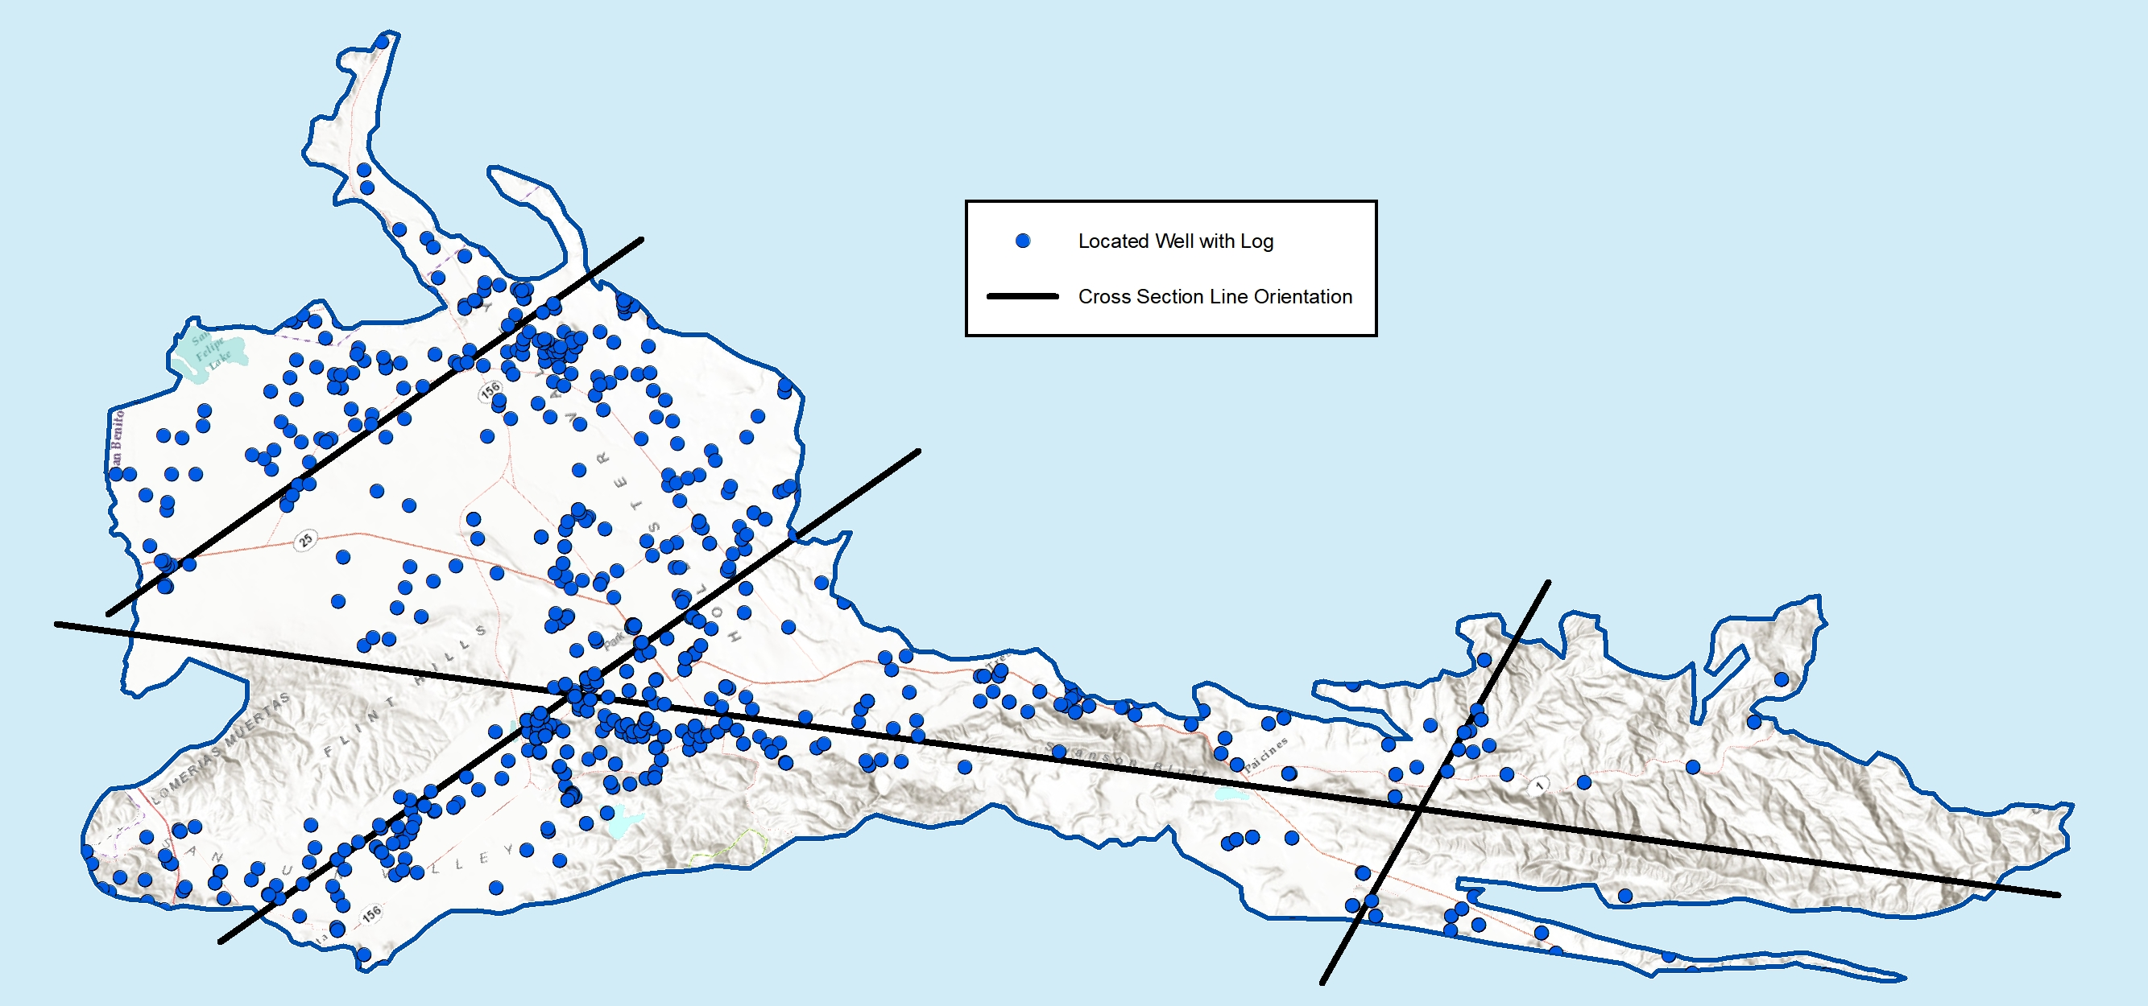
Building a well inventory
The well inventory supports the Hydrogeologic Conceptual Model (HCM), evaluation of Groundwater Conditions, and other GSP sections
Put in the map with the wells and planned cross sections

Slide 7
What is the Sustainability Goal?
  GSP description will include
    Statement
    Information on basin setting used to establish goal
    Discussion of measures to ensure sustainable yield
    Explanation of how to achieve goal within 20 years
    Explanation of how to maintain through the planning horizon

Slide 8
Sustainability Goal statement for discussion:
To maintain North San Benito Basin groundwater resources
for the beneficial use of the community and environment
now and in the future.

Slide 9






Undesirable Results/Sustainability Criteria
Undesirable results
  What are undesirable results that we want to avoid?
Minimum thresholds
  e.g. How low is too low for water levels? What is significant and unreasonable?
Management objectives
  e.g. What is the desired range of water levels?
Lowering GW levels
Reduction of storage
Degraded water quality
Land subsidence
Surface water depletion

Slide 10
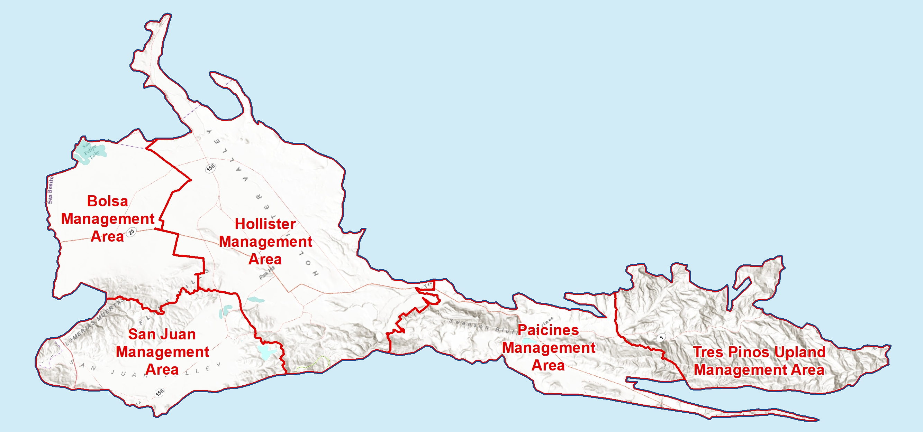
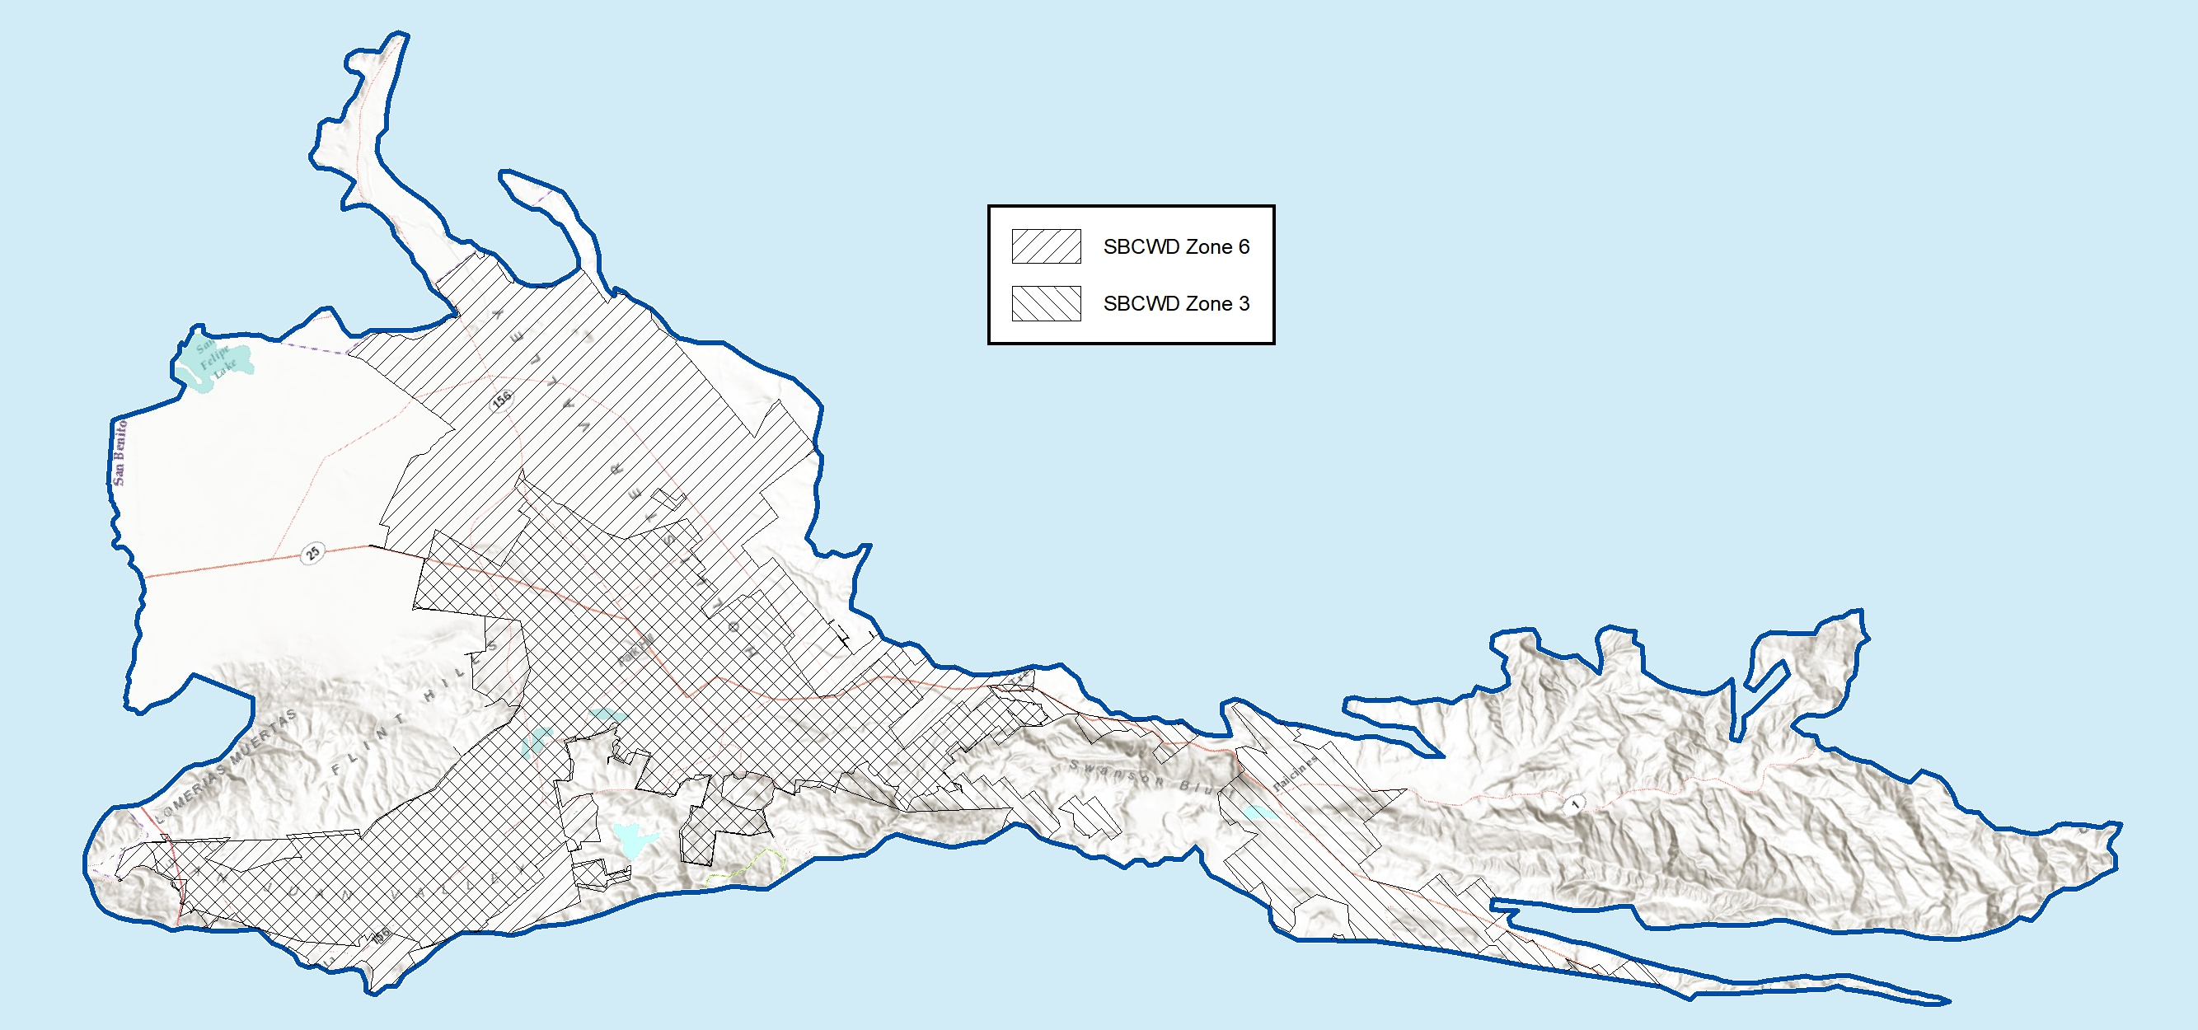
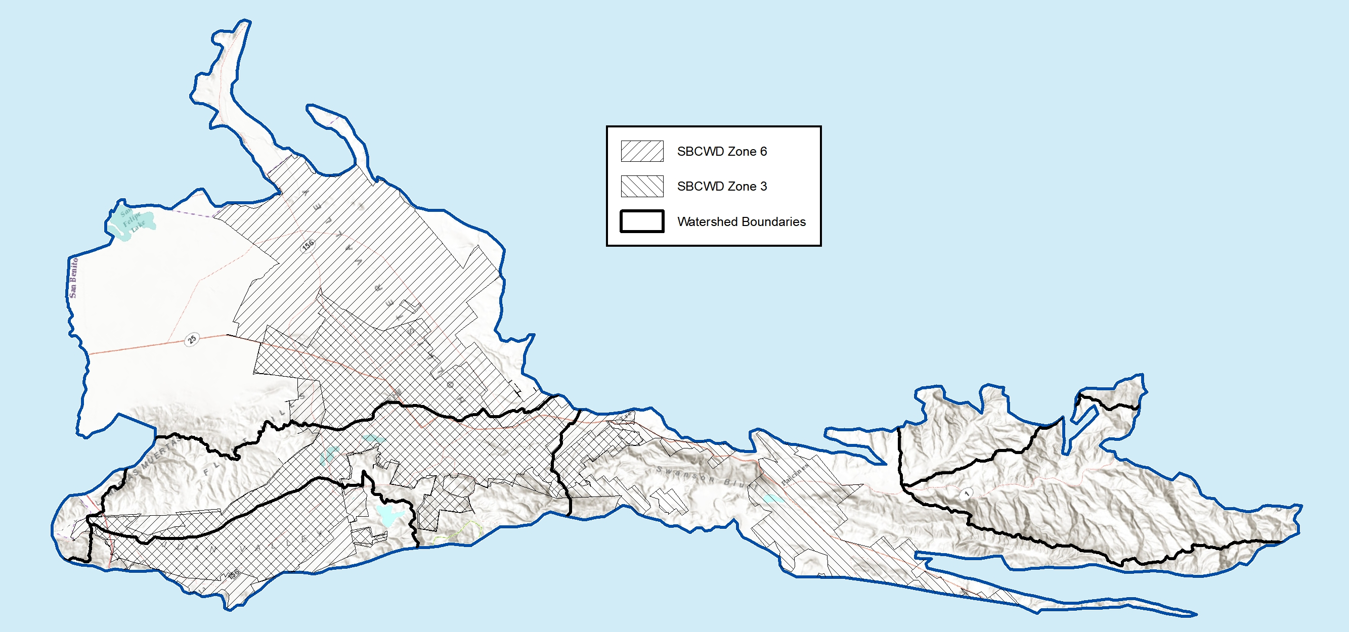
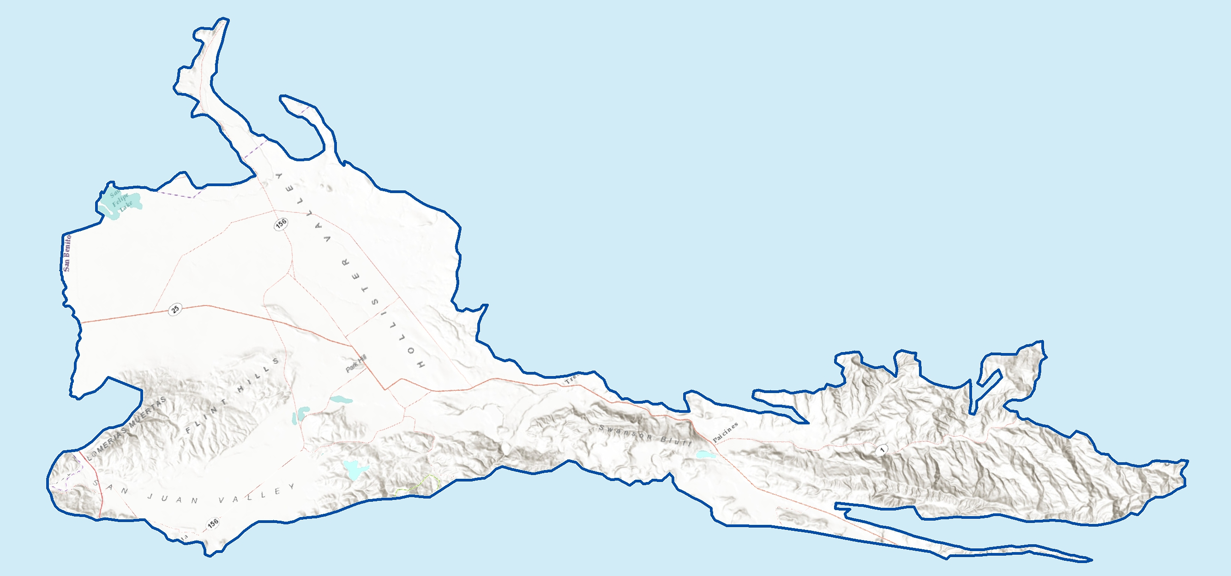
Preliminary Management Areas
Preliminary management areas for discussion
Boundaries include:
Zones 3 and 6
watersheds

Slide 11
Management Areas
GSP will describe
Why management area is created
Basin setting (hydrogeology, water budget, etc.)
Monitoring sites and program as appropriate
Minimum thresholds and measurable objectives
How management areas can operate together

Slide 12
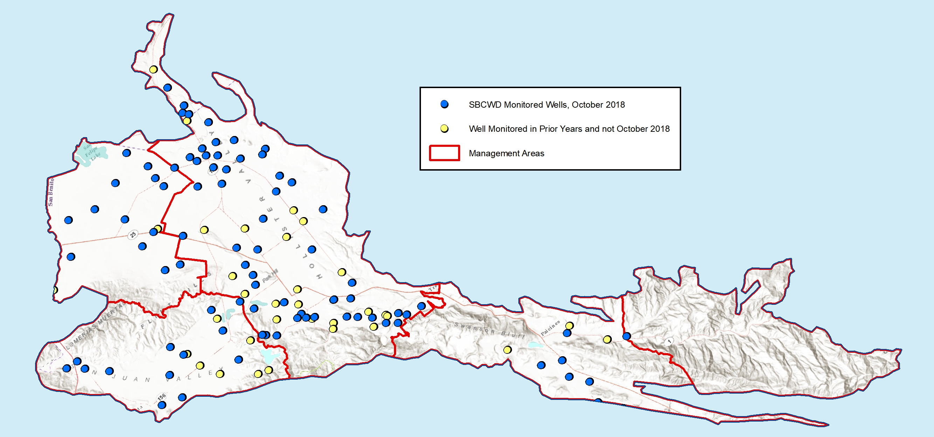
Potential monitoring sites for discussion
Select in terms of five sustainability criteria
Identify key wells with thresholds/objectives
From December 19, 2018 TM, “Data to Support GSP Preparation.”

Slide 13
Sustainability criteria: groundwater levels
In a key well, what is the rationale for minimum thresholds and management objectives?
Key well hydrograph
Minimum Threshold: historical low levels?

Slide 14
Groundwater levels
What is the rationale with respect to:
Shallow wells
Soil drainage
Flow to other areas
Water Table
Operable Range of Water Levels
Pump setting
Top of screen
Total well depth

Slide 15
Hypothetical hydrographs and thresholds
Historical low levels are protective
Recent wells are shallow and not always protected
SBCWD currently is assessing the depth and construction of recent domestic wells

Slide 16
Hypothetical key monitoring sites for groundwater levels
Selecting key sites for each Management Area
What are historical conditions?
What are construction/depths of local wells?
Is this site representative?
What are minimum thresholds in adjacent areas?

Slide 17
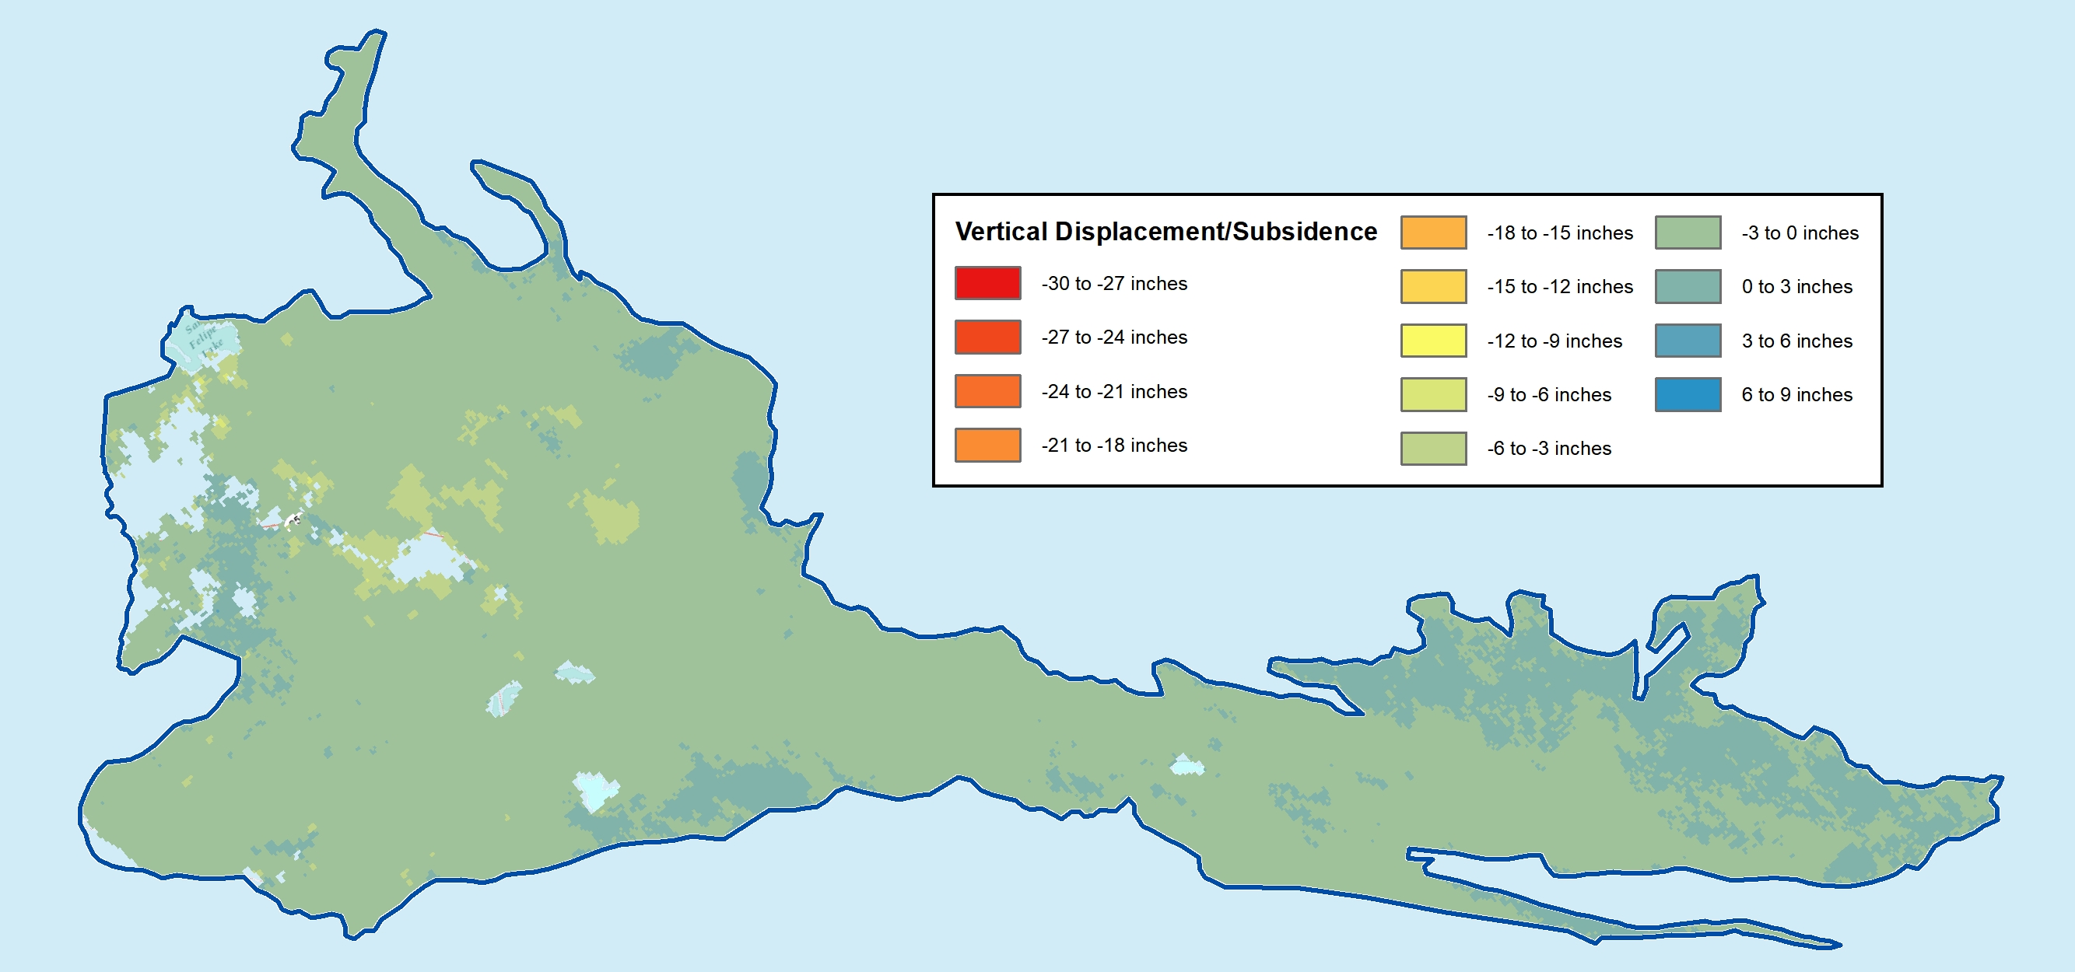
Sustainability criteria: land subsidence
InSAR May 31, 2015 to April 30, 2017

Slide 18
Sustainability criteria: land subsidence
No known historical problems
Potential exists
Probably can avoid problems with groundwater levels above historical
Over the next few years, we need to:
  Track cumulative subsidence (InSAR) over years
  Link subsidence to levels and pumping
  Assess undesirable results
  If undesirable results are present/likely, establish criteria and monitoring

Slide 19
Update on Outreach
First Workshop Nov 14, 2019
School presentations
  Presentation to San Andreas High School
Website sign-ups

Slide 20
GSP Overview, Workshops, and
TAC Meetings
2021
Plan Development
Adoption hearing
Draft GSP workshop
Management Actions / Monitoring
2020
Evaluate actions workshop
Sustainability Criteria
Management options workshop
Management Areas / Water Budgets
Sustainability criteria workshop
2019
Hydrogeologic Conceptual Model / Groundwater
GW Conditions workshop
Data Compilation / Data
Management System
Kickoff workshop Nov 7
2018
Plan Area / Institutional Setting

Slide 21
Next Steps
SBCWD Board of Director’s Meeting Annual Groundwater Report SGMA strategy discussion | Today! January 14, 2019
TAC Meeting No. 4 | April xx, 2019?
Workshop No. 2 | April xx, 2019?

