Slide 1
Community Workshop
San Benito County Water District
Groundwater Sustainability Agency
June 18, 2019

Slide 2
SGMA and the GSP Process

Slide 3
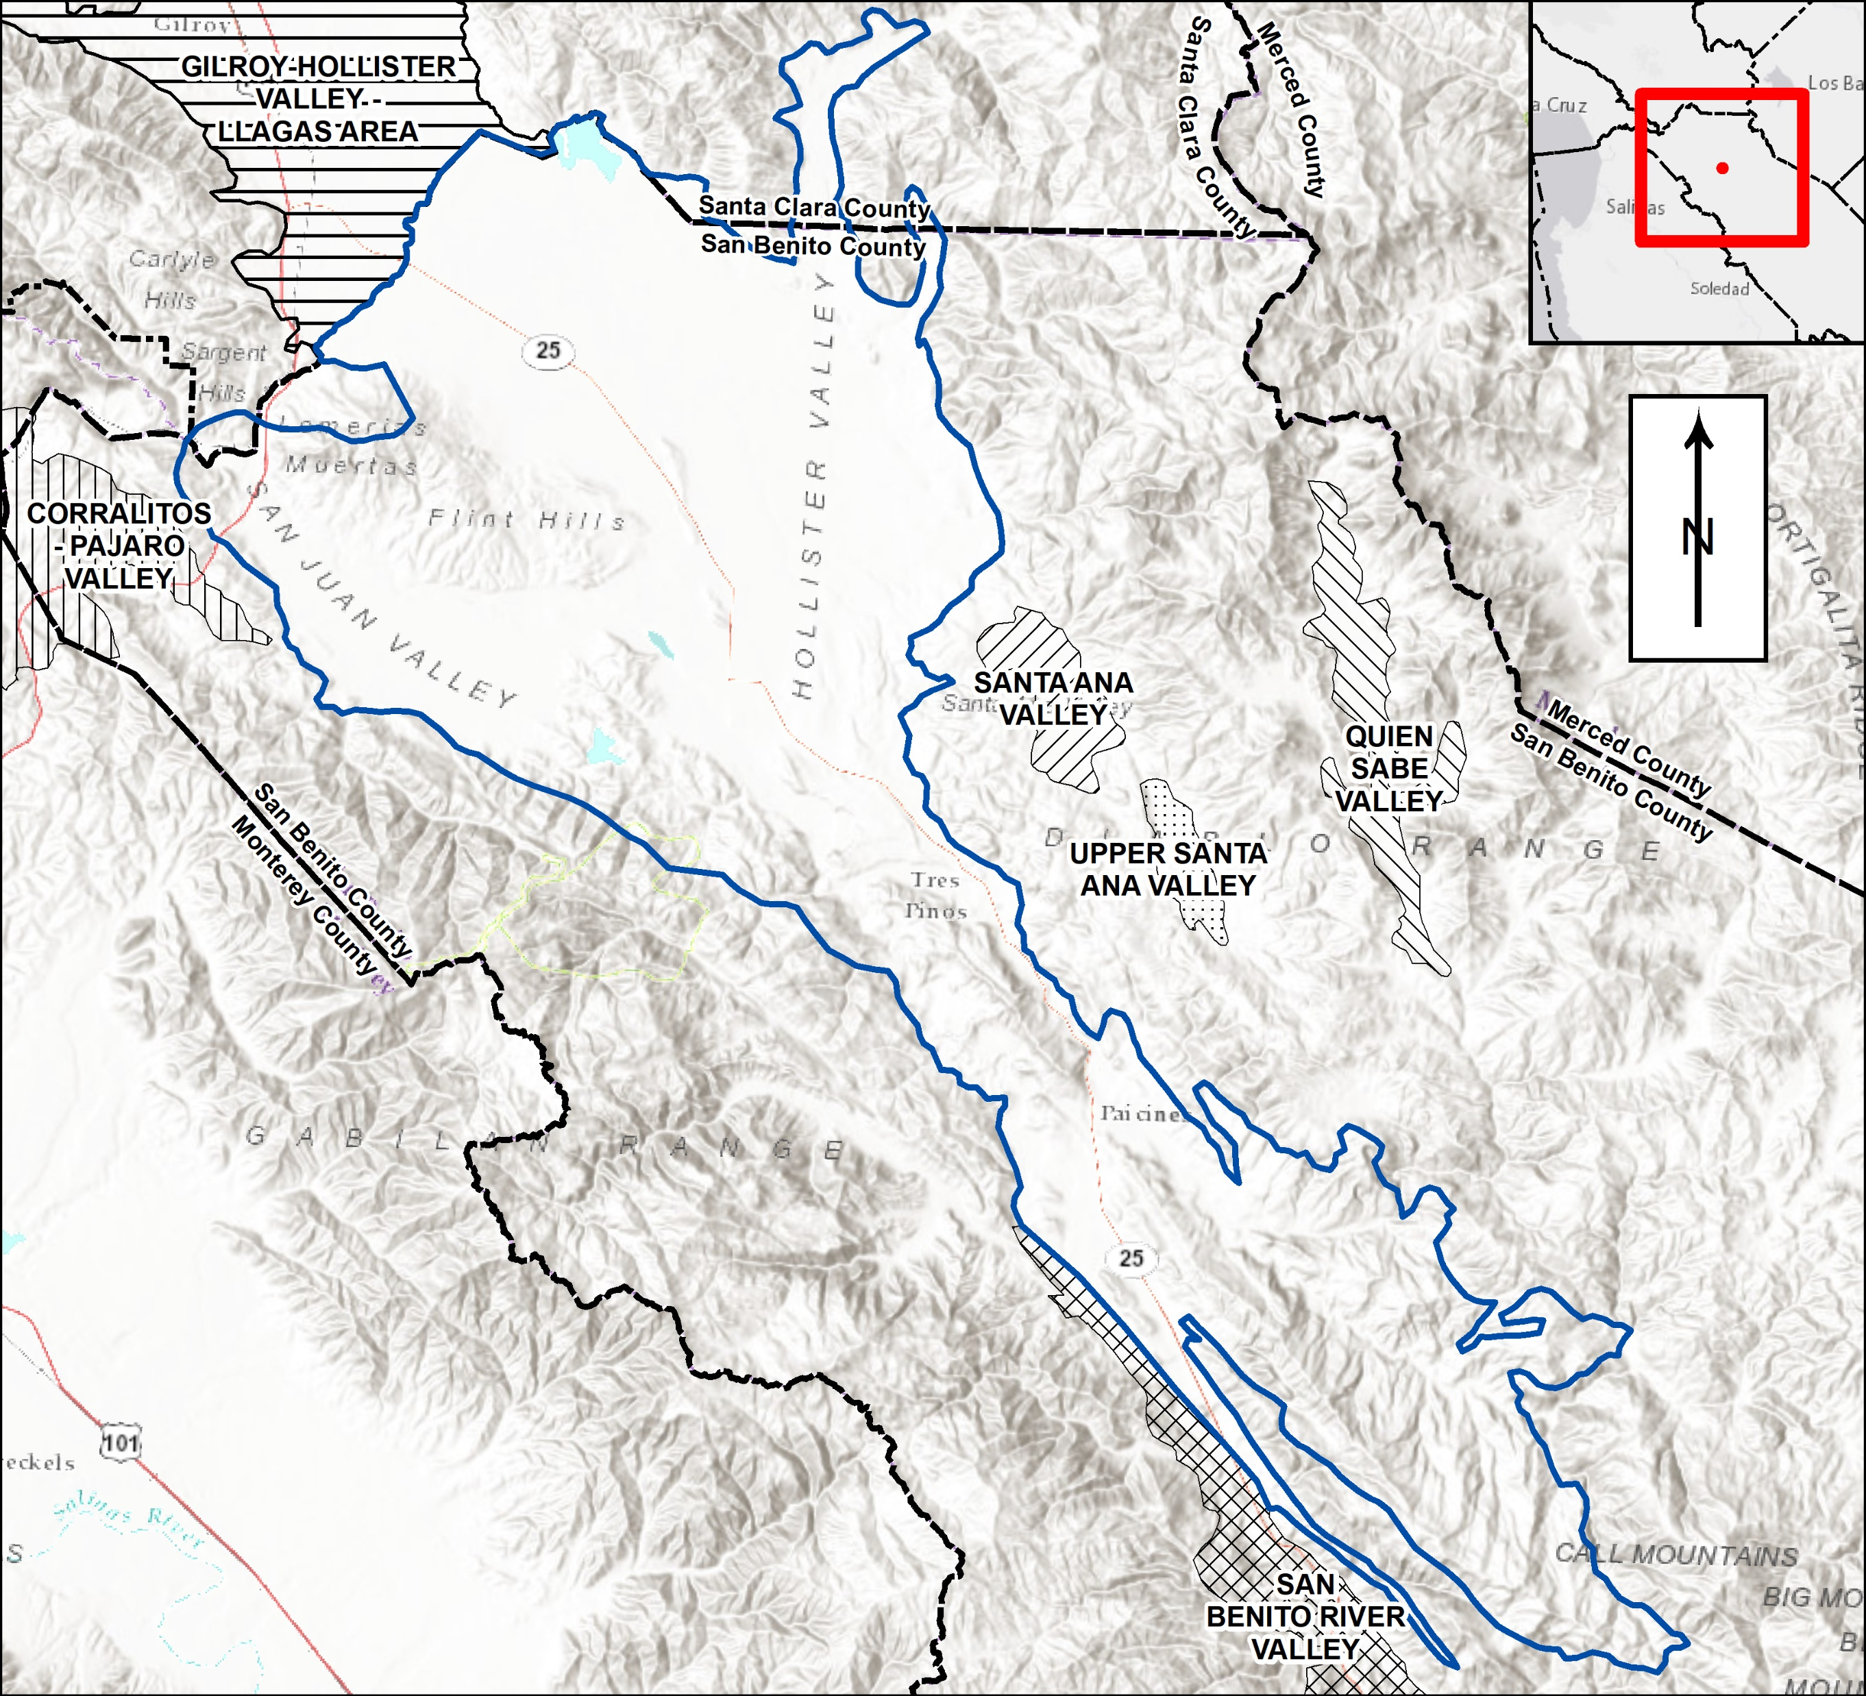
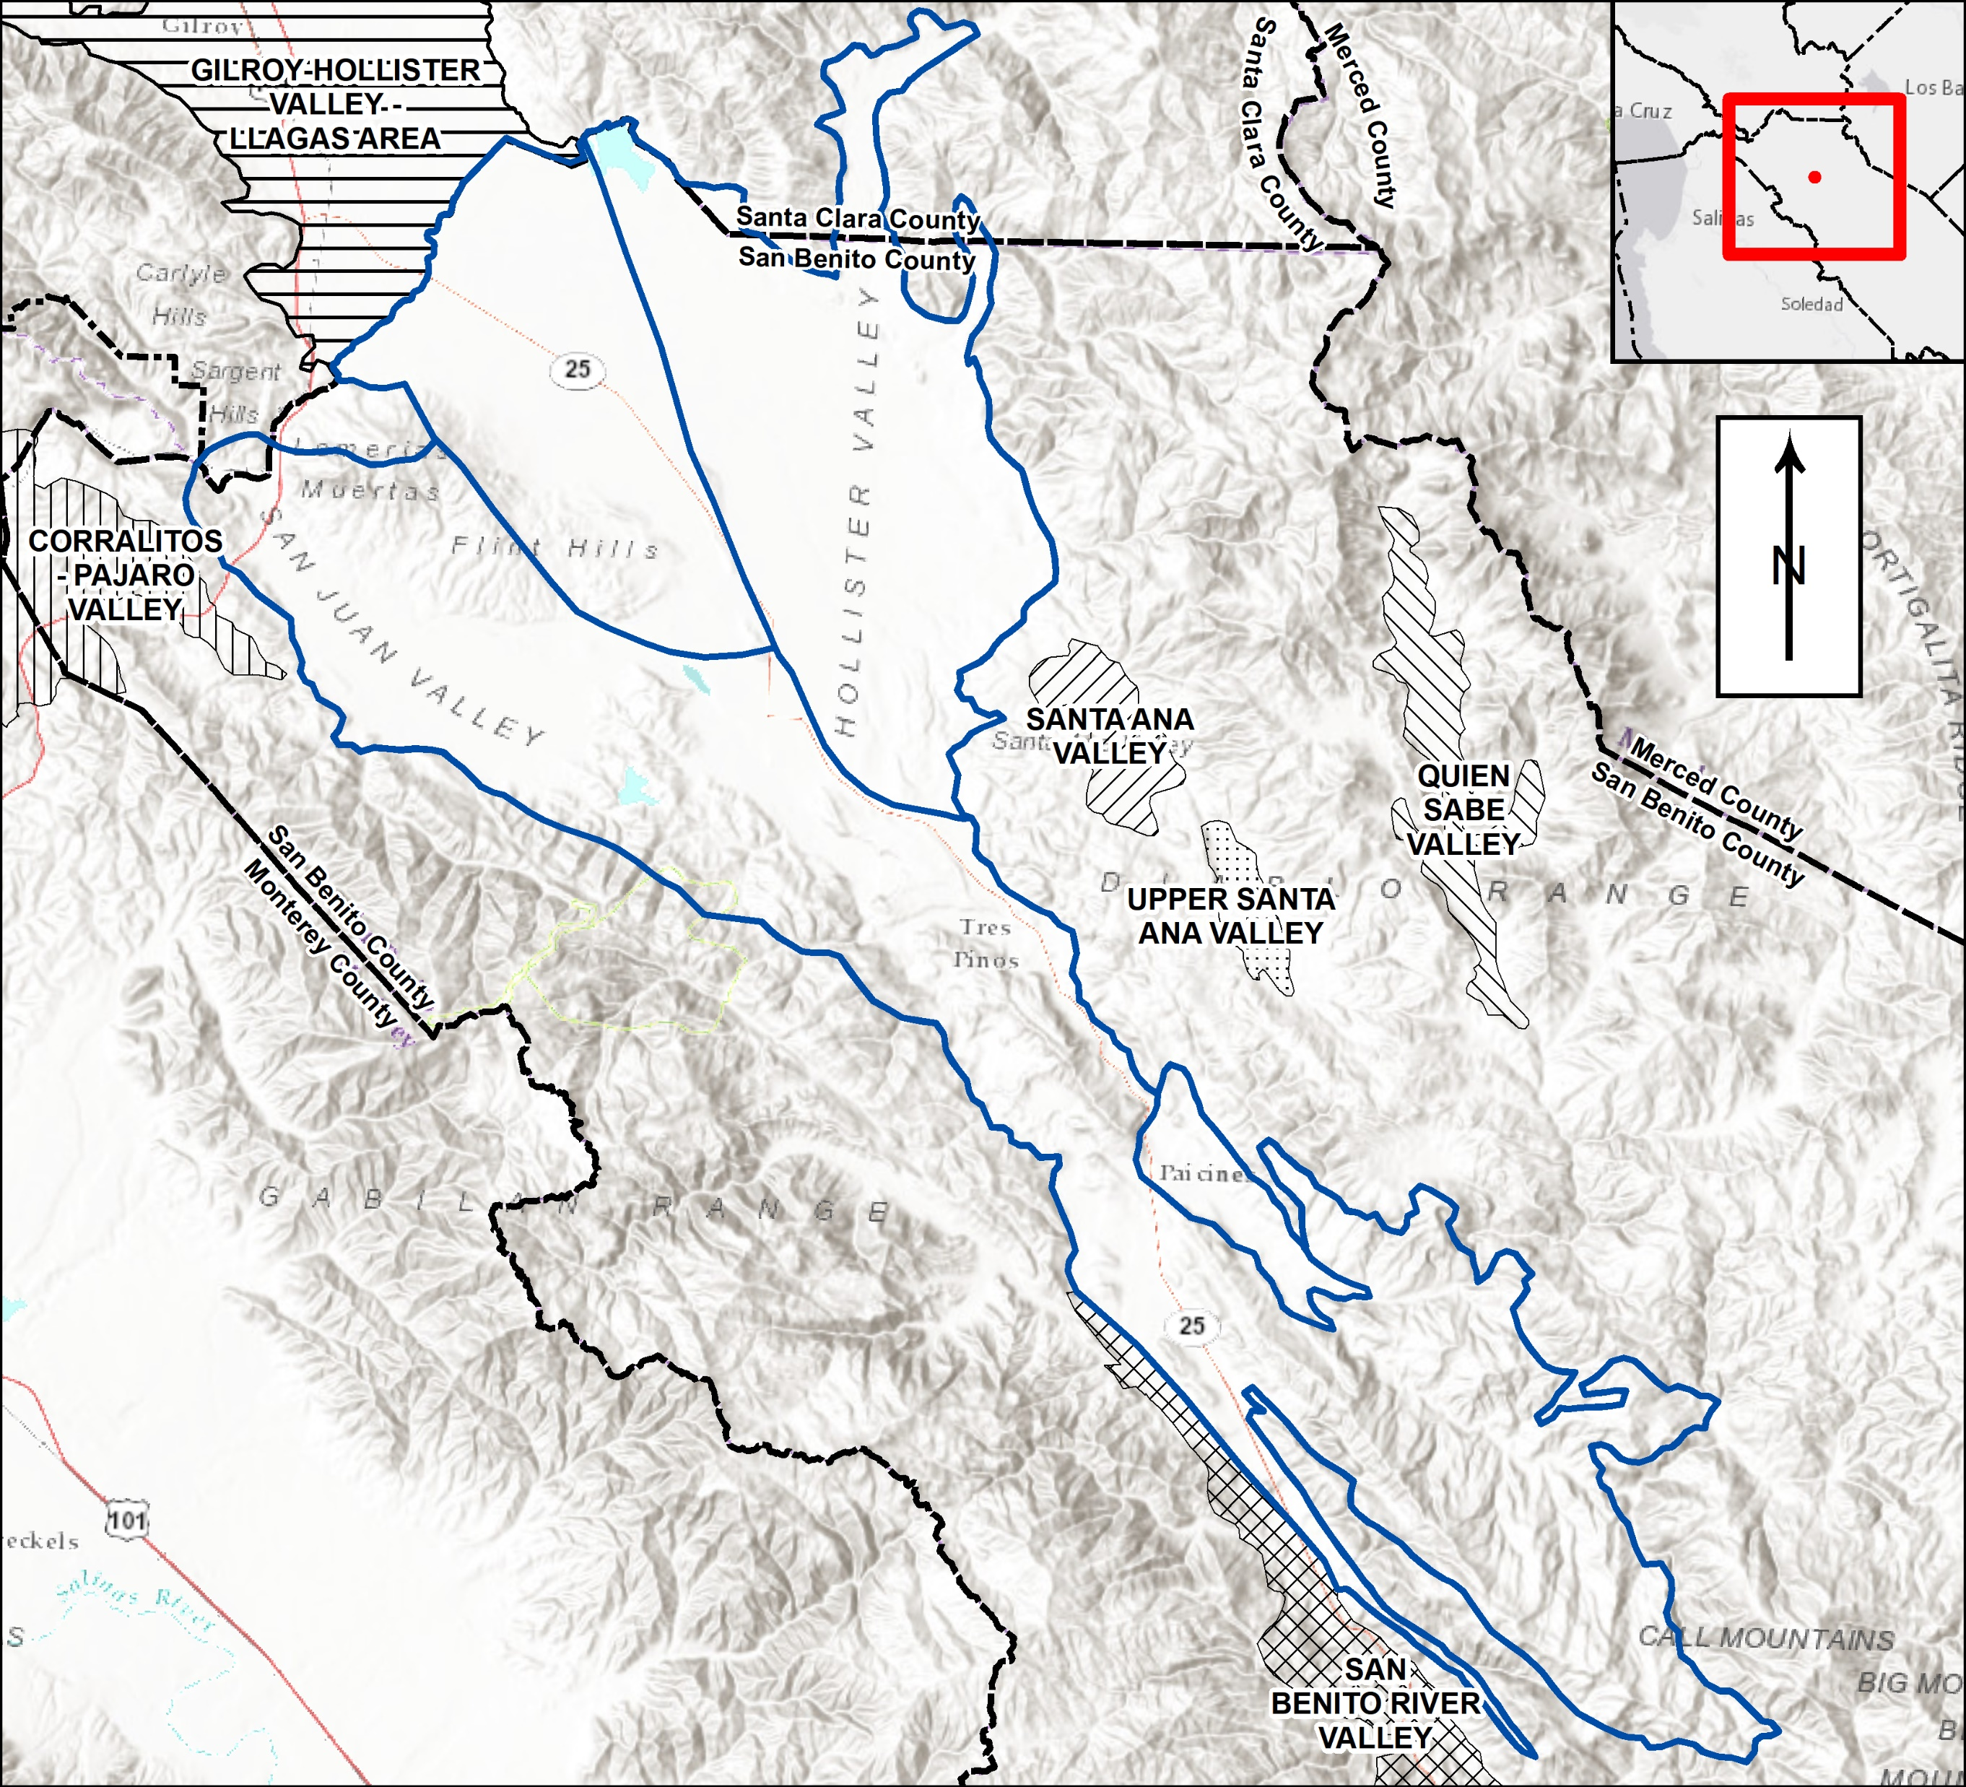
GSP Plan Area
        North San Benito Basin
        Four previous basins were consolidated
      Contiguous and connected
      Managed together historically
      Support one, unified GSP

Slide 4
Where are we now in GSP process?
Introduction chapter starts the GSP
Plan Area introduces the Basin and its management
Hydrogeologic Conceptual Model establishes the physical framework
Groundwater Conditions documents historical and current status

Slide 5
Hydrogeologic Conceptual Model (HCM)
What is the physical framework of the Basin?

Slide 6
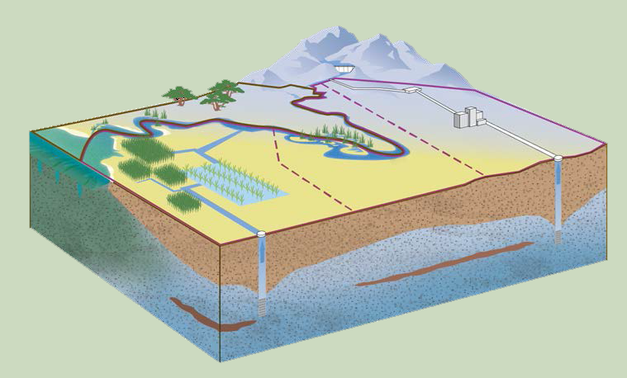
Hydrogeologic Conceptual Model
Descriptions
Boundaries
Geology
Aquifers and aquitards
Aquifer properties
Groundwater pumping and use
Groundwater quality
Maps and Graphics
Topography
Geology
Soils
Cross-sections
Recharge and discharge areas
Surface water features

Slide 7
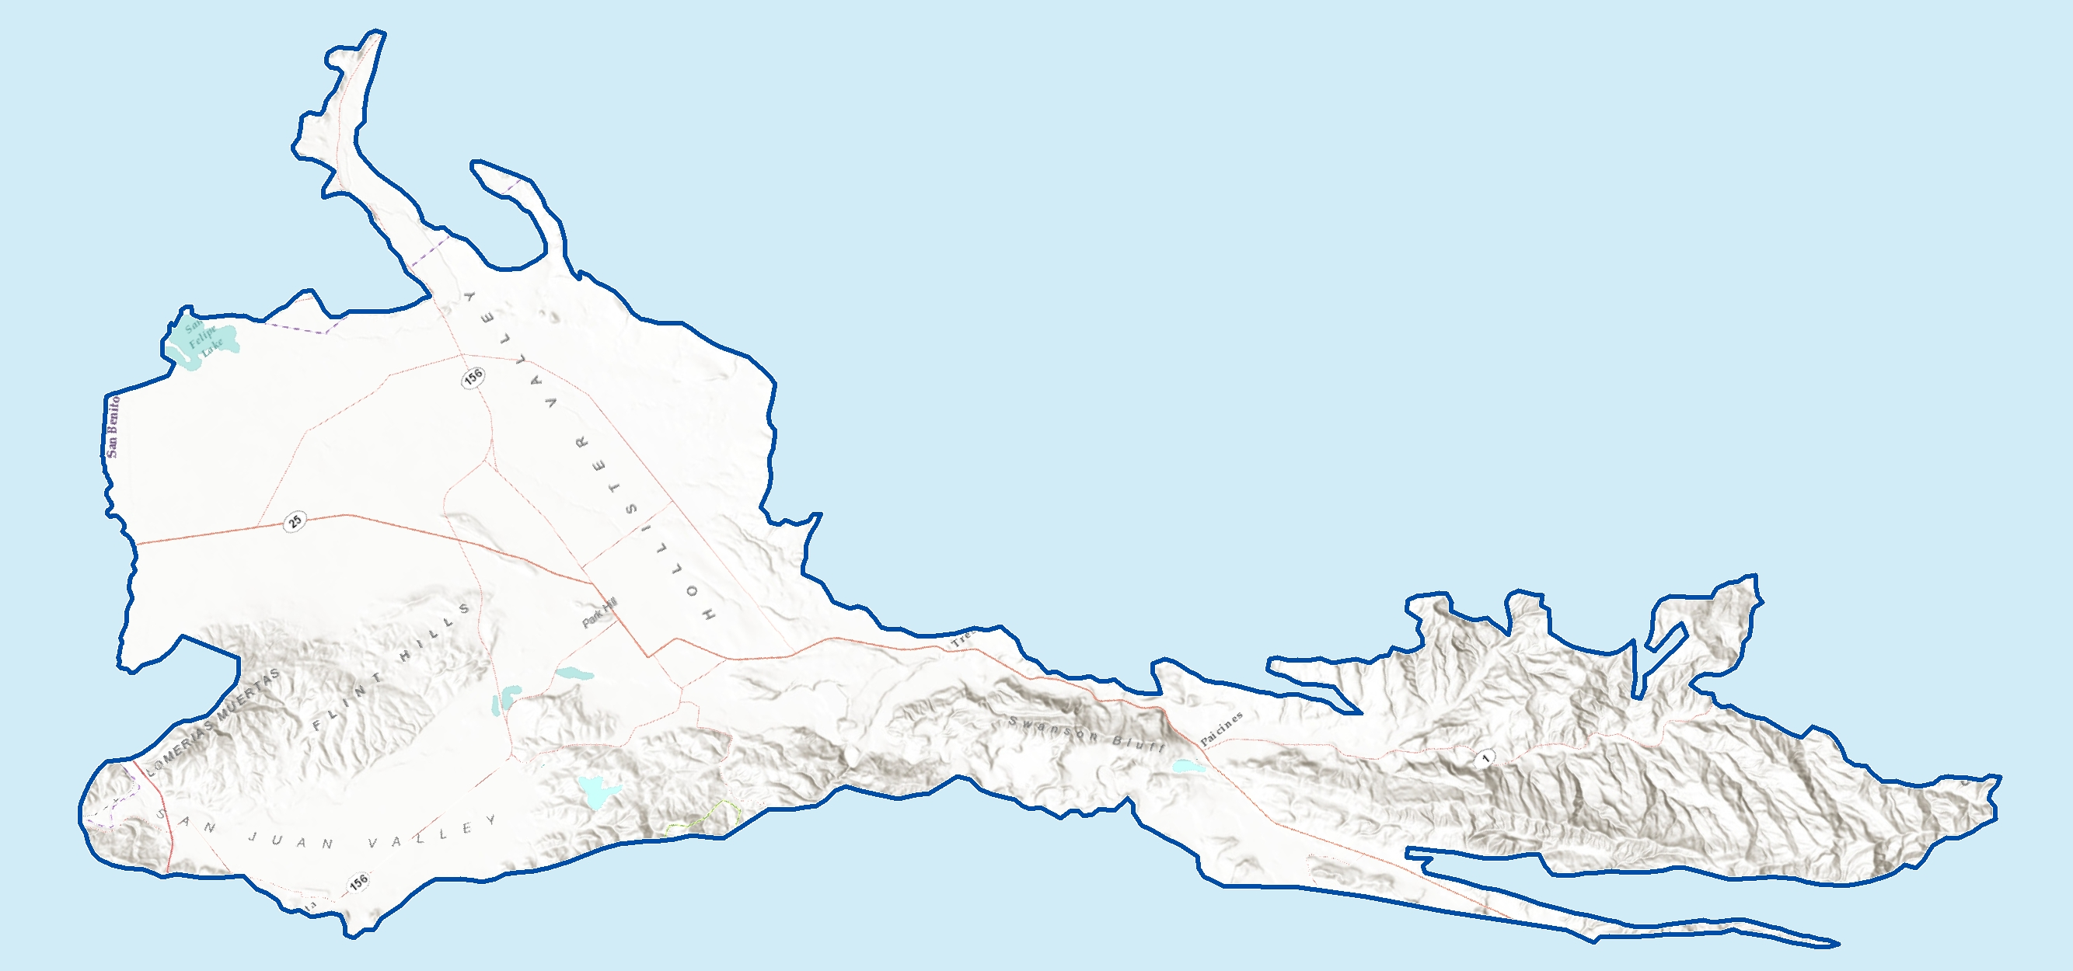
Overview of North San Benito Basin
Long, irregular with hills and valleys
Hydraulically connected
Locally complex

Slide 8
A long, irregular but continuous basin

Slide 10
Aquifer materials
Lenses of coarse grained and fine grained materials
No clear distinction into major identifiable units
Locally variable and discontinuous, but connected at basin-scale
Aquifers extend to variable, poorly-known depths beyond the depth of most wells
Coarse-grained
Fine-grained

Slide 11
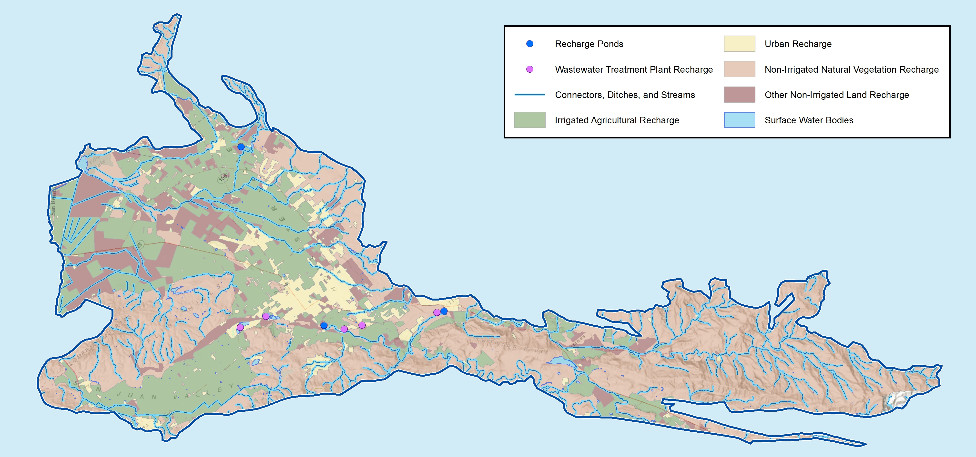
Recharge occurs over the entire Basin

Slide 12
Groundwater Conditions
What is the state of the basin?

Slide 13
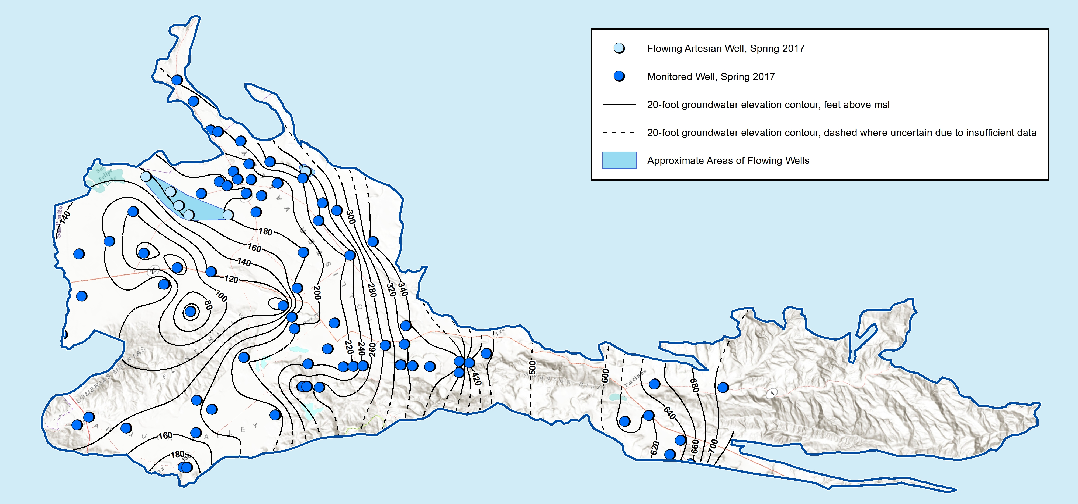
Regional groundwater flow is south to north

Slide 14
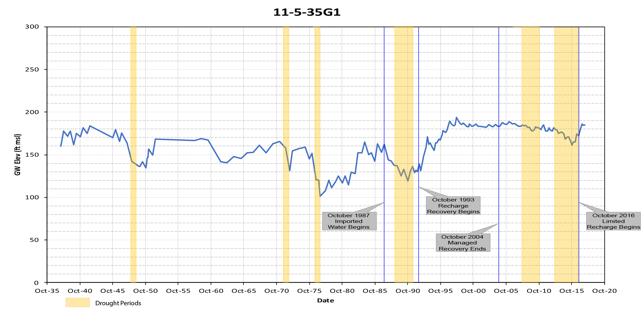
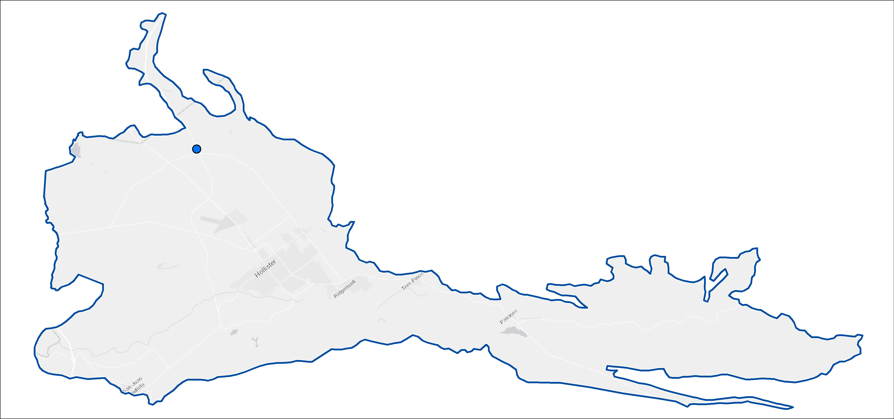
Long-term hydrographs tell basin history
11-5-35G1

Slide 15
Land subsidence
No known historical problems
Potential exists
Probably can avoid problems with groundwater levels above historical
Over the next few years, we need to:
  Track cumulative subsidence information
  See if there is a link to groundwater levels and pumping
  Assess if there are any undesirable results
  If undesirable results are present/likely, establish criteria and monitoring

Slide 16
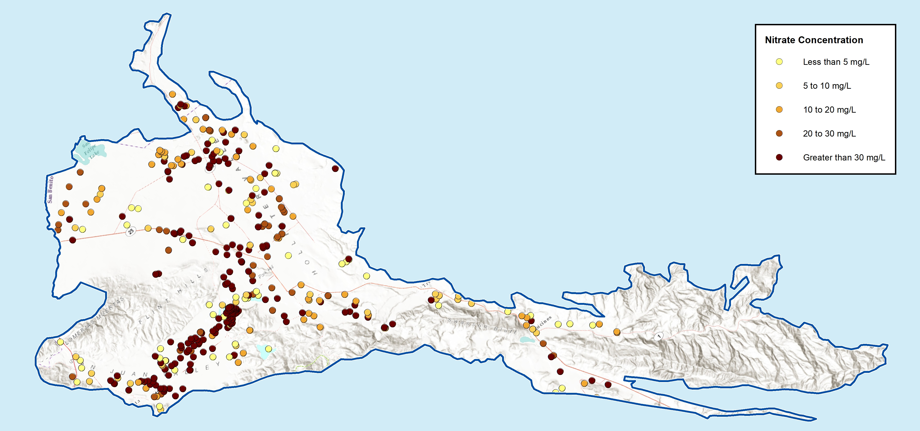
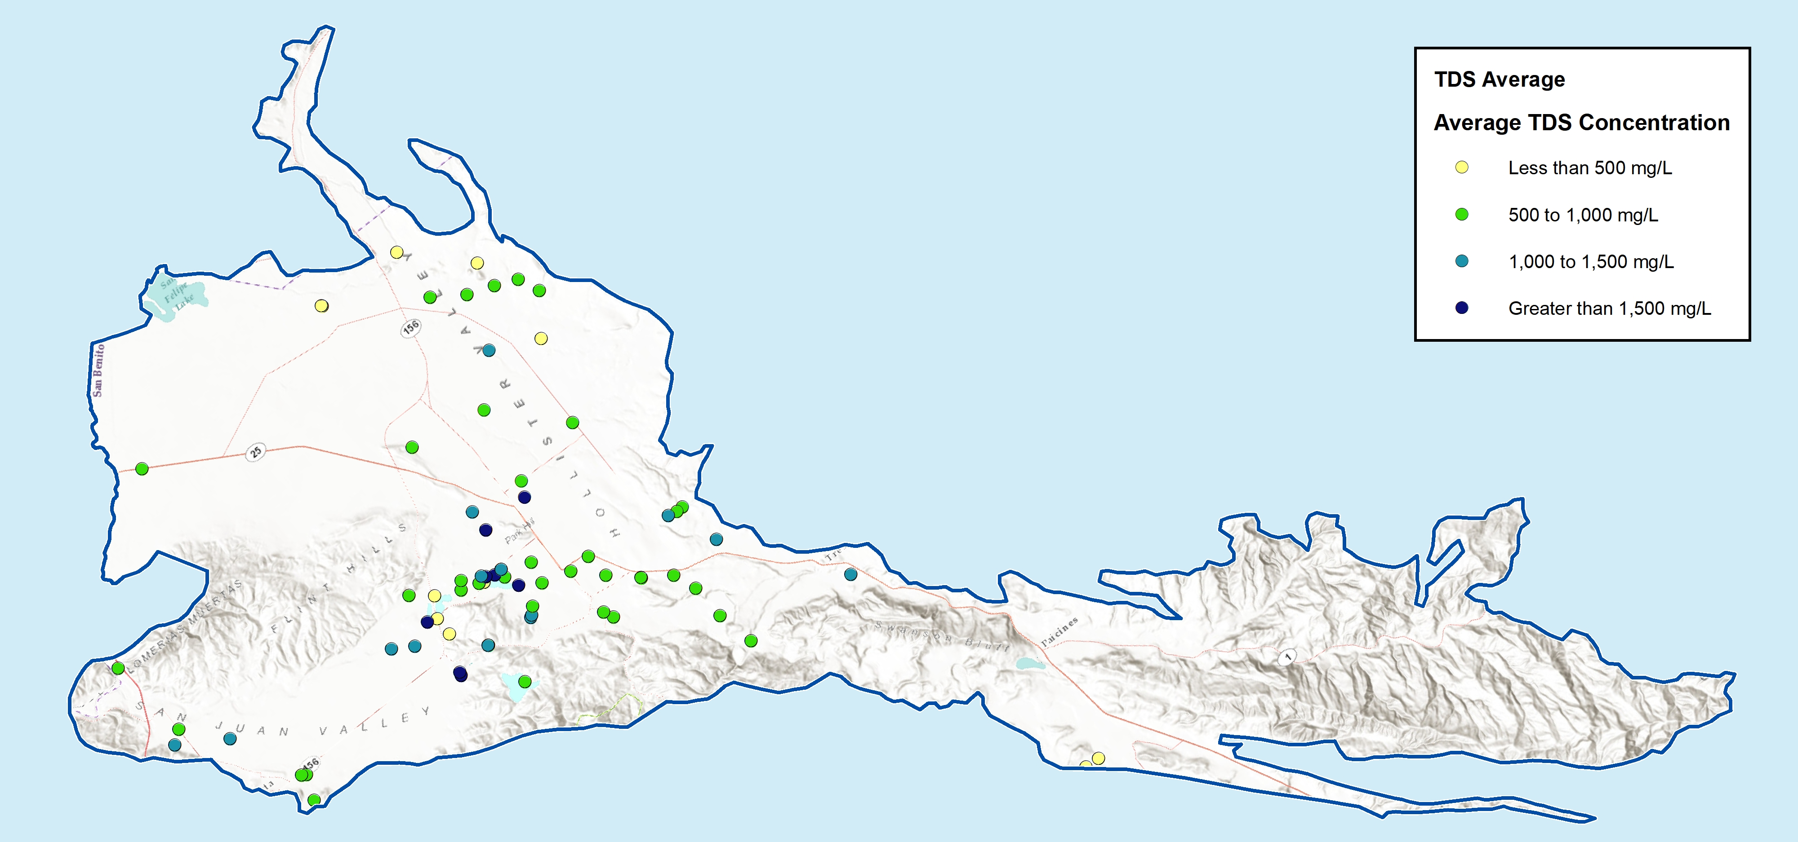
Groundwater quality is documented
Mineralized and marginal
Local geology
Human activities
Nitrate
TDS

Slide 17
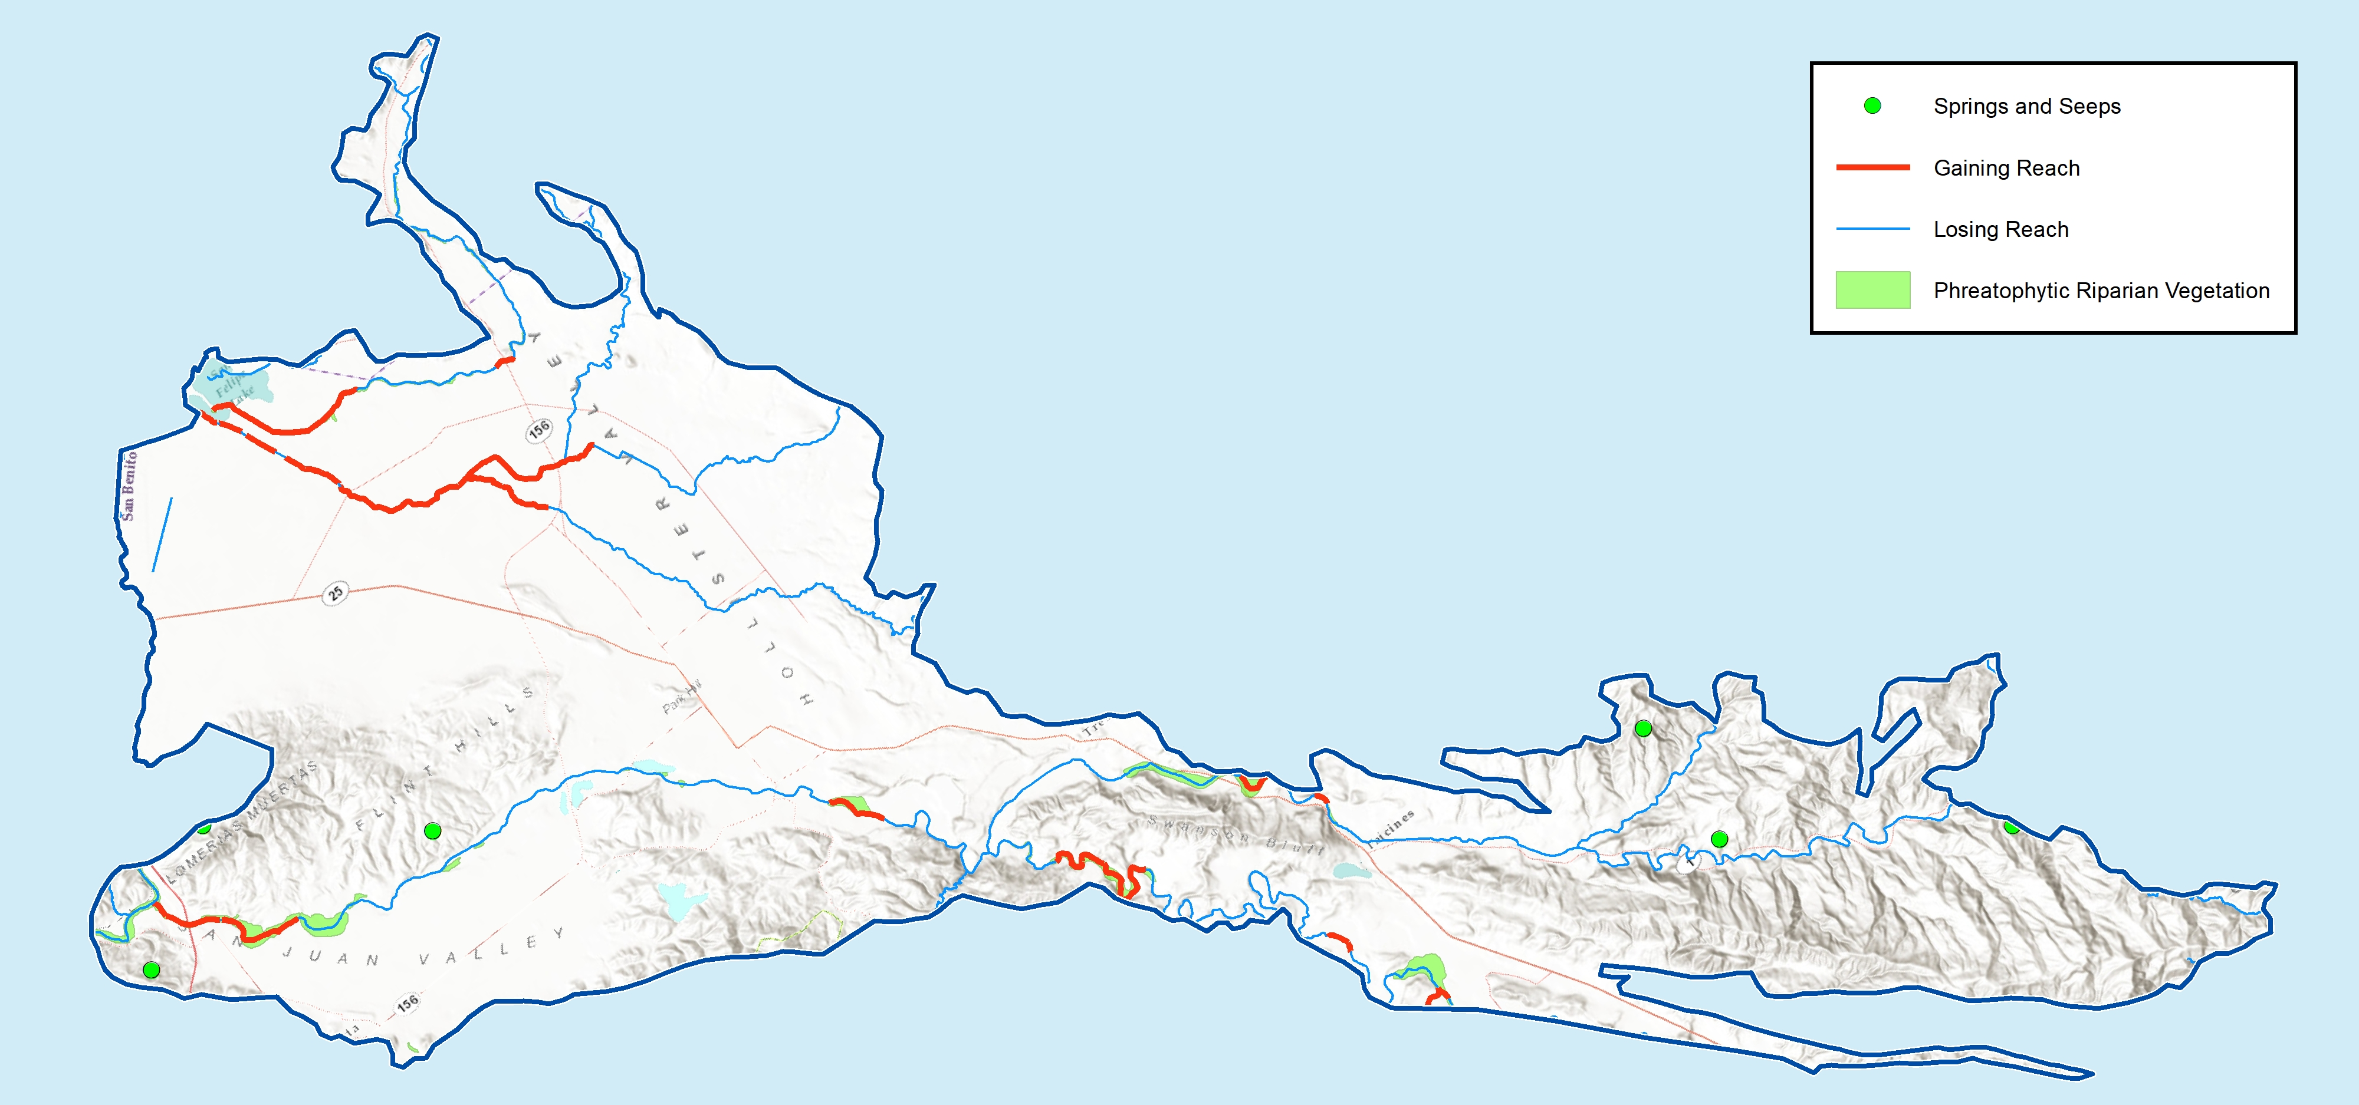
Surface water-groundwater connections are identified… more analysis coming

Slide 18
GSP Overview
2021
Plan Development
Adoption hearing
Draft GSP workshop
Management Actions / Monitoring
2020
Implementation workshop
Sustainability Criteria
Actions workshop
Criteria workshop
Management Areas / Water Budgets
2019
Water budget workshop
Hydrogeologic Conceptual Model / Groundwater
HCM-GW Conditions
Public Workshop #2
June 18 2019
Data Compilation / Data
Management System
2018
Kickoff workshop Nov 7 2018
Plan Area / Institutional Setting

Slide 19
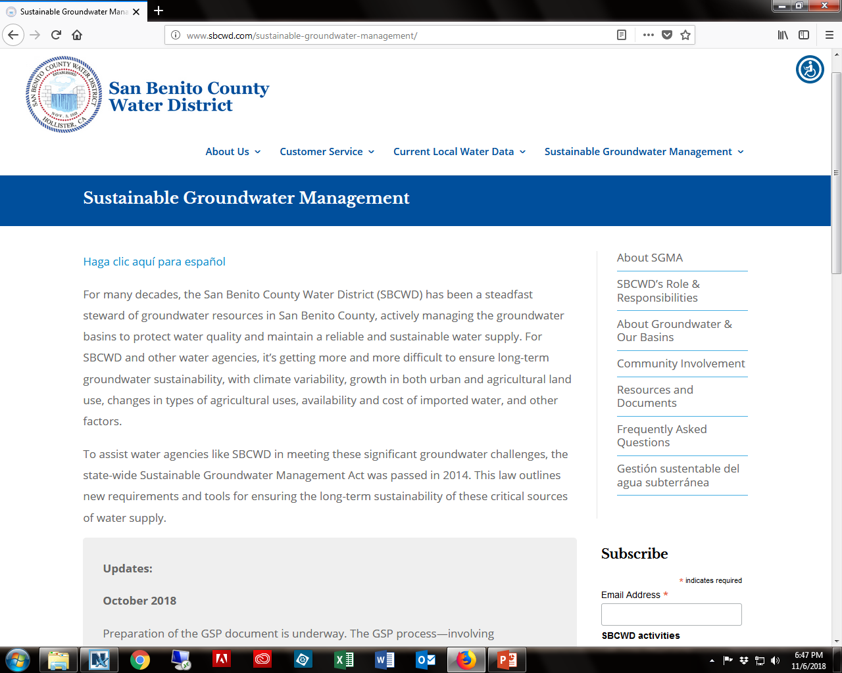
Subscribe
Stay tuned to www.sbcwd.com

Slide 20
Break and Poster Session
Long-term hydrographs tell the basin history
Groundwater quality is being managed
There is water underground (varied and connected)
Recharge occurs everywhere; Surface water is connected locally
What are the steps in preparing a GSP?
What are the next steps?

Slide 21
What’s next?
TAC Meeting No. 5 and Board of Director’s Meeting | Management Areas | July 31, 2019
TAC Meeting No. 6 and Board of Director’s Meeting | Water Budget | October 30, 2019
Workshop No. 3 | Water Budget | November 2019

