Slide 1
Technical Advisory Committee
San Benito County Water District
Groundwater Sustainability Agency
August 28, 2019

Slide 2
Overview of Agenda
Update on GSP schedule
Management areas
Update on sustainability criteria
Update on outreach
TAC next steps

Slide 3
Highlights
Last TAC Meeting
  Hydrogeologic Conceptual Model (HCM)
  Groundwater Conditions
  Sections now on website
Public Workshop on June 18, 2019
Meeting and deliverable schedule updated

Slide 4
Management Areas (MAs)
How defined?
Different water uses, water sources, geology, etc.
Why have them?
MAs may have different minimum thresholds + measurable objectives
MAs may have different monitoring, projects, management actions
MAs are defined to facilitate implementation of the GSP

Slide 5
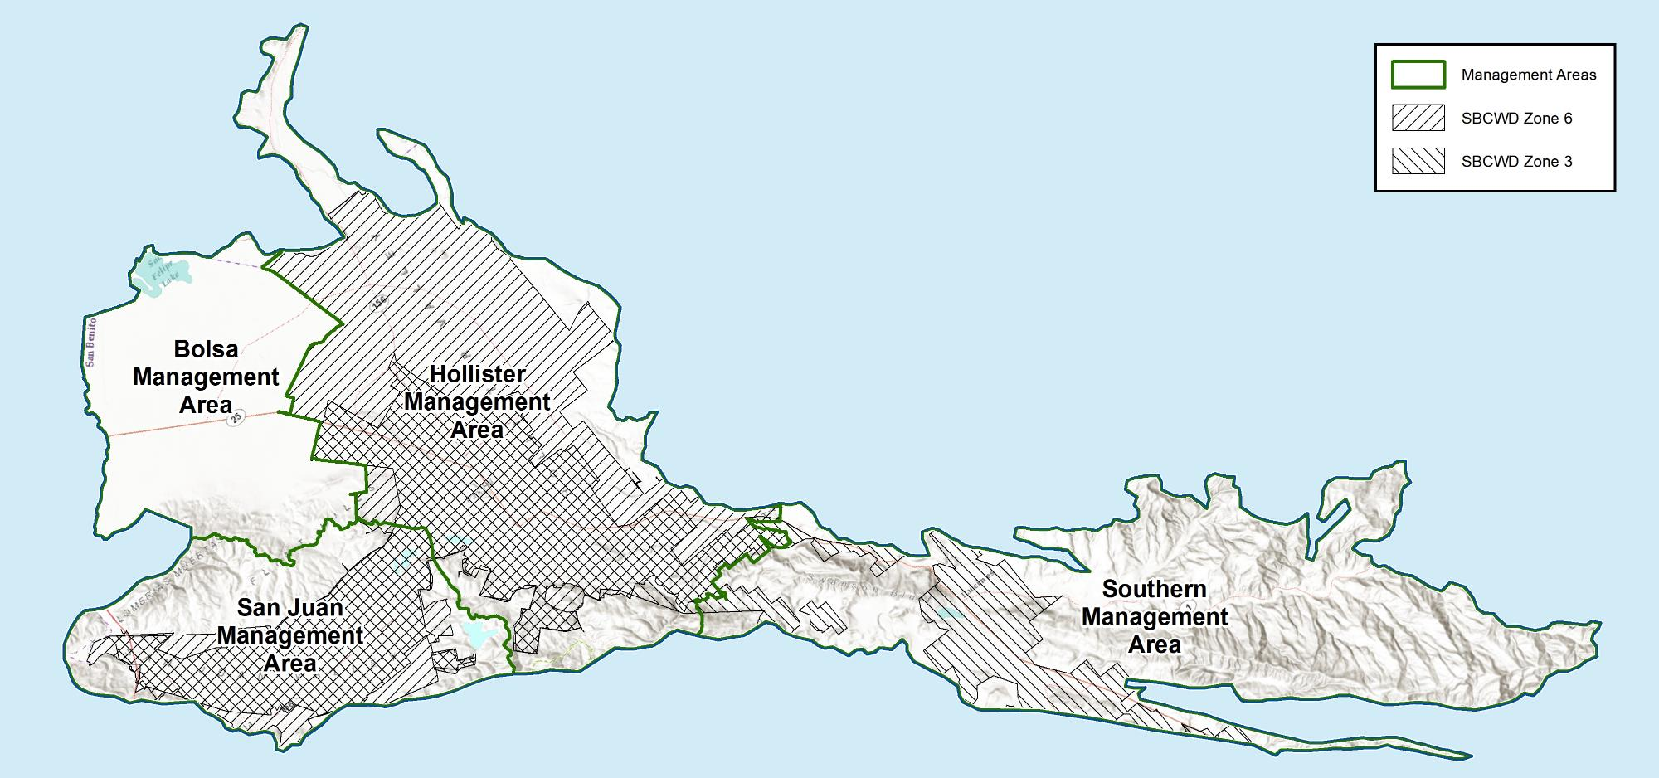
Four MAs based mostly on water supply sources
Imported Central Valley Project water in Zone 6 and in Santa Clara County
Local surface water from Hernandez and Paicines reservoirs in Zone 3

Slide 6
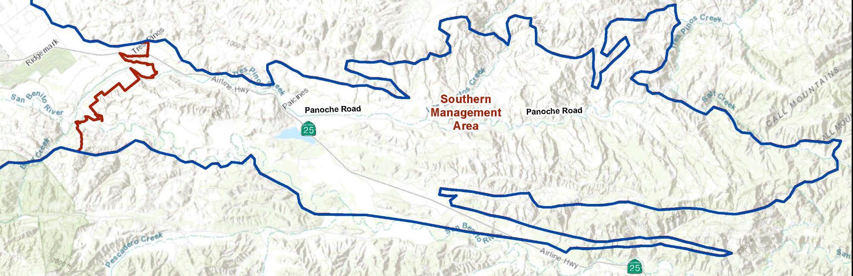
Southern Management Area
Local access to Zone 3 surface water supply through groundwater recharge
Uplands, rangeland, farmland, and rural residential rely on wells
Limited local agencies

Slide 7
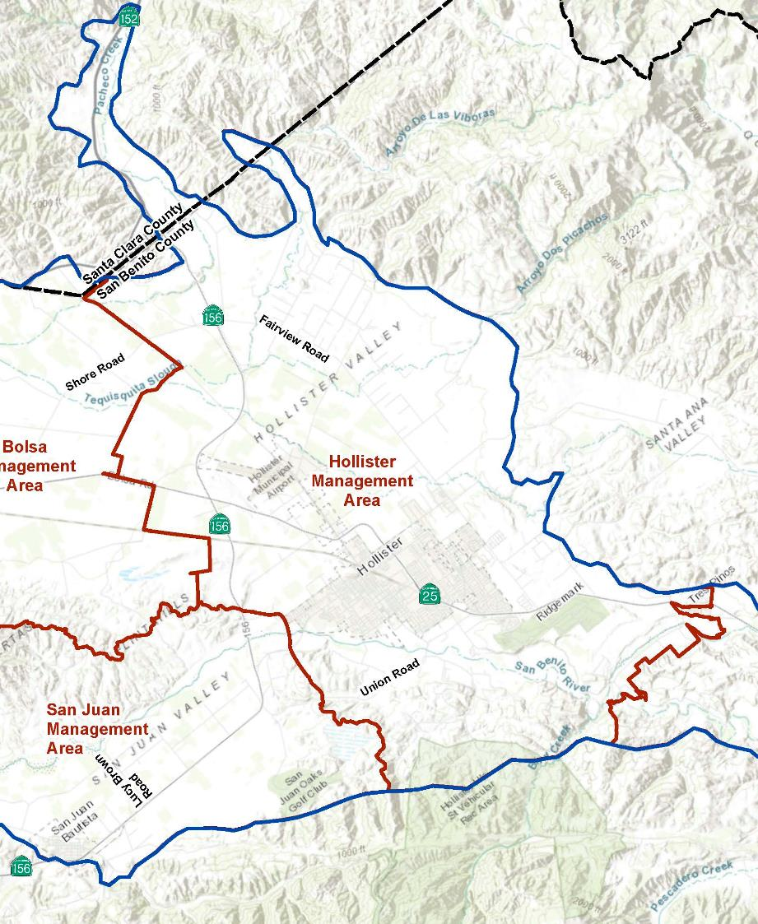
Hollister Management Area
Access to Zone 3 and Zone 6/CVP supply and recycled water
Varied land uses: farmland, rural, urban, industrial, rangeland
City of Hollister and water districts: Valley Water, Sunnyslope, Pacheco Pass, Tres Pinos

Slide 8
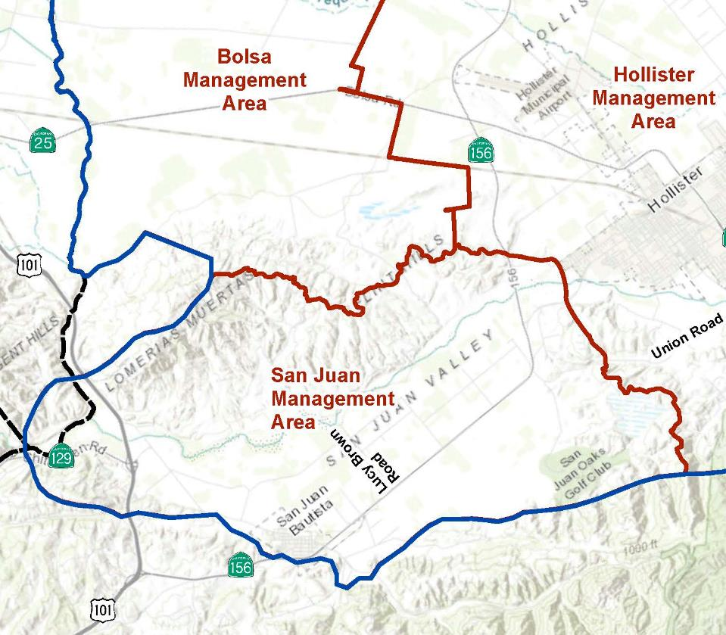
San Juan Management Area
Access to Zone 3 and Zone 6 surface water supply
Prime farmland, rangeland
City of San Juan Bautista and portions of Hollister, Aromas WD

Slide 9
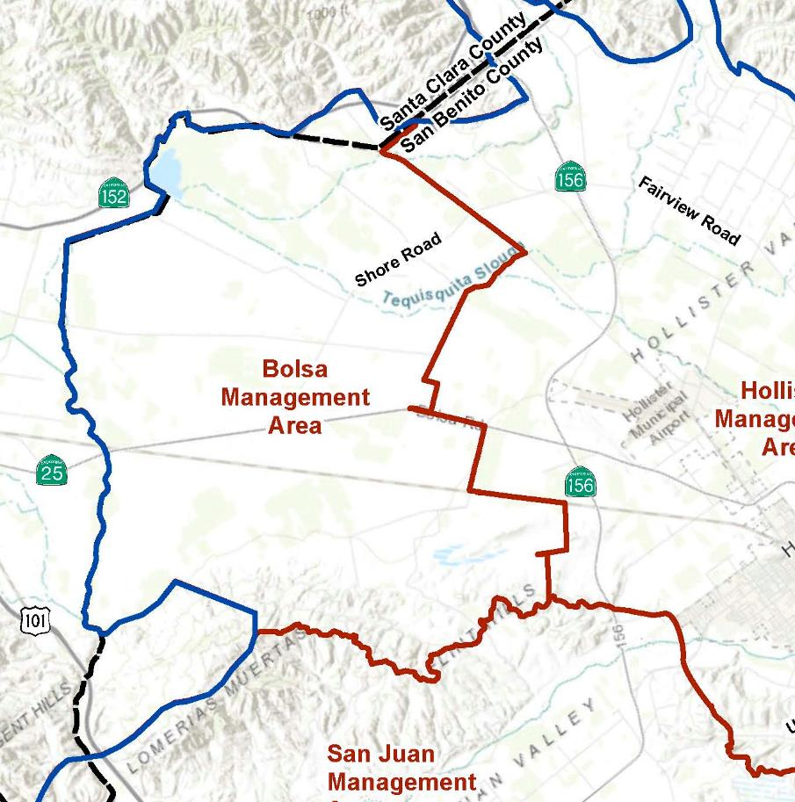
Bolsa Management Area
No direct Zone 3 or Zone 6 surface water supply
Predominantly agricultural and rural, limited local agencies
Relies solely on groundwater

Slide 10
Confirmation of Management Area boundaries
Supports next steps:
Water budget analysis
Definition of sustainability criteria, e.g., thresholds
Identification of management actions and projects
Planning for monitoring and GSP implementation

Slide 11
Ten-minute break
Update on GSP Schedule
Management Areas
Update on Sustainability criteria
  Groundwater levels
  Groundwater storage
  Groundwater quality
Update on outreach
Next steps

Slide 12
Recap: Setting the stage to define sustainability criteria: groundwater levels
What are potential undesirable results?
loss of yield in wells
impacts on flow to/from other areas
How do we identify undesirable results?
Historical lows?
Recent, shallow well construction?
Water Table
Operable Range of Water Levels
Pump setting
Top of screen
Total well depth

Slide 13
Recap options for minimum thresholds: historical low levels and/or well construction?

Slide 14
Considerations on minimum thresholds for groundwater levels
North San Benito Basin hydrographs generally do not show long-term declining trends.
Droughts happen but the basin has fared well (so far, so good).
Well construction may be variable.
Discussion Points
Each groundwater user is responsible for a well and pump that produce sufficient water even with fluctuating water levels.
Management of groundwater storage capacity should not be constrained by the shallowest well(s).

Slide 15
Minimum thresholds and undesirable results
Considerations:
Undesirable results are significant and unreasonable
Need to quantify, be consistent among criteria and areally, to justify
Groundwater level decline due to drought is not sufficient (if basin is operated so that declines are offset subsequently)
Groundwater conditions throughout the basin
Measured with monitoring programs
Management actions avoid undesirable results and attain objectives

Slide 16
Minimum thresholds and undesirable results
Consider this:
Annual reports will track groundwater level changes.
How frequent and when and how long can levels be below the minimum threshold before undesirable results occur?
    e.g., four consecutive measurements?
Minimum Threshold

Slide 17
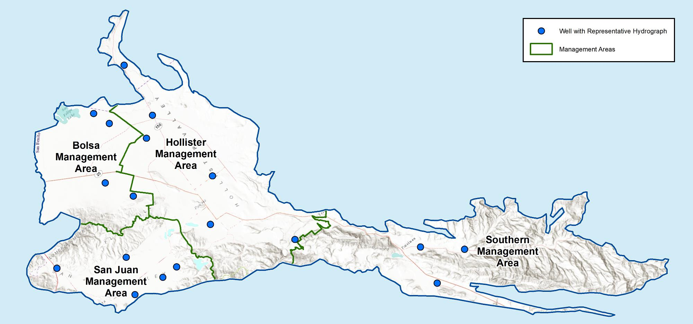
Additional Key Wells have been identified
Long, complete, reliable record
Recently monitored
Geographically distributed
We need dedicated monitoring wells!
Consider this:
How many wells with levels below the threshold represent an undesirable result?

Slide 18
How do we define Management Objectives?
Shallow monitoring wells may be needed in artesian areas.

Slide 19
How do we define Management Objectives?

Slide 20
How do we define Management Objectives?

Slide 21
Sustainability Criteria – Groundwater Storage
Storage is a volume of available water, linked to groundwater levels
How much stored groundwater do we want for drought or shortage?
Change in groundwater storage is computed with the water budget
Inflows – outflows = change in storage
Undesirable result = insufficient storage to get through 5-year drought?
Measurable Objective = zero net storage change over long term
Consider this:

Slide 22
Tracking groundwater storage
SBCWD tracks storage change annually
Cumulative storage change allows tracking year after year
Stay tuned for next steps
Assess storage change for each MA
Assess water budget for historical droughts
Apply numerical model to future scenarios with climate change and CVP shortages

Slide 23
Recap on groundwater quality
GSP documents multiple constituents with focus on TDS and nitrate
Long-term data do not show long-term water quality deterioration
Groundwater quality is regulated by RWQCB and other agencies
What is the GSA role?
Support existing monitoring and management programs, e.g., Salt & Nutrient Management Plan, Irrigated Lands Program, Hollister Urban Area Water and Wastewater Master Plan
Avoid undesirable results from GSP management actions or projects
Maintain sustainability
Consider this: What does sustainability look like?

Slide 24
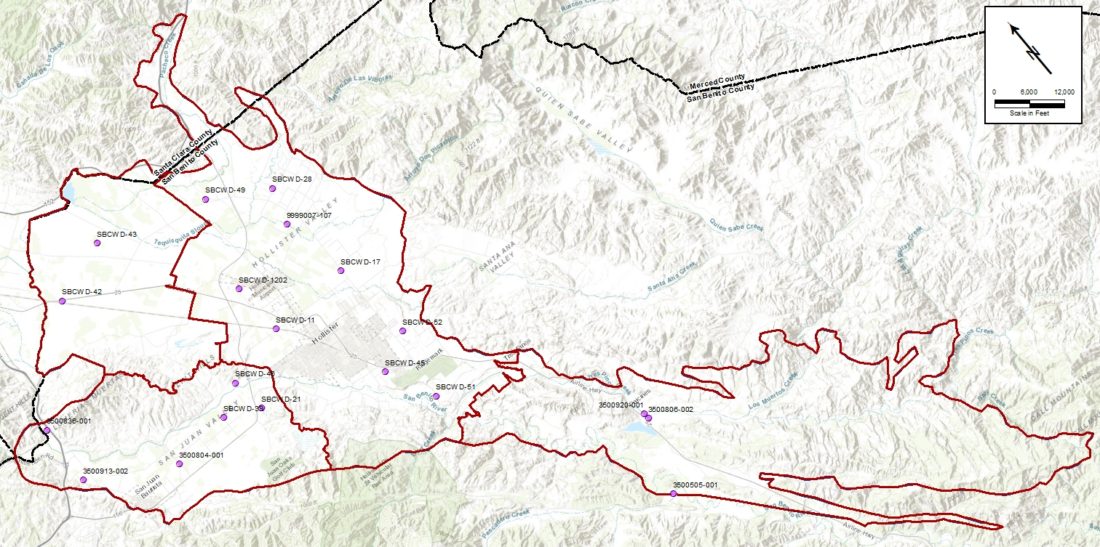
Update on sustainability criteria: groundwater quality
Identifying possible key wells for TDS and nitrate
Reviewing time-concentration graphs
Considering minimum thresholds and management objectives

Slide 25
Consider sustainability criteria for TDS
Consider this:
Minimum threshold = do better than historical high?
Management objective = established Basin Plan objective for TDS?

Slide 26
Consider sustainability criteria for nitrate
Consider this:
Minimum threshold = do better than historical high?
Management objective = Basin Plan objective for nitrate?
DRAFT for discussion purposes only

Slide 27
Sustainability criteria: nitrate
Consider this:
Management objective = Basin Plan objective?
Minimum threshold = drinking water standard?
  GSA role?
  Continue monitoring/reporting
  Cooperate with state agencies
  Work with local water and wastewater agencies and with County
Basin Plan Objective

Slide 28
Data gaps, monitoring, and management
Data gaps identified in Dec 2018 Data Memo and in draft GSP sections
Addressing sustainability criteria will:
  reveal more data needs
  indicate associated management actions:
    In-lieu recharge and managed aquifer recharge (MAR)
    Water demand management / conservation
    Management of well distribution and/or pumping
DWR Planning Grant Round 3 applications due by Nov 1 2019
Ideas for monitoring and management actions + projects are welcome!

Slide 29
Update on Outreach
Website
  Updated website shows new North San Benito Basin
  Uploaded Introduction and Plan Area
  Uploaded HCM and GW Conditions
  School presentations
  County fair

Slide 30
GSP Overview, Workshops, and
TAC Meetings
2021
Plan Development
Adoption hearing
Draft GSP workshop
Management Actions / Monitoring
2020
Implementation workshop
Sustainability Criteria
Actions workshop
Criteria workshop
Management Areas / Water Budgets
2019
Water budget workshop
TBA Nov 2019
Hydrogeologic Conceptual Model / Groundwater
HCM-GW Conditions
workshop #2 June 18 2019
Data Compilation / Data
Management System
Kickoff workshop Nov 7 2018
2018
Plan Area / Institutional Setting

Slide 31
Next Steps
TAC Meeting No. 6 Water Budget | October 30, 2019
SBCWD Board of Director’s Meeting | November 20, 2019
Workshop No. 2 Water Budget | TBA November 2019

