Slide 1
Technical Advisory Committee
San Benito County Water District
Groundwater Sustainability Agency
February 24, 2020

Slide 2
Agenda
Setting Sustainability Criteria: Water Quality
Next steps

Slide 3
What is the objective?
To quantify sustainability criteria that help guide good management without setting off false alarms or triggering costly, ineffective, or harmful management actions.
How have we proceeded?
  Open discussion of requirements in light of uncertainties
In-depth identification of data gaps and the means to fill them
Commitment to adaptive management

Slide 4
GSA responsibilities
Groundwater management/use without causing undesirable results-water quality degradation
Required to address significant and unreasonable effects caused by groundwater conditions throughout the basin
Will cooperate with regulators and avoid management actions that spread contamination
Not required to address undesirable results that occurred before 2015
Not responsible for local problems or degradation caused by others
No mandate or authority to duplicate role of regulatory agencies, e.g., RWQCB

Slide 5
GSA responsibility to use best available data
Recap: District Monitoring Program
Sampled to track trends, detect exceedances, support analysis of causes
About 29 wells, including the nested well
Wells in general are regionally representative and show historical trends
Some wells track local problems and have highly variable data
Supports management actions:
  Investigate samples/wells with significant increase or trend
  Identify potential cause(s) of problem (if possible)
  Initiate outreach and cooperate with appropriate regulatory agency
As monitoring needs change, District Program represents the focus of GSP monitoring improvements

Slide 6
GSA responsibility to use best available data
Recap: Triennial Update data set
Larger data set from multiple agencies compiled on triennial basis
Set of sampled wells varies over time, but more sites and widely distributed
Provides a snapshot and overview of TDS and nitrate
Constituent | Number of Wells with Nitrate or TDS Data, 2015-2017
 | Southern MA | Hollister MA | San Juan MA | Bolsa MA | Total
Nitrate (as NO3) | 19 | 121 | 81 | 35 | 256
Total Dissolved Solids | 11 | 108 | 63 | 31 | 213

Slide 7
Background (1)
General mineral quality is naturally poor
Salt and nitrate loading has occurred for decades due to human activities
Groundwater is used for agriculture, municipal, rural, and environmental beneficial uses
There has been historical and ongoing groundwater use with reasonable accommodation by users
Accordingly, current conditions are considered sustainable.

Slide 8
Background (2)
Data gaps exist in terms of wells being sampled, geographic distribution of constituents, and vertical distribution and migration of constituents
  Monitoring program improvements are planned to reduce uncertainty
Legacy loading means:
  Quality could get worse despite improved practices now
  Short-term monitoring data reflect past practices
  Sustainability criteria based on such data must be viewed in context
  Management actions will make a real difference in the long term

Slide 9
Monitoring and management actions
  Increase CVP percolation
  Managed Aquifer Recharge of local surface water
  Maintain groundwater outflow
  Prepare and implement SWRP Storm Water Resource Plan
  Continue SNMP and ILRP
  Cooperate with County on OWTS and wastewater treatment/disposal
  Continue and expand water softener conversion to cartridge type
  Work with UC Extension on measures to reduce loading
  Improve monitoring program

Slide 10
Minimum Threshold (MT) for water quality
Numeric value used to define significant and unreasonable degraded water quality throughout the basin
MT required here because there is potential for degradation (and California has a non-degradation policy)
In setting MTs for degraded water quality, GSAs shall consider local, state, and federal water quality standards applicable to the basin.

Slide 11
Setting MTs for quality answers questions:
What is the issue?
At what level is it significant and unreasonable?
MT defines the concentration of constituents at which potential undesirable results are determined by the GSA to a concern for the basin.
Per GSP Regulations, MT must be based on a:
  location of an isocontour, or
  volume of water, or
  number of supply wells
Where and when?

Slide 12
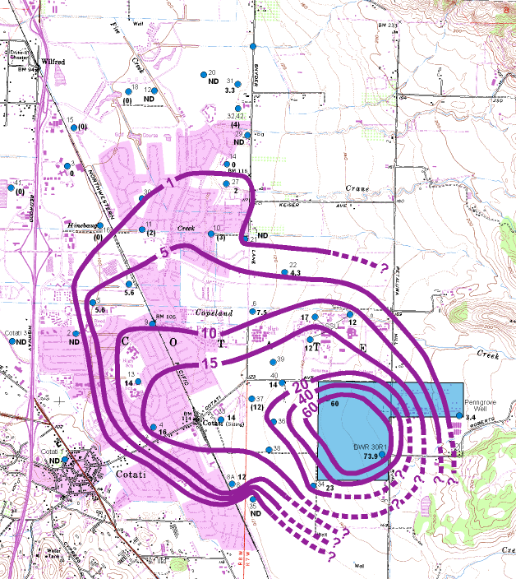
An isocontour can be the basis for a MT
Line of equal concentration in groundwater is most useful where:
Quality degradation has a specific source and extent
Data are sufficient for contouring
Historical example: nitrate plume from septic tank failures (now replaced with sewer system)
Not appropriate for North San Benito regional loading and current data

Slide 13
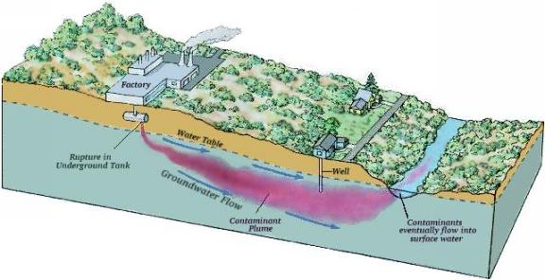
A volume of water can be the basis for a MT
A volume is useful where data are available to characterize constituent concentrations geographically and vertically
Contaminant plumes
Not appropriate for North San Benito regional loading and current data
www.earthsci.org

Slide 14
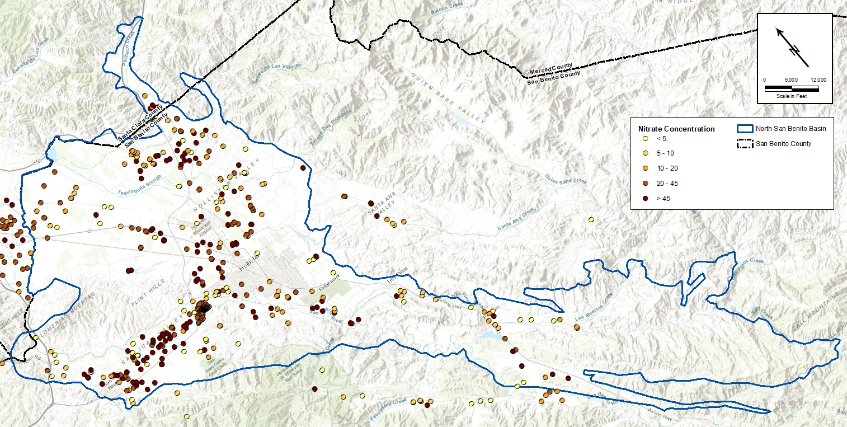
A number of wells can be the basis for a MT
A number of water supply wells is most useful where:
Quality degradation is regional and diffuse
Data are limited
The question is: how many supply wells are affected?
Most appropriate for North San Benito regional loading and current data

Slide 15
Setting MTs: what concentration?
Parameter | Units | Municipal | Ag
TDS | mg/L | 500/1,000/1,500 | 450
Nitrate (as NO3) | mg/L | 45 | 100
RWQCB General Basin Plan Objectives
Basin-Specific Basin Plan Objectives
Parameter | Units | Hollister (Bolsa and San Juan) | Tres Pinos (now in Southern MA)
TDS | mg/L | 1,200 | 1,000
Nitrate (as NO₃) | mg/L | 22.5 | 22.5

Slide 16
Setting MTs: how many wells?
Starting point: triennial update data set for 2015-2017
Not a monitoring program designed by SBCWD
Not representative of conditions throughout the basin
geographic distribution of wells is uneven
information from shallow and deep wells are combined
Computation of a representative value for each well:
wells with one sample, the single value
wells with two samples, the average value
wells with three or more values, the median value

Slide 17
Approach to MTs
Honor the goal to protect water quality and the non-degradation policy
Refer to numeric basin plan objectives
Quantify current conditions based on available data
Recognize data gaps and uncertainties and
Respond with GSP implementation:
  monitoring program improvements including investigation of nitrate and salt loading under current conditions
  management actions that will reduce nitrate and salt loading in the long run
GSP will be updated and adapted and MTs will be revisited

Slide 18
What is significant and unreasonable? How many wells?
The Minimum Threshold for nitrate for each MA is defined initially as the percentage of wells with concentrations exceeding the nitrate MCL (45 mg/L) based on current conditions (2015-2017).
MCL and Basin Plan Objective | Percent Wells with Concentration over 45 mg/L, Current Conditions, 2015-2017
 | Bolsa MA | San Juan MA | Hollister MA | Southern MA
45 mg/L | 11% | 26% | 14% | 5%

Slide 19
What is significant and unreasonable? How many wells?
The Minimum Threshold for TDS for each MA is defined initially as the percentage of wells with concentrations exceeding the TDS value of 1,200 mg/L based on current conditions (2015-2017).
General Basin Plan Objective | Percent Wells with Concentration over 1,200 mg/L, Current Conditions, 2015-2017
 | Bolsa MA | San Juan MA | Hollister MA | Southern MA
1,200 mg/L | 26% | 45% | 24% | 27%

Slide 20
Approach to Measurable Objectives (MOs)
Define with the same metrics and monitoring data as MTs
Recognize significant uncertainties of legacy loading and data limitations
Established to maintain or improve groundwater quality
Notes:
.

Slide 21
Measurable Objectives MOs)
The Measurable Objective for nitrate is defined as maintaining or reducing the percentage of wells with concentrations exceeding the nitrate MCL (45 mg/L) based on conditions documented in the Triennial Updates.
The Measurable Objective for TDS is defined as maintaining or reducing the percentage of wells with concentrations exceeding the TDS value of 1,200 mg/L based on conditions documented in the Triennial Updates.
Notes:
.

Slide 22
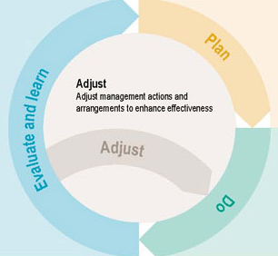

Slide 23
Next Steps
Public Workshop No. 3 Water Budget | March 24, 2020
TAC Meeting Sustainability Criteria | April 29, 2020

