Slide 1
Technical Advisory Committee
San Benito County Water District
Groundwater Sustainability Agency
August 26, 2020 2:00-4:00
Join Zoom Meeting
Zoom Meeting
https://zoom.us/j/92497853788?pwd=YnRVbU5MMWtvWWlRTkNQWXdmcjdRdz09
Meeting ID: 924 9785 3788
Passcode: 761145
Or, dial by your location: +1 669 900 9128 US (San Jose)
Meeting ID: 924 9785 3788
Password: 761145

Slide 2
Agenda
Roll call
Update on GSP Schedule and Progress
Setting Sustainability Criteria for:
  Land Subsidence
Depletion of Interconnected Surface Water
Next steps for GSP Section 6, “Sustainability Criteria”
Upcoming meetings

Slide 3
GSP Overview
2021
Plan Development
Adoption hearing
Draft GSP workshop
Management Actions / Monitoring
Round 3 Monitoring Wells
MAR
2020
Evaluate actions workshop
Sustainability Criteria
Management options workshop
TAC Meetings
Management Areas / Water Budgets
Sustainability criteria workshop
2019
Water Budget workshop Date TBA 2020
Hydrogeologic Conceptual Model / Groundwater
GW Conditions workshop June 18 2019
Data Compilation / Data
Management System
Kickoff workshop Nov 14 2018
2018
Plan Area / Institutional Setting

Slide 4
Recap: Ground surface vertical displacement from InSAR satellite
Suggests differential subsidence
Period of record is short
Changes are relatively small
Pattern is patchy
More monitoring needed for systematic analysis to identify any specific areas that might be subject to long-term subsidence

Slide 5
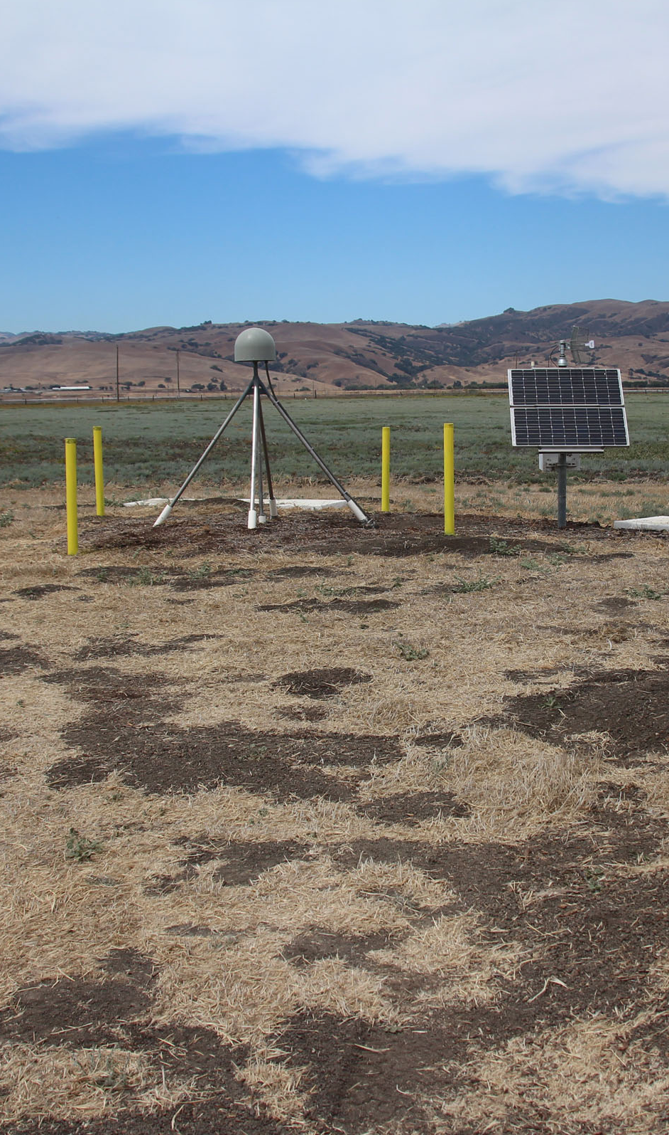
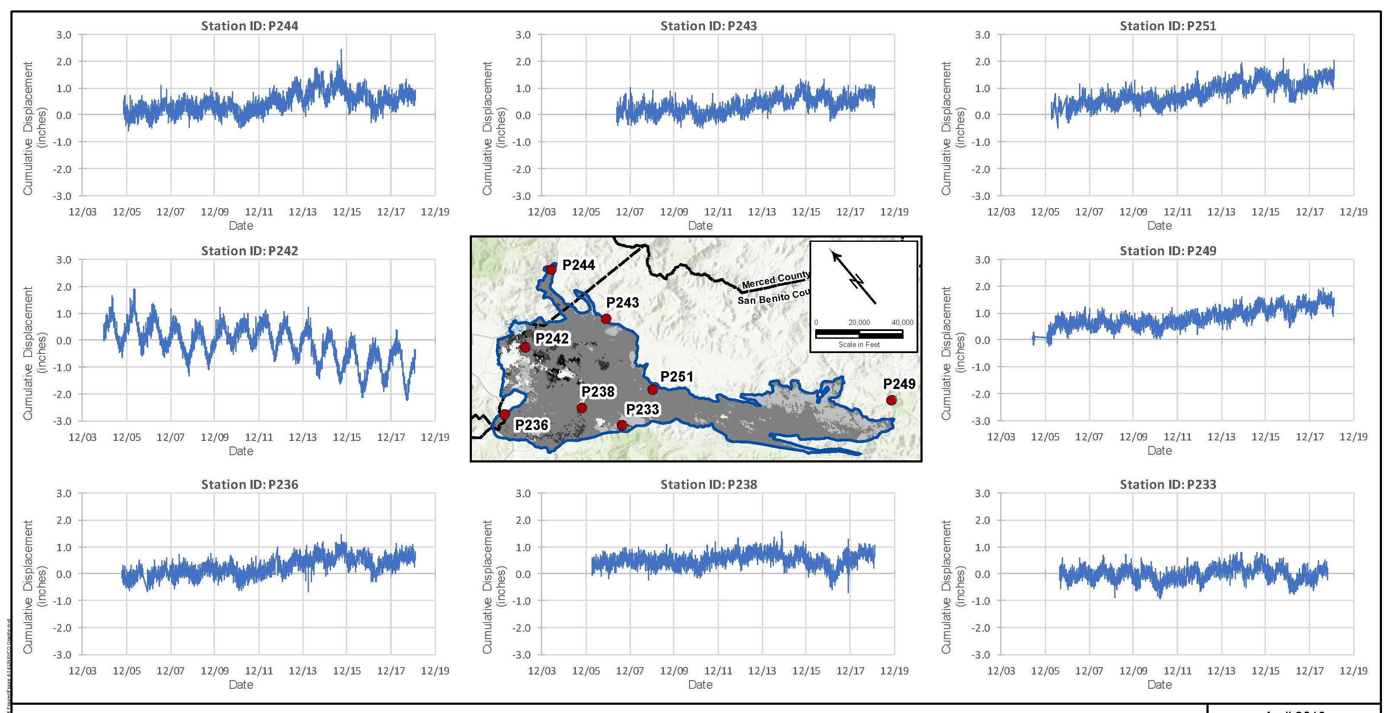
Recap: UNAVCO stations track land surface changes around North San Benito

Slide 6
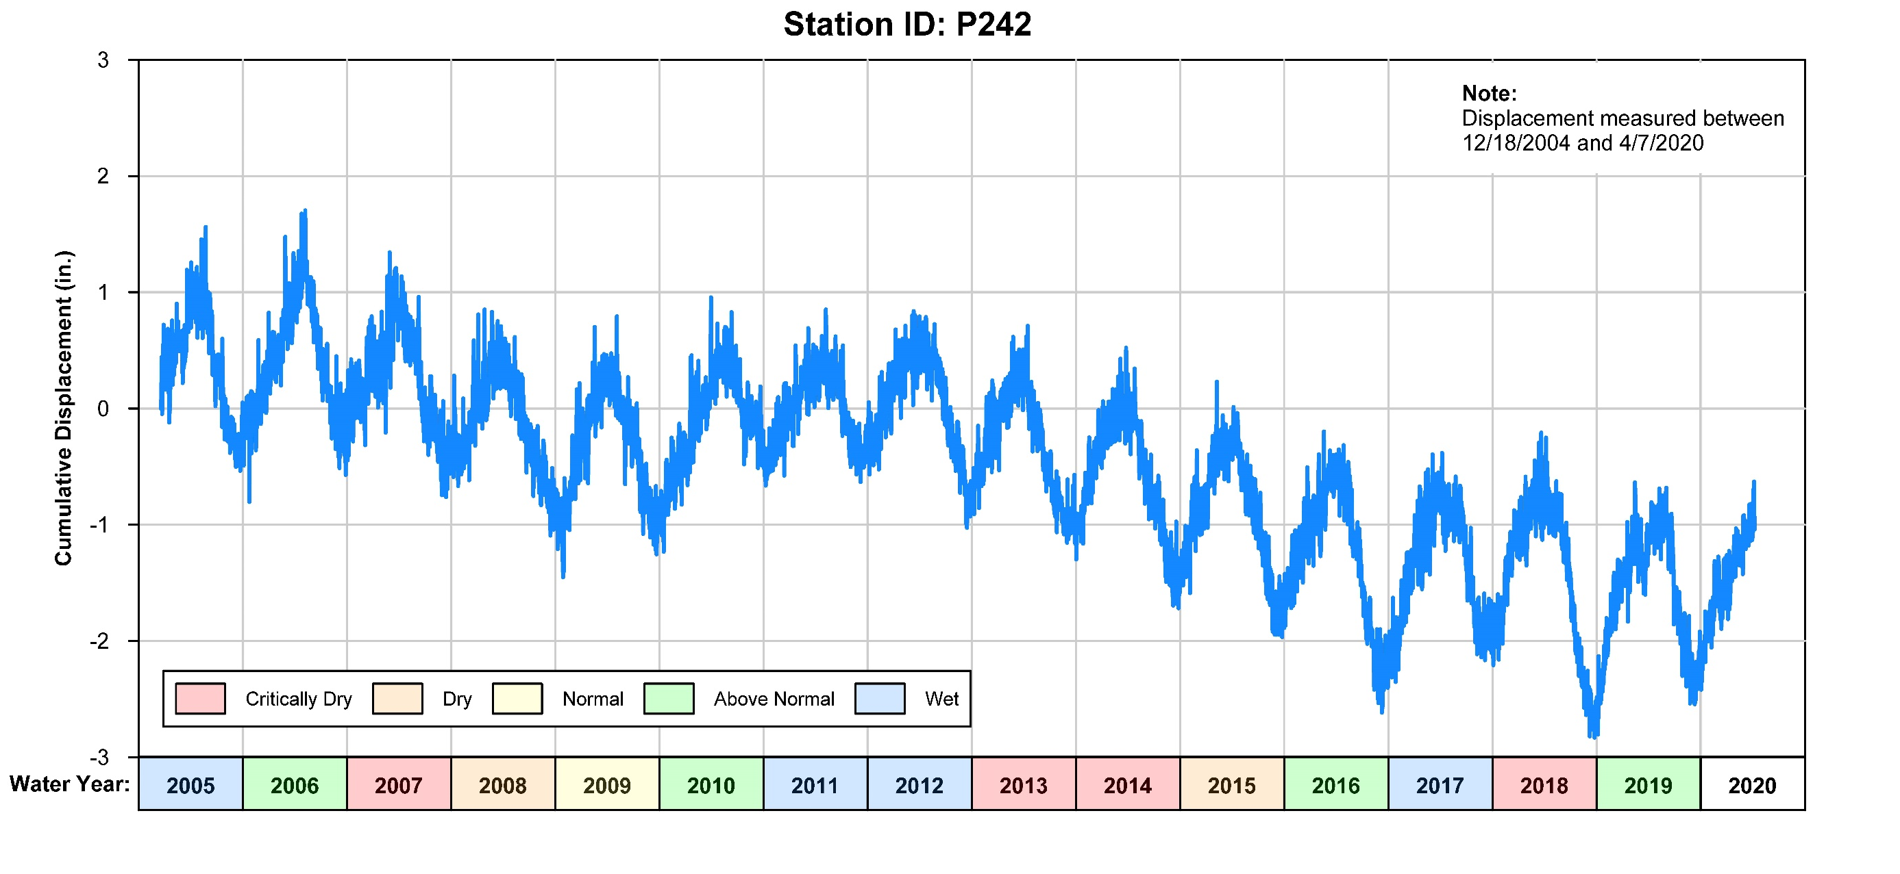
Monitoring for subsidence is needed
Seasonal elastic variability
Linked to hydrologic conditions
Long term small downward trend, about 2 inches over 15 years

Slide 7
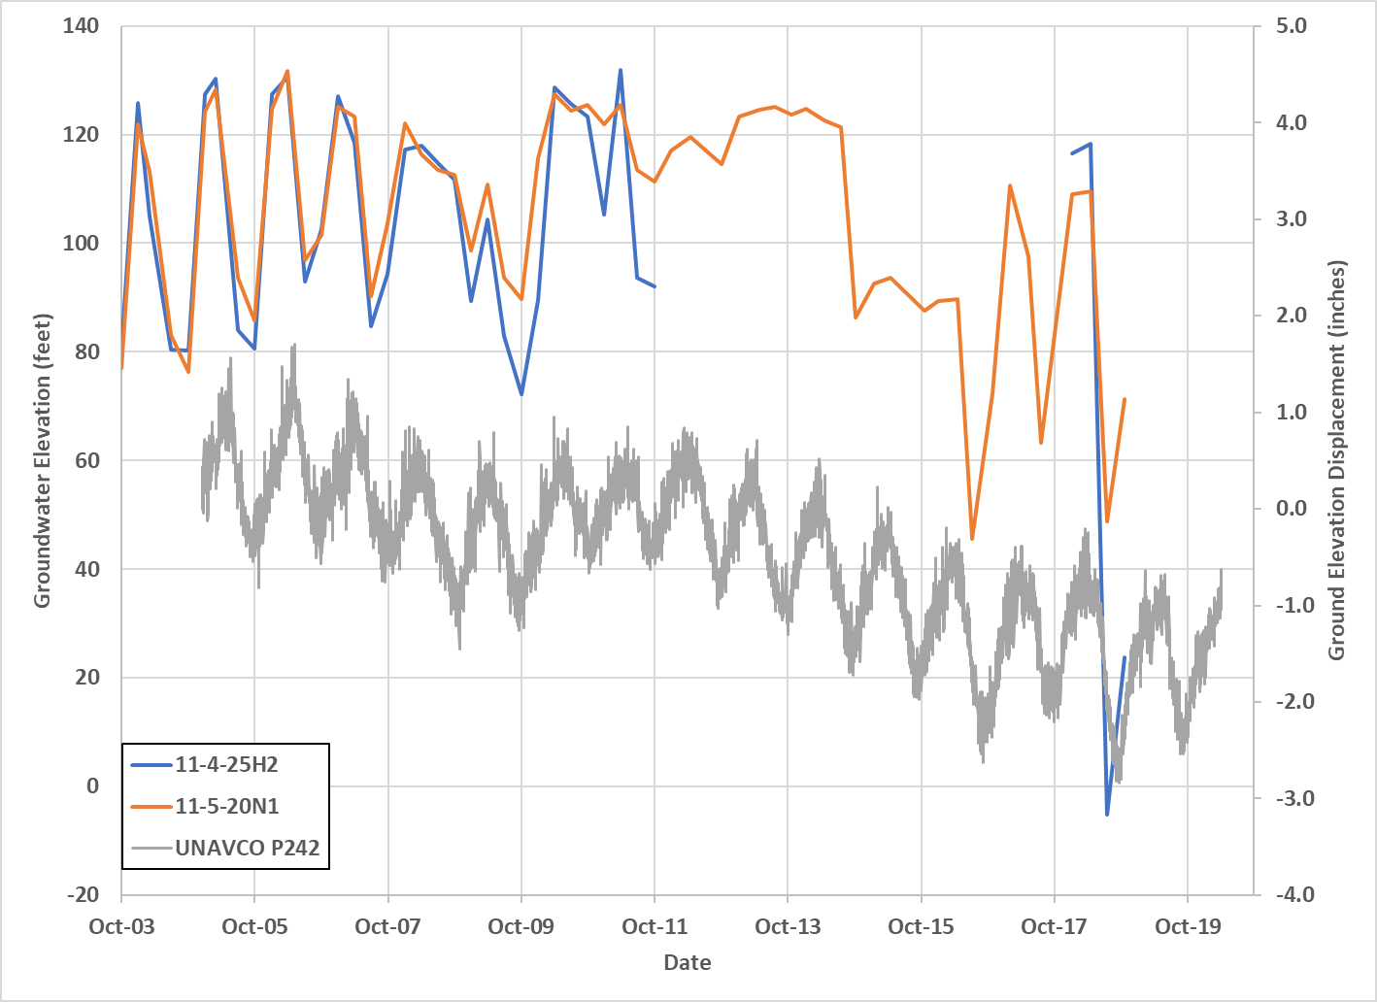
Subsidence correlated to groundwater levels
Notes:
.

Slide 8
Minimum Threshold
  The Minimum Threshold for land subsidence
  is the rate and extent that interferes with surface land use
  Rate:
    Decline of more than 2 inches in any 5-year period
    Cumulative decline of more than 1 foot since 2015 (the SGMA start date)

Slide 9
Minimum Threshold Context
  One foot of elevation change:
  Is the freeboard typically required in drainage ditches
  Is the elevation that structures must be above the 100-year floodplain
  Would spread water an additional 1,800 feet out from the shoreline of San Felipe Lake and 2,400-2,900 feet out from either side of Miller Canal and sections of the Pajaro River during a flood event

Slide 10
Analysis of InSAR information is needed to assess extent
Extent:
InSAR mapping indicates ground surface changes 2015 to 2019 from about +0.1 feet to about -0.25 feet
Error is about +/- 0.1 feet
Annual download and screening of InSAR information
Detailed analysis for Five-Year update

Slide 11
Measurable Objective
The Measurable Objective is to prevent subsidence.
Management Action
The management action is to maintain groundwater levels above historical lows; this should be achieved with the groundwater level Minimum Thresholds

Slide 12
Interconnected Surface Water and Groundwater Dependent Ecosystems (GDEs)

Slide 13
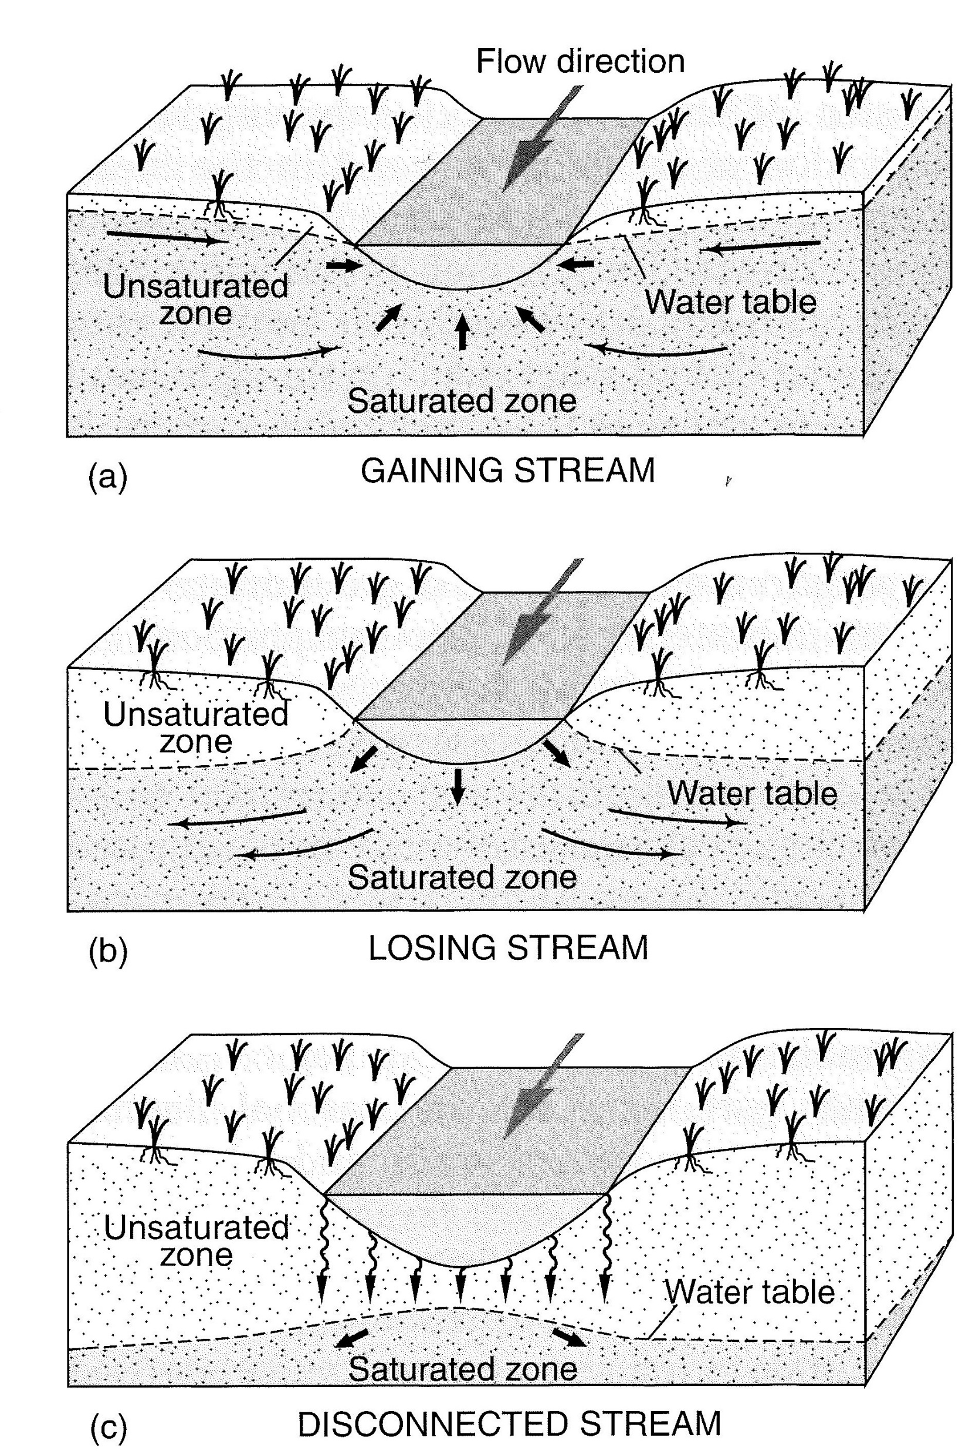
Where is groundwater coupled to surface water?
Hydraulically
Coupled
These are the textbook concepts, but how can you tell in practice?
Decoupled

Slide 14
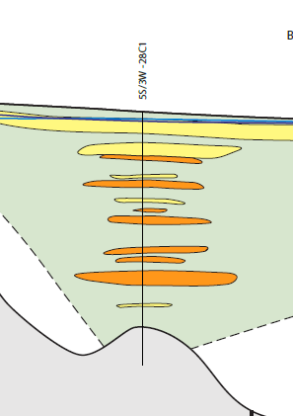

Well Water Levels are NOT the Water Table
Vertical and horizontal water-level gradients are common near streams.
DATA GAP: shallow monitoring wells in riparian areas are rare
Notes:
.

Slide 15
Surface Water Depletion Impacts
Downstream Flow and Water Rights
GDEs
Seasonal Streams and Rivers
Off-Channel Wetlands
Plants
(riparian vegetation)
Animals
(fish, amphibians)
Water Temperature
Passage Flows

Slide 16
Downstream Water Users: PVWMA
No significant impact on PVWMA supplies because:
No plan to increase San Benito pumping
San Benito needs outflow to maintain basin salt balance
No impact of flow reduction when Pajaro River flows to the ocean.
PVWMA planning studies do not place emphasis on Pajaro River flows.

Slide 17
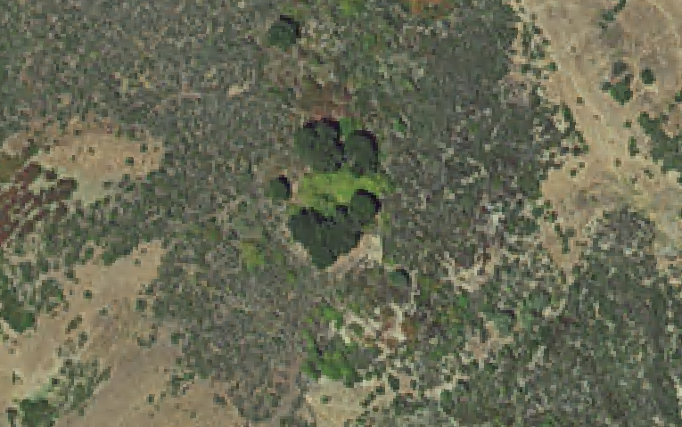
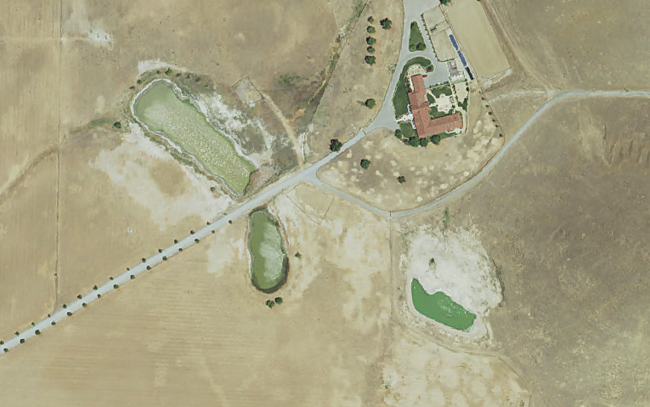
Off-Channel Wetlands
This looks like a spring
Nature Conservancy NCCAG map
Many “wetlands” are not natural or not plausibly affected by pumping.
These look like stock ponds and have low habitat value

Slide 18
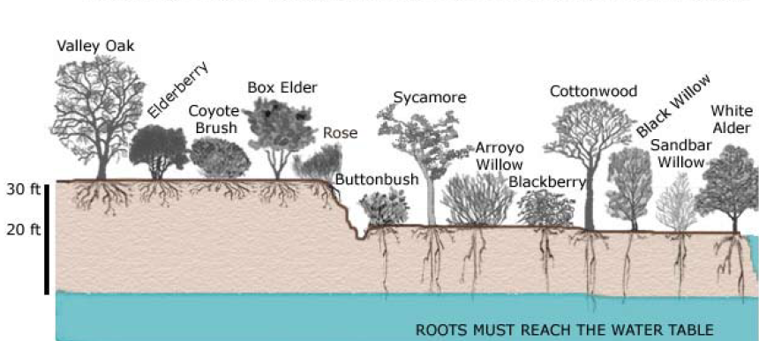

Riparian Vegetation Impacts
For Stream Flow Depletion:
Stream Bed Elevation
For Riparian Vegetation:
About 20 feet

Slide 19
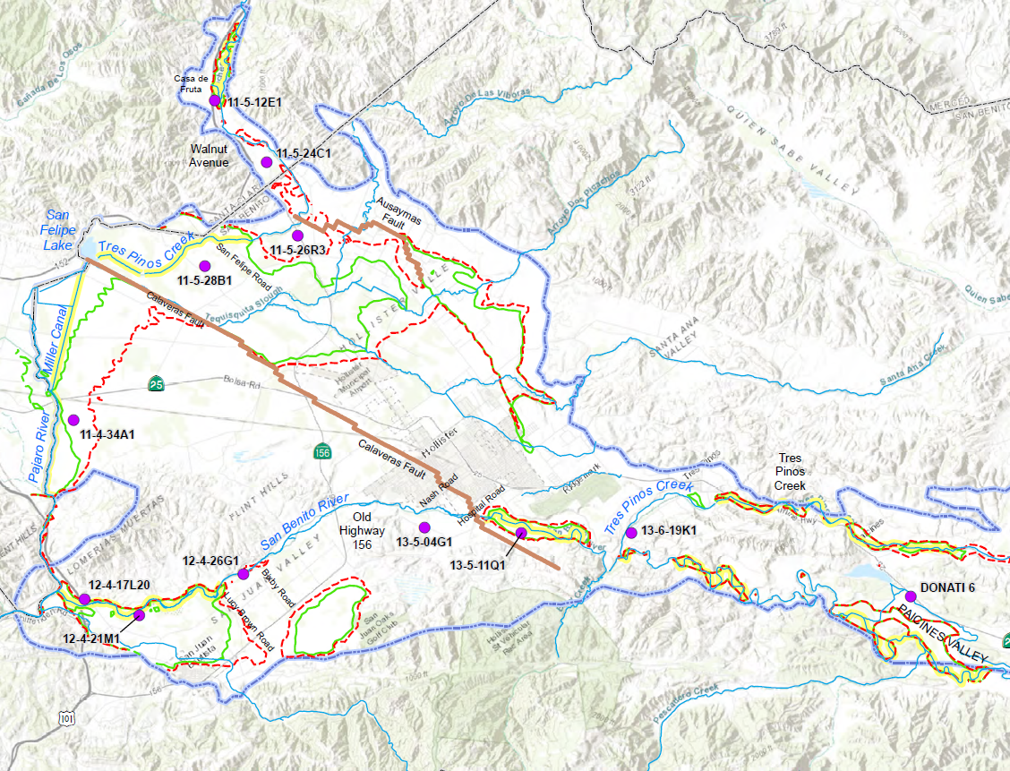
Depth to Water <20 Feet in 1992 and 1998
October 1992
(end of drought)
April 1998
(end of wet period)

Slide 20
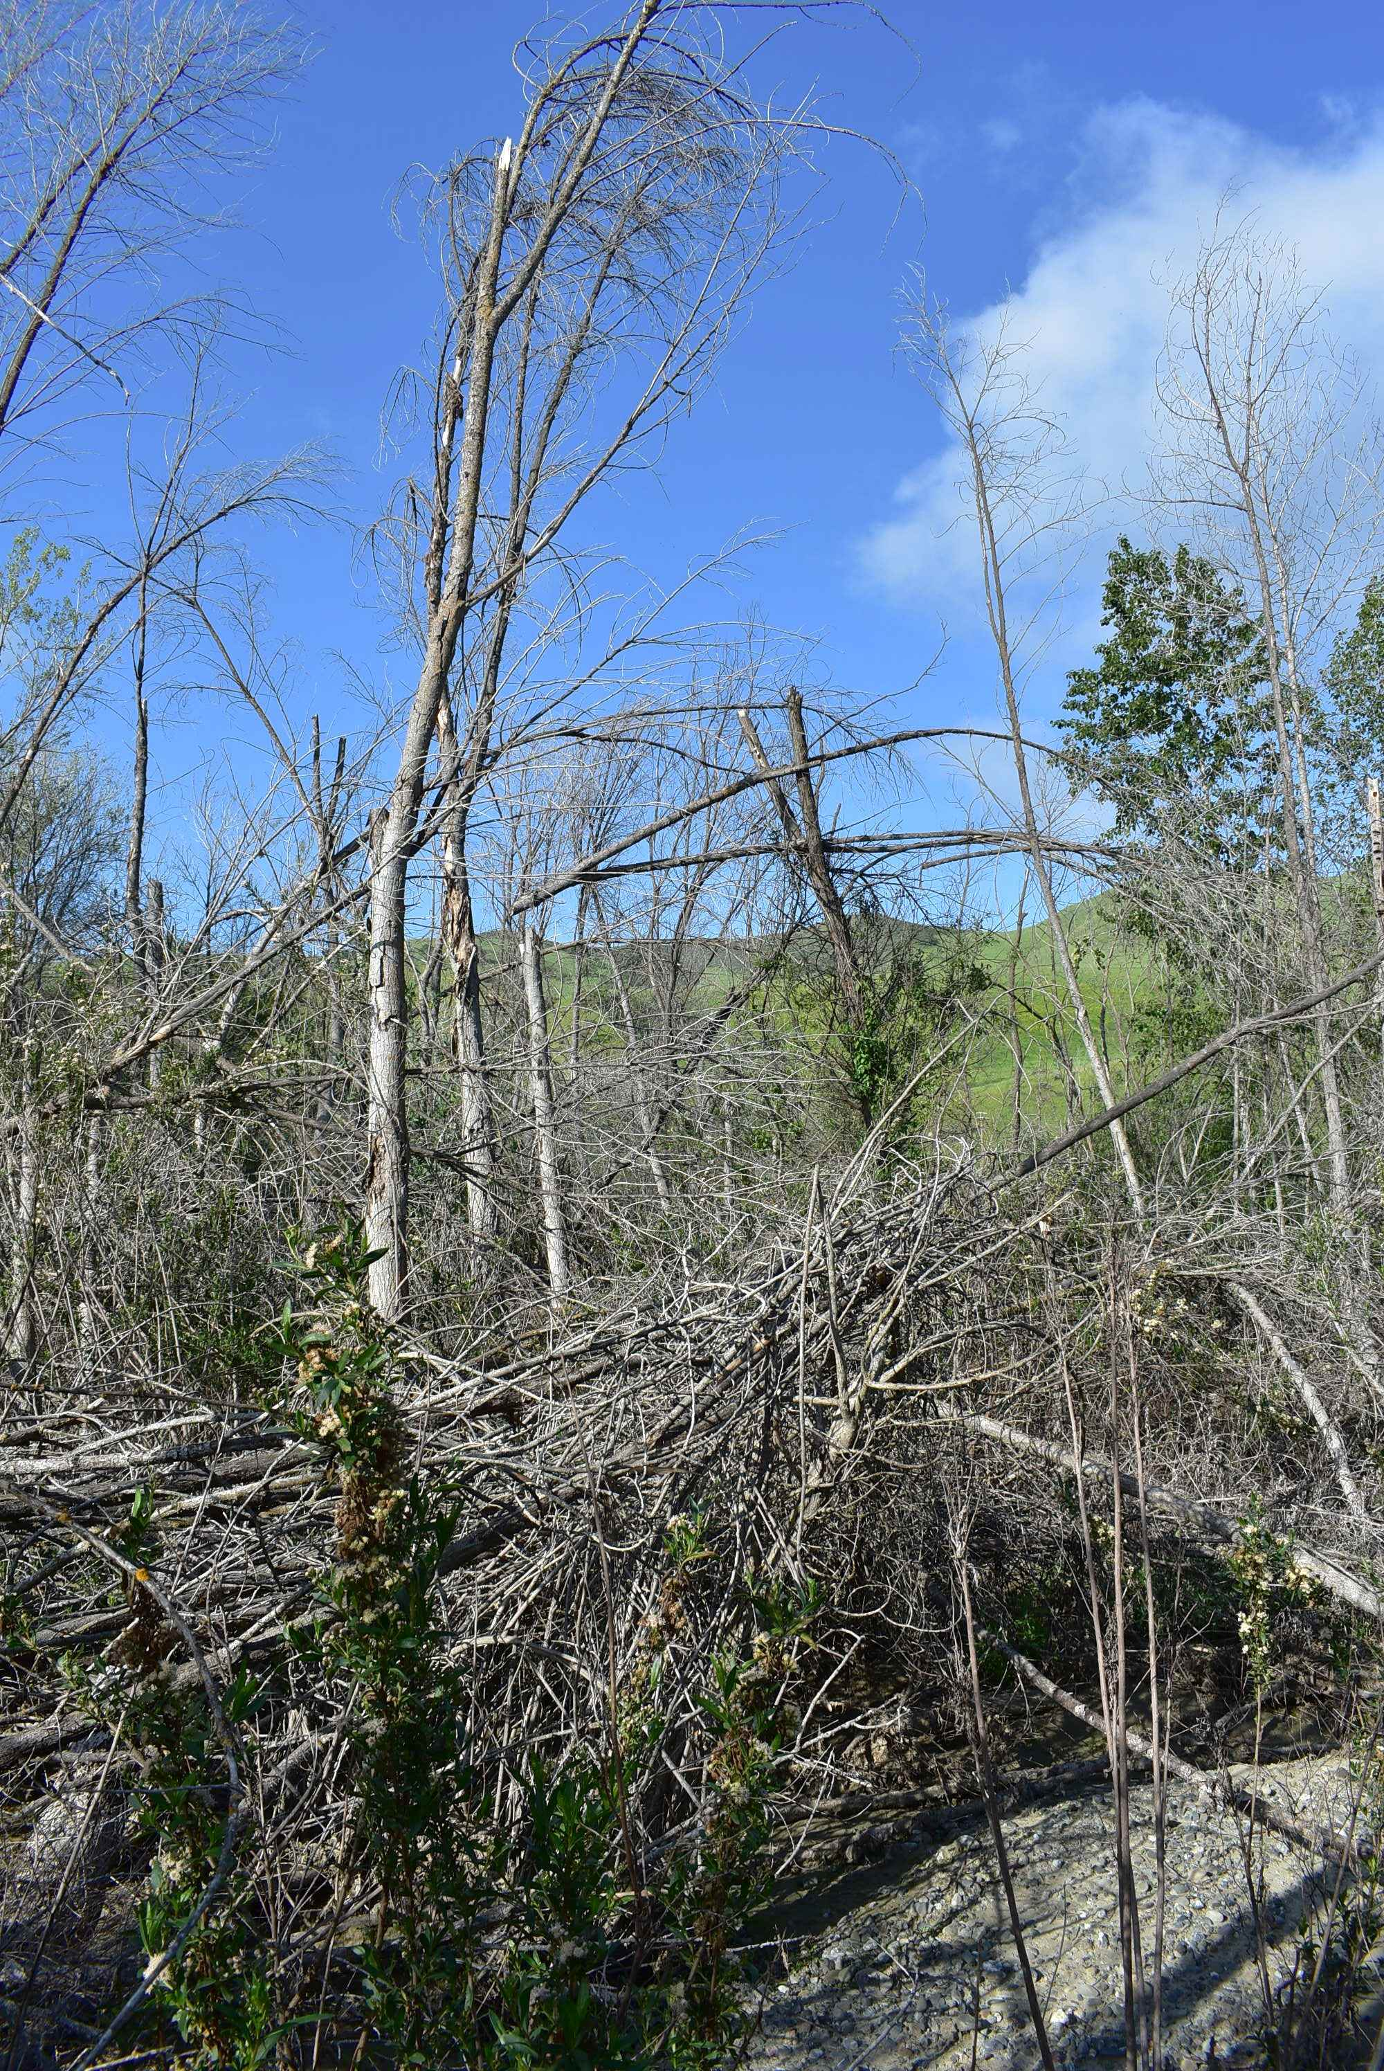
The One Location where Tree Mortality was Found
Tres Pinos Creek
Photo taken April 2019
New nearby well a possible contributing factor

Slide 21
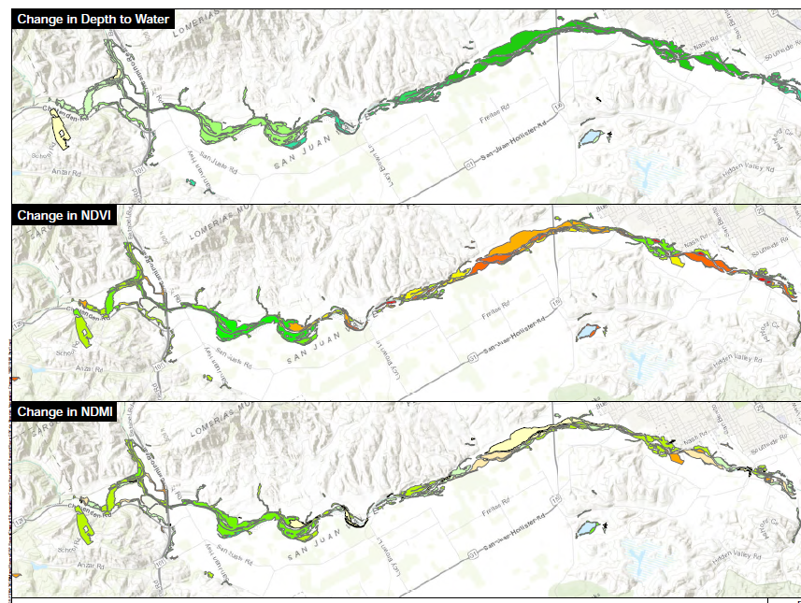
Little or No Observed Correlation between Water Levels and Vegetation Health
N

Slide 22
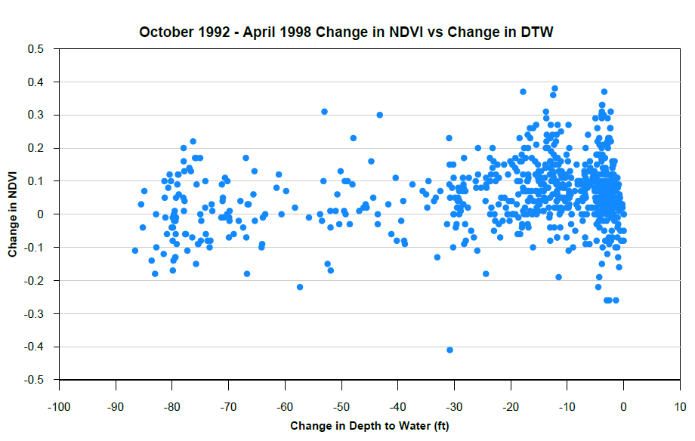
Little or No Observed Correlation between Water Levels and Vegetation Health

Slide 23
Impacts on Animals
Focus on species of concern:
Tiger salamander
Red-legged frog
Birds
Steelhead trout--passage

Slide 24
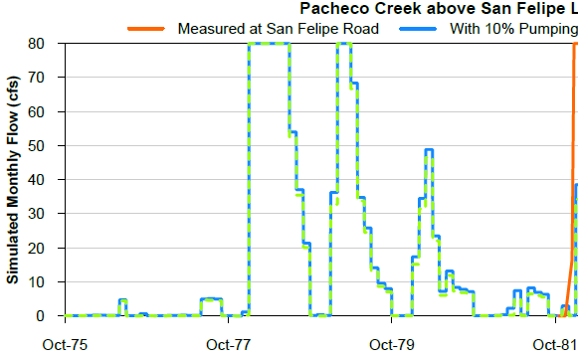
Effects of Pumping on Pacheco Creek Flow
Hypothetical 10% change in basin-wide pumping
Simulated flow in Pacheco Creek above San Felipe Lake

Slide 25
Steelhead Passage Opportunity: San Benito River
Flow profile for June 1994
6 cfs difference in flow, but still dry near Lucy Brown Lane

Slide 26
Definition of Minimum Threshold
The Minimum Threshold for depletion of interconnected surface water is the amount of depletion associated with the lowest water levels during the 1987-1992 drought

Slide 27
Definition of Minimum Threshold, continued
Undesirable results if >25% of wells within 1 mile of a riparian reach have a static spring water level lower than lowest spring water level during 1987-1992.

Slide 28
Measurable Objective
The Measurable Objective is an amount of depletion that is less than the amount specified as the minimum threshold.

Slide 29
Future Baseline Simulation: Is Threshold Likely to be Exceeded?
Only three of the 19 GDE compliance wells have simulated future baseline levels close to the MT:
Two where levels are fairly constant (Paicines Valley and west end of San Juan Valley)
One where future water levels similar to historical (near Casa de Fruta)

Slide 30
Management Actions if Threshold is Exceeded
Recommended for consideration:
Conservation easements to reduce ag pumping near critical riffle along San Benito River
Decrease pumping near critical riffle along Pacheco Creek when flow recedes past minimum passage flow

Slide 31
Actions not Recommended at this Time
Reoperate Hernandez Reservoir to increase releases in drought years
Preferentially deliver CVP water to parcels near riparian areas during droughts
Eradicate invasive vegetation
Irrigate riparian vegetation that is on the verge of dying
Groundwater recharge projects with habitat benefit in addition to water supply benefit

Slide 32
Next Steps
Administrative Draft Section 6 will be sent to you for review and comment
We respond to comments, edit Admin Draft, prepare public Draft
Topics for Next TAC meeting
  Monitoring Network
  Projects and Management Actions

Slide 33
Stay tuned
SBCWD Board of Director’s Meeting | August 26, 2020 5:00pm
Next TAC Meeting: Monitoring, Projects and Management Actions | September ? 2020
Public Workshop No. 3 Water Budget | TBA September 2020

