Slide 1
Community Workshop
San Benito County Water District
Groundwater Sustainability Agency
September 23, 2020

Slide 2
Update:
Sustainable Groundwater Management for North San Benito Groundwater Basin
Sustainable Groundwater Management Act (SGMA)
Landmark legislation in 2014- based on local control
Includes comprehensive requirements for:
  Forming a groundwater sustainability agency (GSA)
  Preparing a groundwater sustainability plan (GSP)
  Meeting deadlines

Slide 3
SGMA and the GSP Process
Today
2040/2042
Achieve and demonstrate sustainability
June 2017: GSAs formed
June 2018: GSP started
January 2022: GSP completion

Slide 4
Where are we now in GSP process?
Introduction chapter starts the GSP
Plan Area introduces the Basin and its management
Hydrogeologic Conceptual Model establishes physical framework
Groundwater Conditions documents historical and current status
  Topics for Today
  Management areas defined
  Water budget quantified
  Sustainable yield has been defined

Slide 5
One Basin with Four Management Areas (MAs)
Why have them? This basin differs from one area to the next
MAs may have different minimum thresholds + measurable objectives
MAs may have different monitoring, projects, management actions
MAs are defined to facilitate implementation of the GSP
How defined?
Different water uses, water sources, geology, etc.

Slide 6
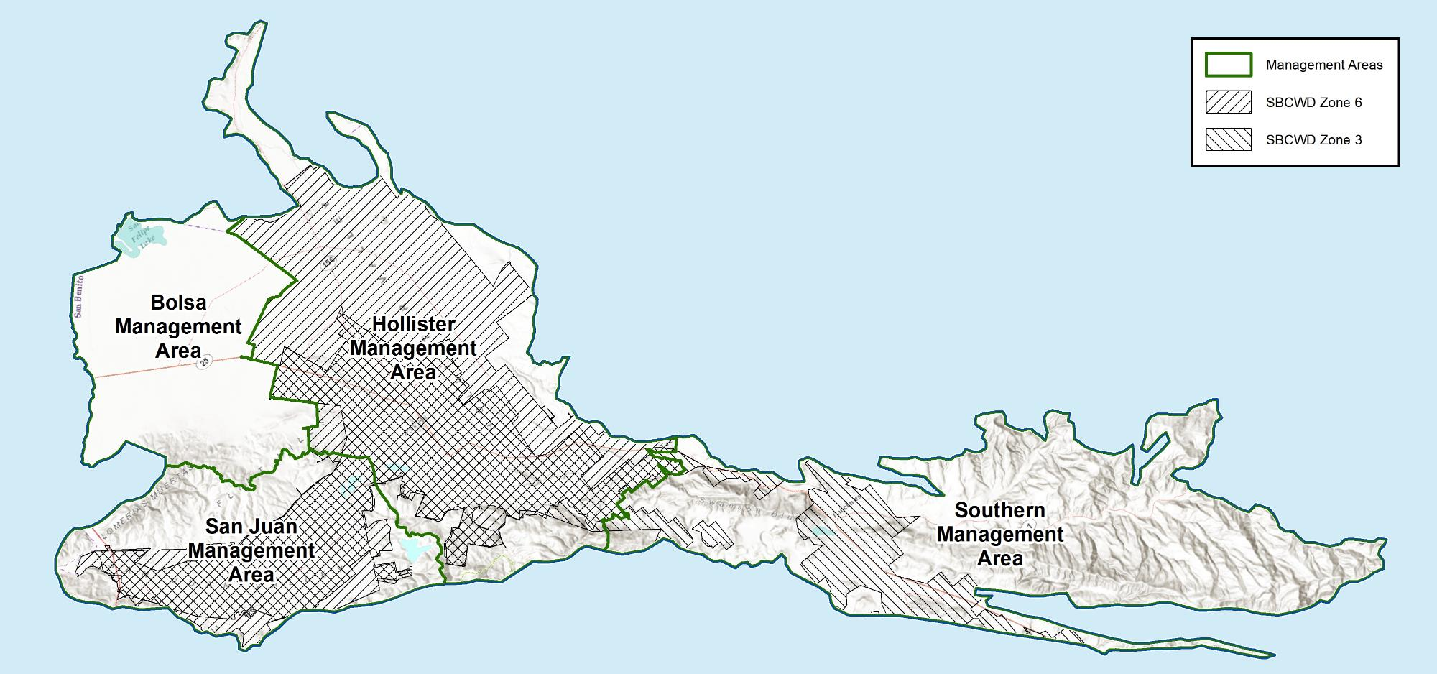
Four MAs based mostly on water supply sources
Imported Central Valley Project water in Zone 6 and in Santa Clara County
Local surface water from Hernandez and Paicines reservoirs in Zone 3

Slide 7
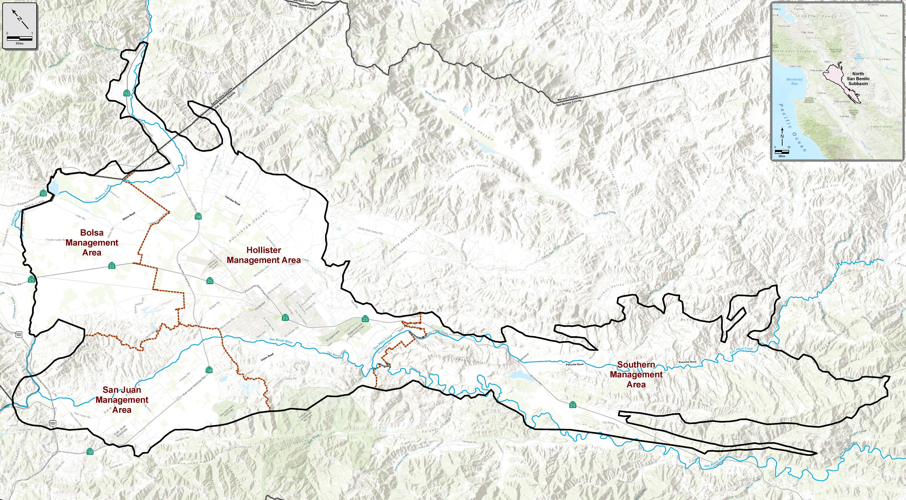
Management Areas

Slide 8
Discussion
GSP Process
Management Areas

Slide 9
What is a Water Budget?
Inflows – Outflows = Change in Storage
INFLOWS
CHANGE IN STORAGE
OUTFLOWS

Slide 10
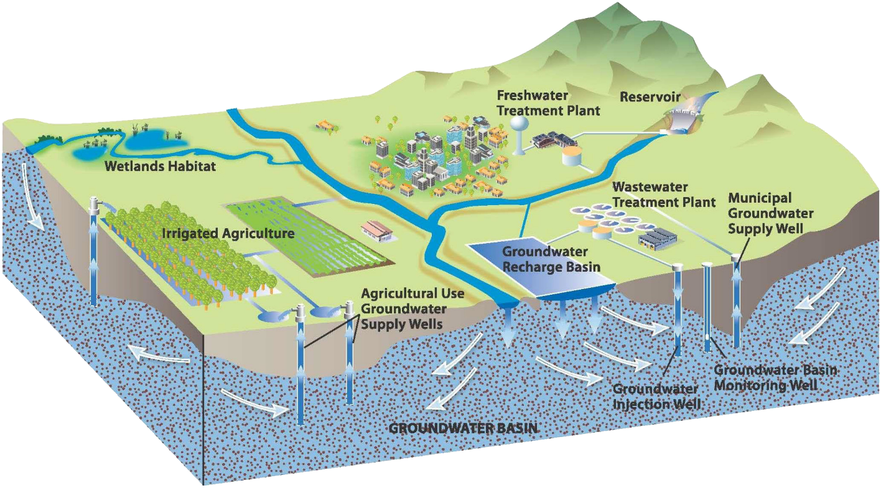
Water Budget
Addresses climate, surface water and groundwater
Quantified using linked models

Slide 11
Linked Water Budget Components
Rainfall-Runoff-Recharge Model
Surface Water Model
Groundwater Model

Slide 12
Why Use Models?
Incorporate all available data
Produce estimates of unmeasured variables
Enforce consistency among variables
Quantify uncertainty
Simulate alternatives

Slide 13
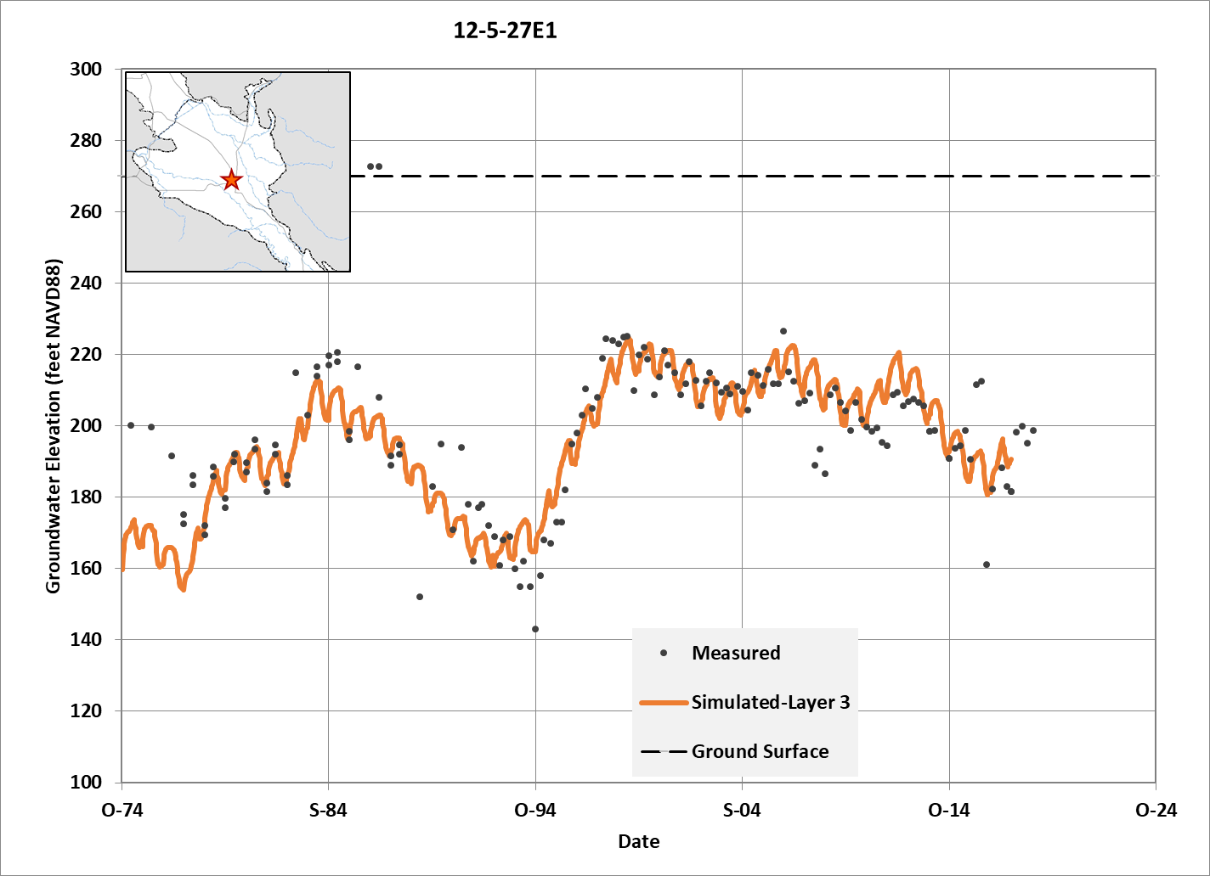
Simulates Groundwater Levels
Computed monthly
Calibrated to measured levels in wells
Applied to historical, current and future conditions:
  Pre-CVP historical (1975-1988)
  Historical–recovery (1997-2014)
  Current (2015-2017)
  Future (next 50 years)

Slide 14
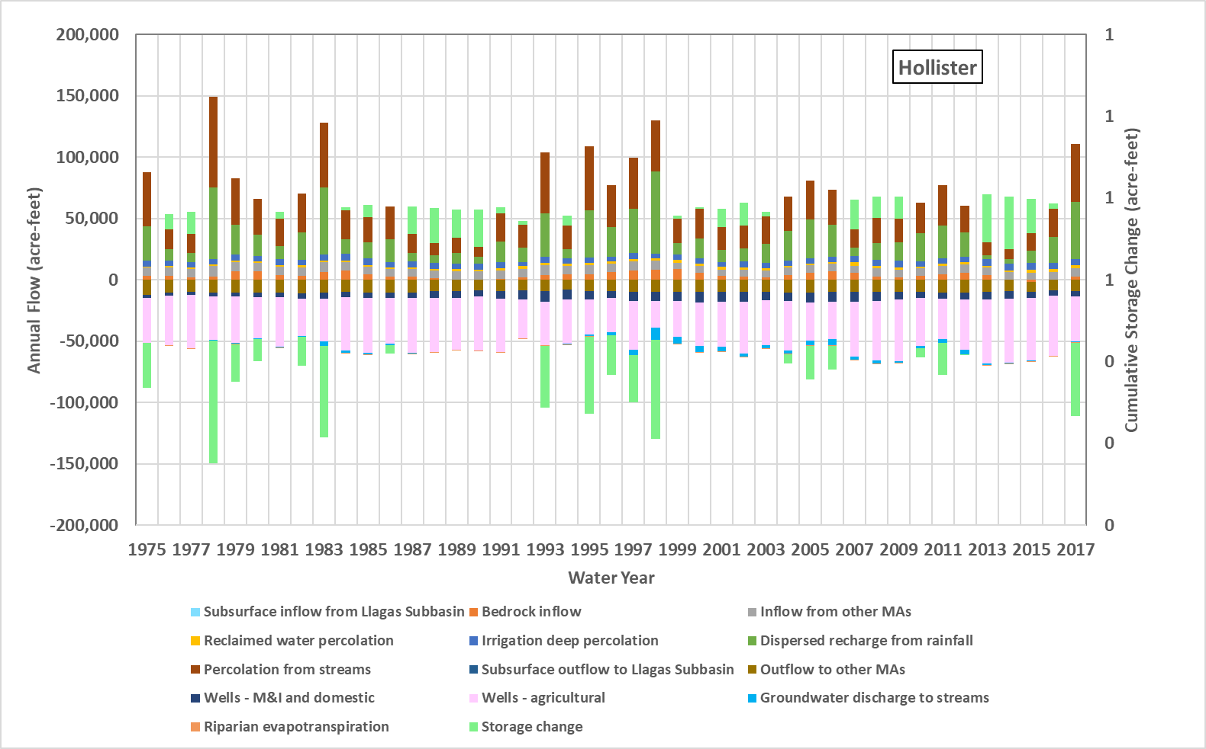
Simulates Groundwater Budgets
Surface water and groundwater
Four management areas
Four time periods analyzed
  Pre-CVP historical (1975-1988)
  Historical–recovery (1997-2014)
  Current (2015-2017)
  Future (next 50 years)

Slide 15
Sustainable Yield
Sustainable yield is not a fixed, inherent characteristic of the Basin.
It is affected by land use, water and wastewater management, imported water, and even locations of wells with respect to streams.
For planning purposes, a “forward looking” estimate of sustainable yield based on the future baseline simulation is most useful.
  Yield = simulated pumping + simulated net storage change
  Net storage change ≈ zero, so yield = pumping

Slide 16
Sustainable Yield Estimate
Caveat: sustainable yield can be constrained by the occurrence of undesirable results, separate from this water balance approach!

Slide 17
Discussion
Water Budget
Sustainable Yield

Slide 18






What is sustainable management?
The management and use of groundwater in a manner that can be maintained without causing undesirable results:
Groundwater levels
Groundwater storage
Seawater intrusion: Not applicable here!
Water quality
Land subsidence
Depletion of connected surface water

Slide 19
Sustainability Criteria
Undesirable results
  What are undesirable results that we want to avoid?
Minimum thresholds
  e.g. How low is too low for water levels?
Measurable objectives
  e.g. What is the desired range of water levels?

Slide 20
Groundwater Levels
Background:
  Hollister and San Juan MAs: water levels rose following start of CVP imports in early 1990s
  All MAs: water levels decline during droughts and recover afterwards
Objective:
  Avoid widespread loss of well output during droughts

Slide 21
Groundwater Level Minimum Threshold
Minimum threshold = lowest historical water level
Adjust upward where historical overdraft caused excessively low water levels (to protect relatively shallow wells)
Select Key Wells for comparing against threshold
Undesirable if water levels below MT in two consecutive years
Undesirable if two-thirds or more of the Key Wells in each Management Area are below the MT

Slide 22
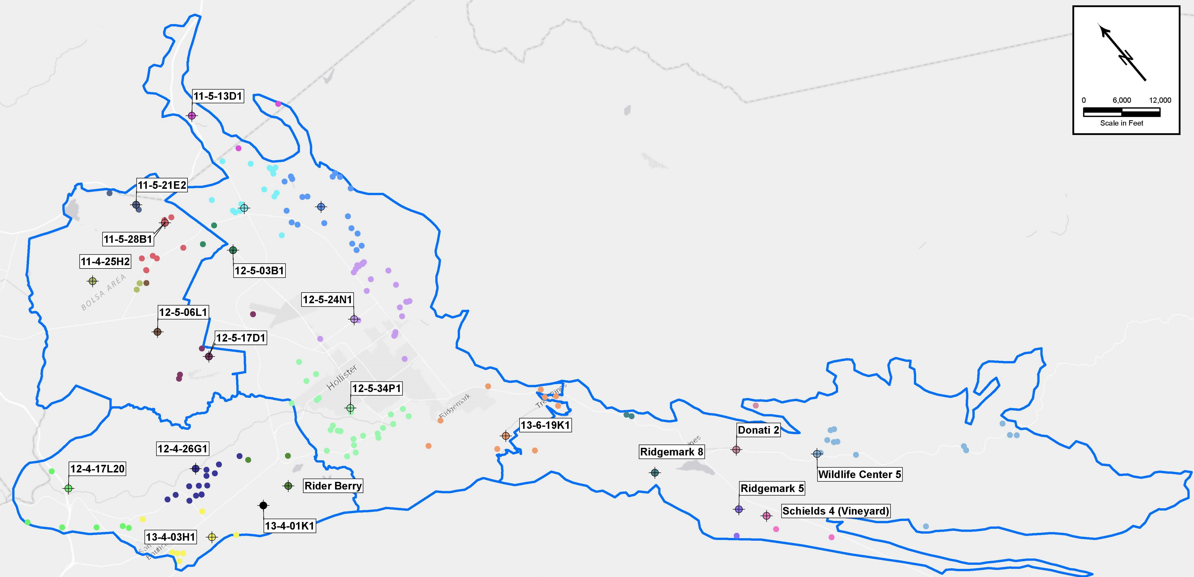
Key Wells as representative monitoring sites
22 Key Wells (identified)
Long, complete, reliable record
Recently monitored
Geographically distributed but gaps persist
More dedicated monitoring wells to be drilled
12-6-06L4
169 Existing Supply Wells (colored dots)
May not have existed when historical lows occurred
Not all wells; those digitized with location and construction data
Assigned to nearest Key Well regardless of Management Area
11-5-35G1

Slide 23
Minimum Threshold and Measurable Objective
Minimum Threshold: historical low level at Key Well adjusted upward
Measurable Objective: maintain levels in the historical operating range

Slide 24
Groundwater Storage
Objective:
Provide reliable storage for water supply resilience during drought
Approach:
Use the numerical model to evaluate change in groundwater storage:
How much storage has been used during past droughts?
How much will we need to withstand future droughts?

Slide 25
Groundwater storage
Findings:
Groundwater basin has provided water supply during prolonged and severe droughts (1922-1934, 1987-1990)
The amount of storage in the operating range of water levels is enough to meet demands during future droughts
The basin is sustainably managed relative to storage: no overdraft since CVP imports

Slide 26
Water Quality
Background
General mineral quality is naturally poor
Salt and nitrate loading has occurred for decades due to human activities
Beneficial uses have not yet stopped due to poor water quality (agriculture, municipal, rural, and environmental)
Accordingly, current conditions are considered sustainable.

Slide 27
Objective and GSA responsibilities
Objective: protect and improve groundwater quality
Manage groundwater without causing undesirable results-water quality degradation
Address significant and unreasonable effects that are common throughout the basin
Avoid duplication of existing programs that address pollutant discharges and site cleanup
Avoid management actions that spread localized contamination

Slide 28
Approach
Identify constituents of concern: TDS and nitrate
Refer to Regional Water Quality Control Board Basin Plan Objectives
Quantify current conditions (2015-2017) based on all available data
Recognize data gaps and uncertainties (e.g. water quality vs. depth)

Slide 29
What is significant and unreasonable? How many wells?
The Minimum Threshold for nitrate for each MA is defined initially as the percentage of wells with concentrations exceeding the nitrate MCL (45 mg/L) based on current conditions (2015-2017).
MCL and Basin Plan Objective | Percent Wells with Concentration over 45 mg/L, Current Conditions, 2015-2017
 | Bolsa MA | San Juan MA | Hollister MA | Southern MA
45 mg/L | 11% | 26% | 14% | 5%

Slide 30
What is significant and unreasonable? How many wells?
The Minimum Threshold for TDS for each MA is defined initially as the percentage of wells with concentrations exceeding the TDS value of 1,200 mg/L based on current conditions (2015-2017).
General Basin Plan Objective | Percent Wells with Concentration over 1,200 mg/L, Current Conditions, 2015-2017
 | Bolsa MA | San Juan MA | Hollister MA | Southern MA
1,200 mg/L | 26% | 45% | 24% | 27%

Slide 31
Approach
Data gaps exist in terms of wells being sampled, geographic distribution of constituents, and vertical distribution and migration of constituents
Legacy loading means:
  Quality could get worse despite improved practices now
  Short-term monitoring data reflect past practices
  Sustainability criteria based on such data must be viewed in context
Respond with GSP implementation:
  monitoring improvements including investigations of nitrate and salt loading
  management actions that will reduce nitrate and salt loading in the long run

Slide 32
Water quality management actions
Improve monitoring (data gaps)
Increase municipal use of CVP water (expanded treatment capacity)
Improve quality of recycled water (nitrate removal)
Reduce salt loading from water softeners
Existing irrigated lands regulatory program (ILRP) to reduce nitrate loading

Slide 33
Discussion
Sustainability Criteria
  Groundwater levels
  Groundwater storage
  Groundwater quality

Slide 34
Land subsidence
No undesirable results have been reported
But potential exists for undesirable results
  Reduction in drainage capacity; drainage problems
  Impacts on grade of facilities, e.g. pipelines, roads, runways
  Subsidence around a wellhead, e.g., casing collapse
  Non-recoverable loss of storage capacity in the aquifers

Slide 35
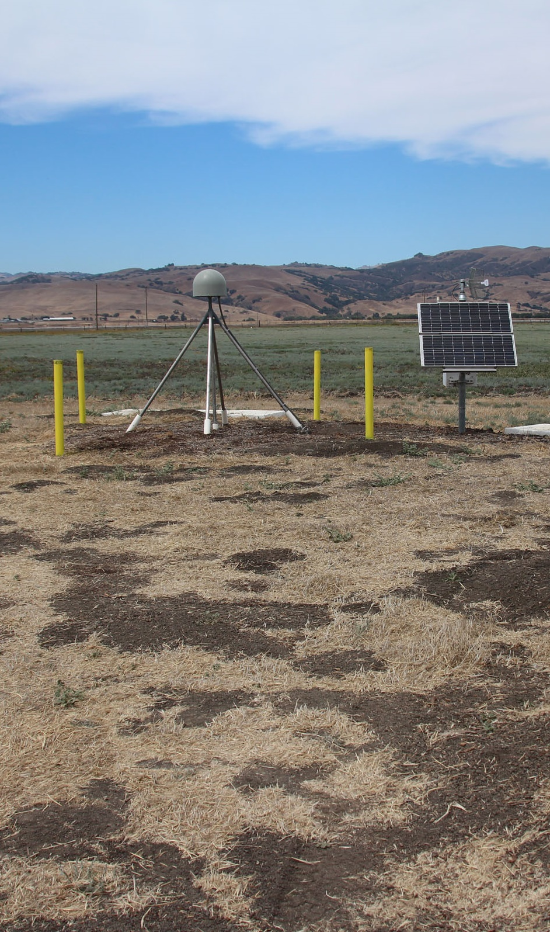
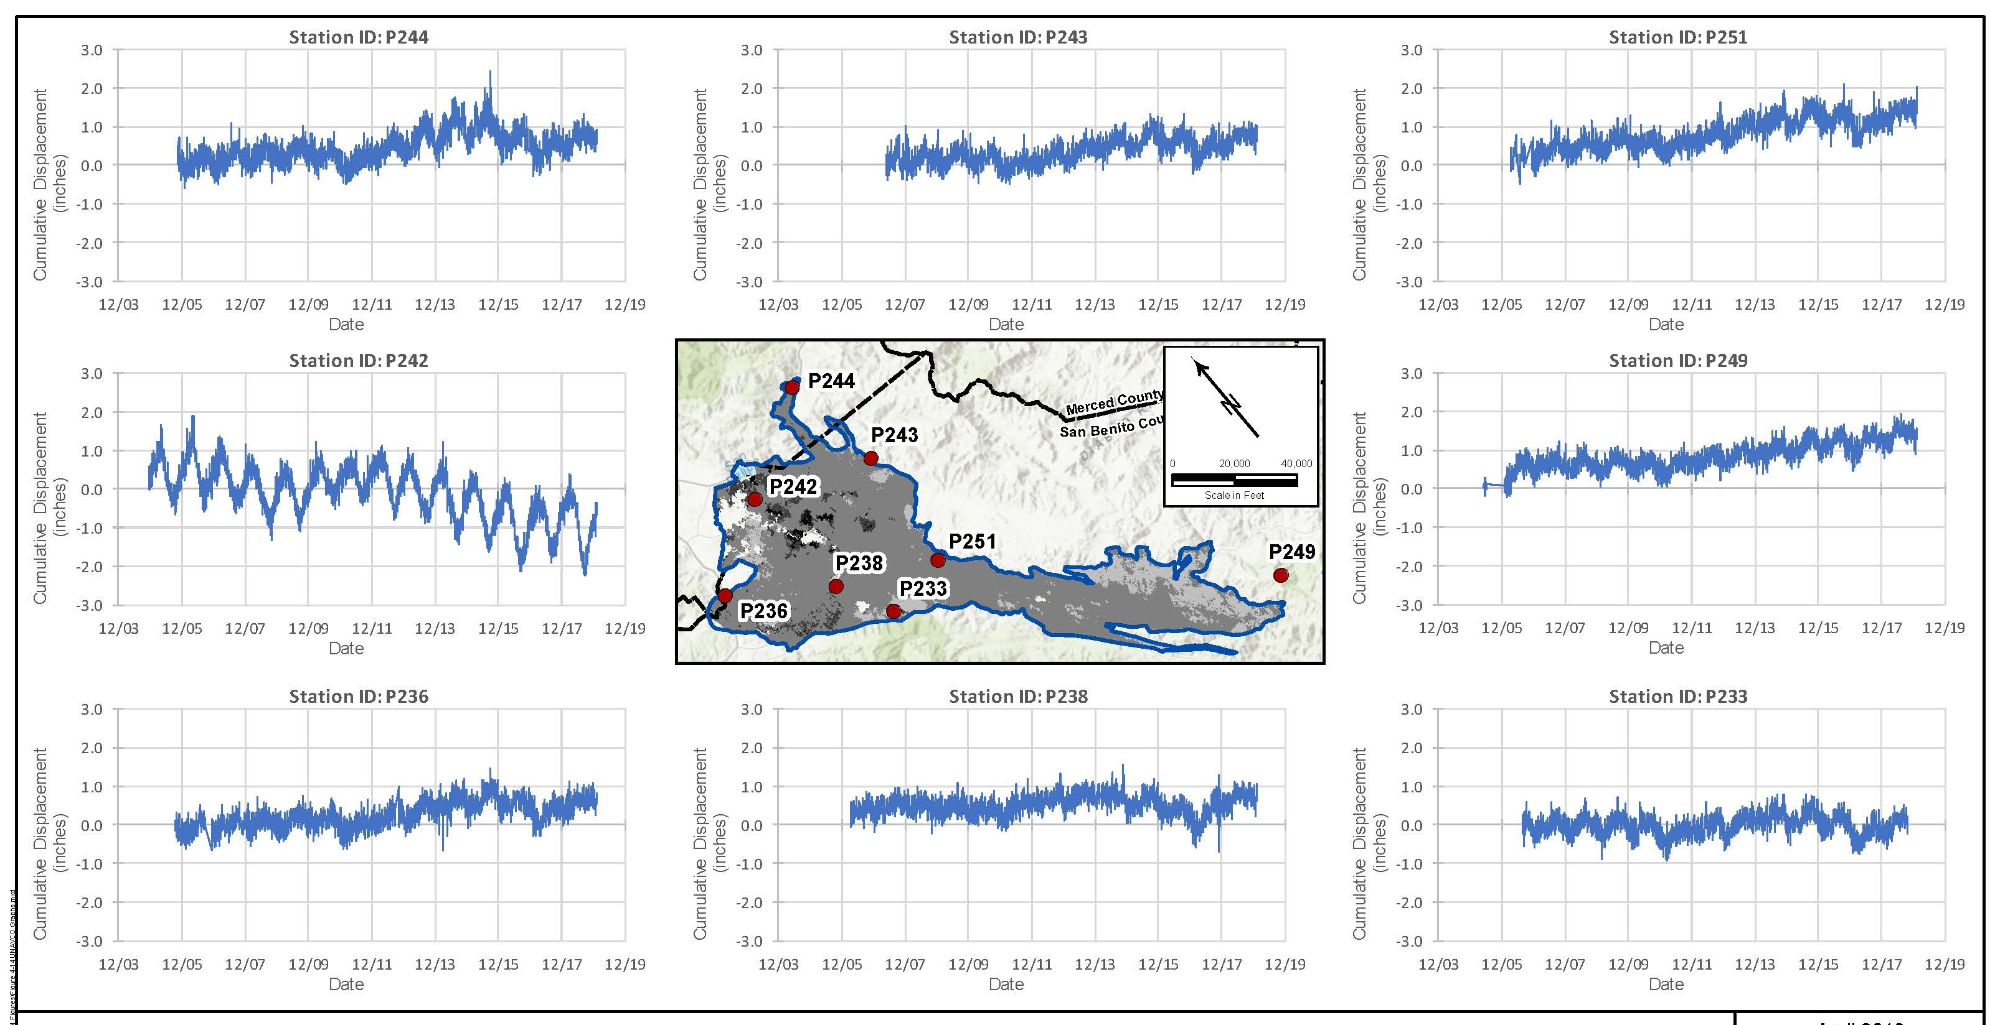
Satellite data on land surface changes indicate local land subsidence

Slide 36
Minimum Threshold
  The Minimum Threshold for land subsidence
  is the rate and extent that interferes with surface land use
  Recommended definition:
    Decline of more than 2 inches in any 5-year period
    Cumulative decline of more than 1 foot since 2015 (the SGMA start date)
More monitoring and mapping is needed

Slide 37
Measurable Objective
The Measurable Objective is to prevent subsidence.
Management Action
No specific action for subsidence
The water level Minimum Threshold will prevent future subsidence

Slide 38
Interconnected Surface Water and Groundwater Dependent Ecosystems (GDEs)
Objective:
Protect beneficial uses of connected surface waters
Downstream water users
Off-channel wetlands, seasonal streams, rivers
Riparian vegetation
Animals, such as steelhead

Slide 39
Interconnected Surface Water and Groundwater Dependent Ecosystems (GDEs)
Approach:
Identify potentially connected surface waters
Relate groundwater levels to riparian vegetation health
Simulate pumping effects on stream flow
Assess passage flows for steelhead

Slide 40
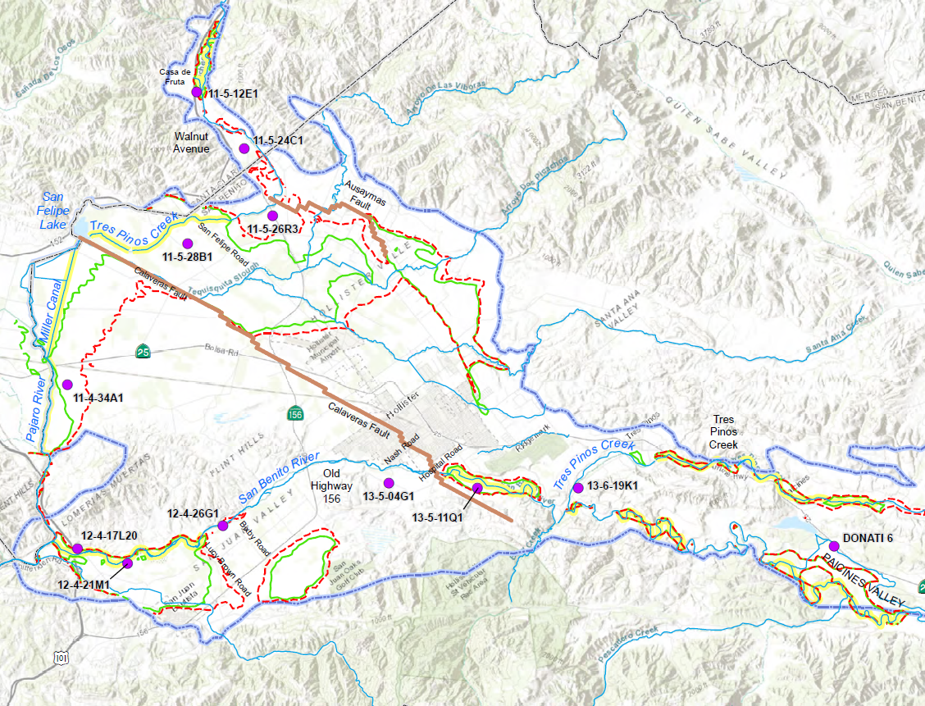
Depth to Water <20 Feet in 1992 and 1998
October 1992
(end of drought)
April 1998
(end of wet period)

Slide 41
Steelhead Passage Opportunity: San Benito River
Flow profile for June 1994
6 cfs difference in flow, but still dry near Lucy Brown Lane

Slide 42
Definition of Minimum Threshold
Undesirable results are defined to occur:
if >25% of wells within 1 mile of a riparian reach have a static spring water level lower than the lowest spring water level during 1987-1992 drought

Slide 43
Discussion
Sustainability Criteria
  Land Subsidence
  Interconnected surface water and GDEs

Slide 44
GSP Overview
2021
Plan Development
Adoption hearing
Draft GSP workshop
Management Actions / Monitoring
2020
Implementation workshop
Sustainability Criteria
Actions workshop
Management Areas / Water Budgets
Water budget/sustainability workshop
September 23, 2020
2019
Hydrogeologic Conceptual Model / Groundwater
HCM-GW Conditions
June 18 2019
Data Compilation / Data
Management System
2018
Kickoff workshop Nov 7 2018
Plan Area / Institutional Setting

Slide 45
What’s next?
TAC Meeting No. 12 and Board of Director’s Meeting | Monitoring Program | September 29, 2020
TAC Meeting No. 13 and Board of Director’s Meeting | Management Actions | November 4, 2020
Workshop No. 4 | Management Actions | TBA December 2020

Slide 46
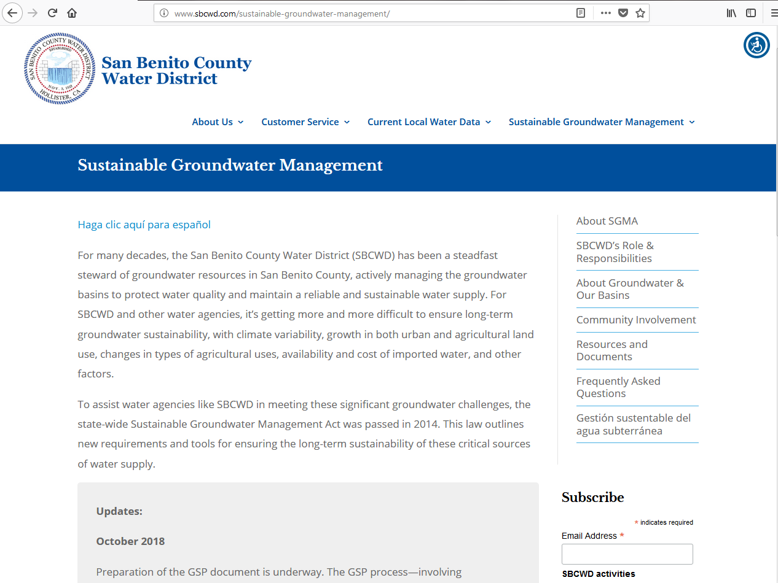
Subscribe
Stay tuned to www.sbcwd.com

