Slide 1
Technical Advisory Committee
San Benito County Water District
Groundwater Sustainability Agency
January 27, 2021 2:00-4:00
Join Zoom Meeting
Zoom Meeting: https://zoom.us/j/96081573060?pwd=RFBsUE1jVWY5YUsvckZJSi9CajI2QT09
Meeting ID: 960 8157 3060
Passcode: 156665
Or dial by your location: +1 669 900 91 28

Slide 2
Agenda
Roll call
Review of objectives for today’s meeting
Measuring groundwater use
Funding for GSP development and implementation
Discussion
Next steps and upcoming meetings

Slide 3
GSP Overview
2021
Plan Development
Adoption hearing
Draft GSP workshop
Management Actions / Monitoring
Round 3 Monitoring Wells
MAR
2020
Implementation workshop
Sustainability Criteria
Management actions workshop
TAC Meetings
Management Areas / Water Budgets
2019
San Benito Public Agencies Workshop: GSP Overview December 9, 2020
Hydrogeologic Conceptual Model / Groundwater
Water Budget/Sustainability workshop September 23, 2020
Data Compilation / Data
Management System
GW Conditions workshop June 18, 2019
2018
Kickoff workshop November 14, 2018
Plan Area / Institutional Setting

Slide 4
Objectives for Today
Receive update on alternatives to measure groundwater use
Review ConserWater pilot program
Consider means to collect fees for GSP development and implementation
  Short-term approach (next five years)
  Long-term approach

Slide 5
Measuring Groundwater Use - Recap
In-line metering is direct and accurate, but too slow to implement and requires well access, well owners bear meter costs
Remote sensing is accurate, can be implemented quickly and over the entire basin, can provide additional information
ConserWater and SBCWD have designed a pilot project

Slide 6


Pilot Satellite Data Program
Using Satellite Data and Artificial Intelligence (AI) to Predict Conditions at Farm Level.
District to pay for a one-year Pilot Program
Five local growers to participate in Pilot Satellite Data Program
Pilot Satellite Data Program start date February 1, 2021 runs to January 31, 2022
Objectives:
  Find a method to accurately measure water pumped
  Determine accuracy of remote sensing versus in-line meters
  Gain community acceptance of remote sensing options

Slide 7
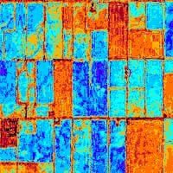
ConserWater:
NASA satellite data, weather data, topography and Artificial Intelligence (AI) to predict irrigation water needs
Features:
AI-based irrigation recommendations
Up to four different depths to check soil moisture (from 0 to 80 inches)
Weekly nutrient reports (nitrogen & phosphorous) to 30 feet
Plant disease protection
Irrigation leak protection
Farm specific weather

Slide 8
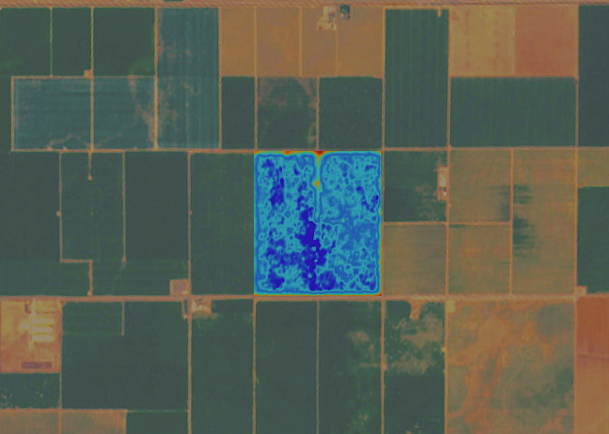
Benefits of remote sensing:
Growers:
100% participation at start-up
Growers have access to information daily
No long-term contract required
Nutrient information available (nitrogen & phosphorus)
No annual maintenance required
Cost effective
District:
Better access to water-use information
More tools to assist in management decisions
Less intrusive to customers
Cost effective

Slide 9
Categorization for Land Based Funding
Categorization of Assessor’s Parcels in North San Benito Basin
Unirrigable range land-topography, hydrology, recent/current land use
Irrigated / irrigable lands
  Urban service areas-Hollister, Sunnyslope, San Juan Bautista, Tres Pinos
  Golf courses-Ridgemark, San Juan Oaks
  Small water systems
  Rural parcels less than five acres
  Agriculture

Slide 10
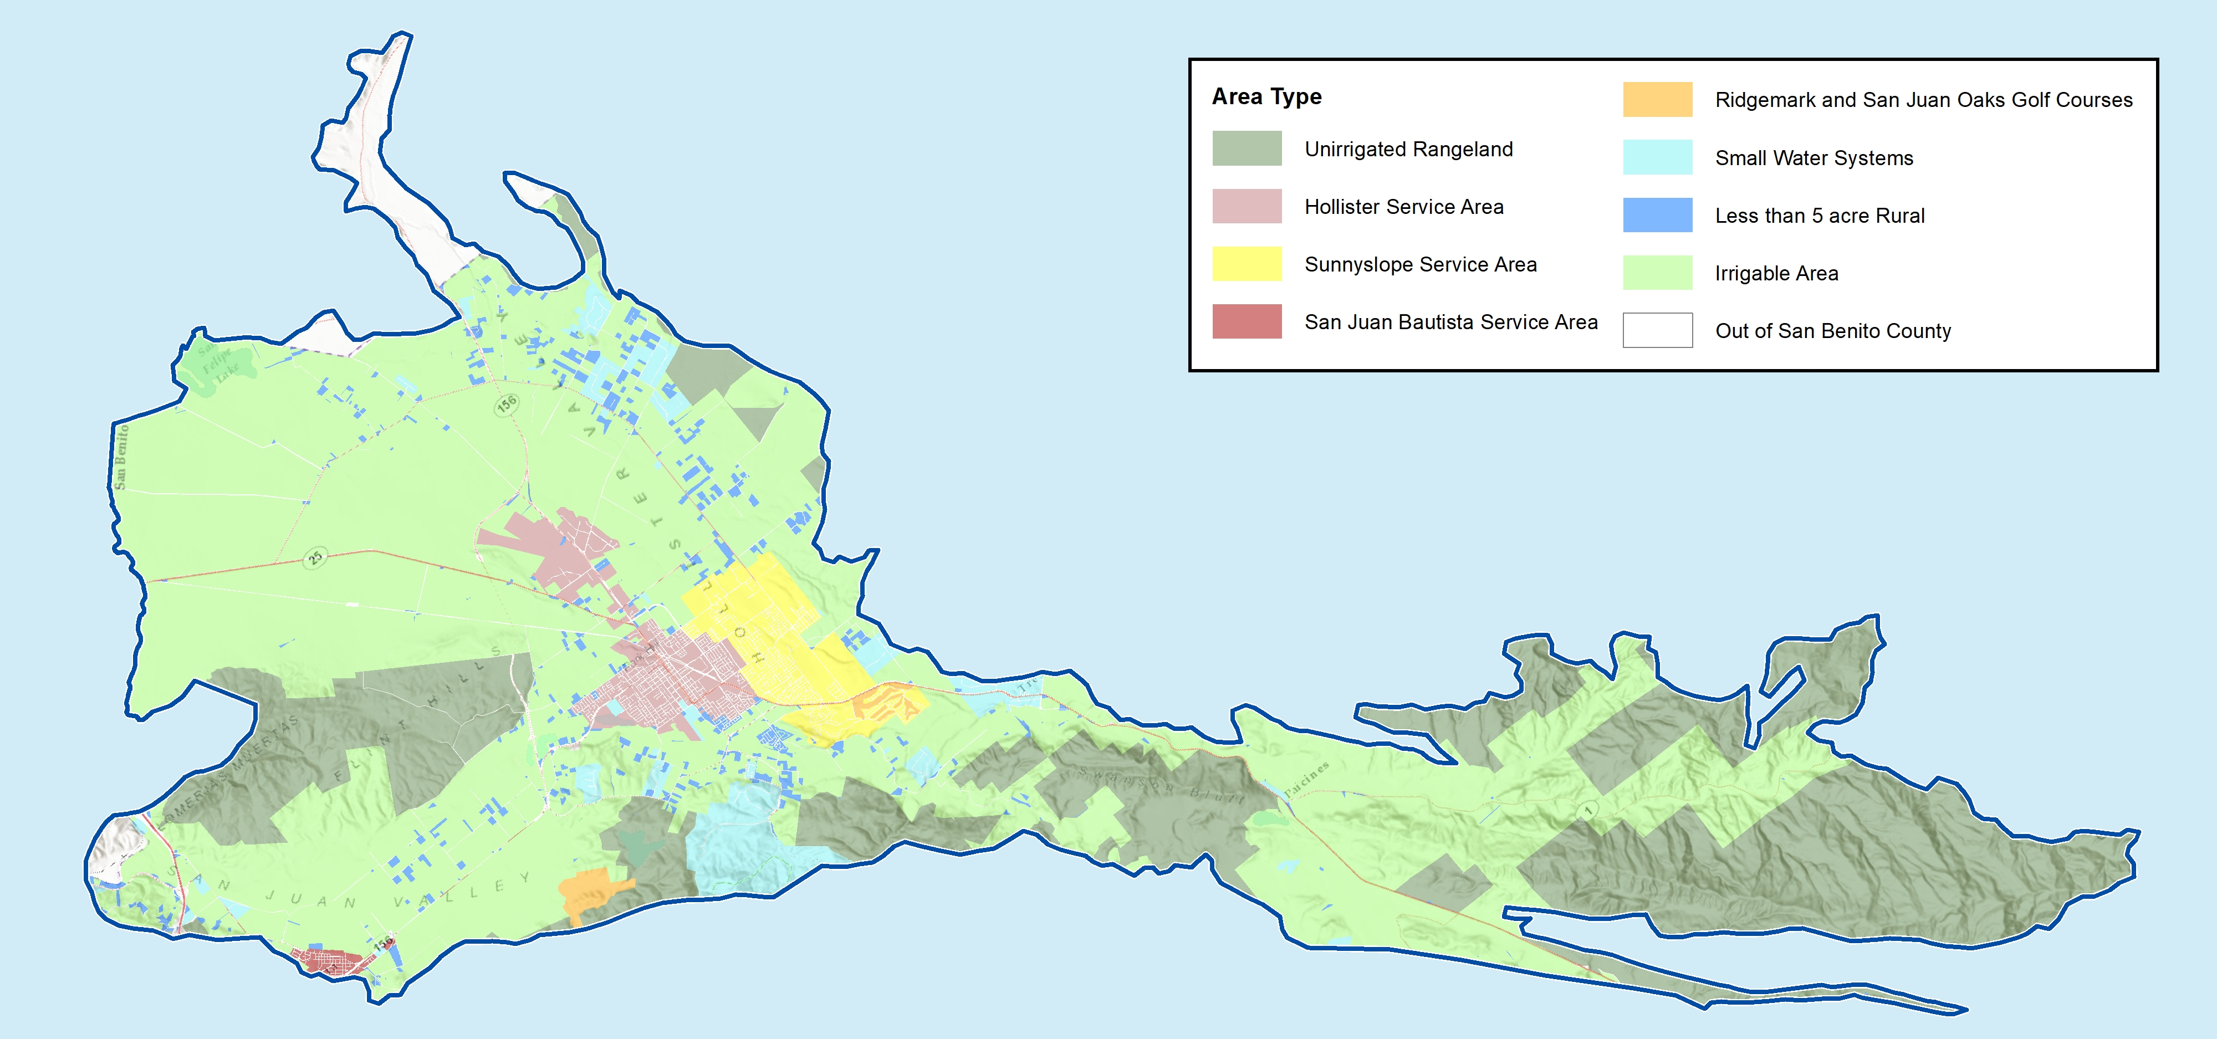
Preliminary Mapping for Land Based Funding

Slide 11
Land Based vs Consumption
First 5 years-Acreage Based Fee
Land Category | Costs for GSP Development, Monitoring and Reporting for Annual Update
Irrigated/Irrigable Acres | √
Urban Area | √
Golf Courses | √
Small Water Systems | √
Industrial | √
Rural Parcels < 5 acres | √
Unirrigated Rangeland | N/A

Slide 12
Land Based vs Consumption
Proposed Fee After 5-years
Land Category | Costs for GSP Annual and Plan Updates | Costs for Monitoring for Annual GSP Updates | Costs for Measurement of Extractions
 | (Acreage Based) | (Acreage Based) | (Consumption Based)
Irrigated/Irrigable Acres | √ | √ | √
Urban Area | √ | √ | √
Golf Courses | √ | √ | √
Small Water Systems | √ | √ | √
Industrial | √ | √ | √
Rural Parcels < 5 acres | √ | √ | √
De Minimis | √ | √ | N/A
Unirrigated Rangeland | N/A | N/A | N/A

Slide 13
Authority to Charge Fees
Water Code Sec 10730(a) A GSA may impose fees to fund costs of a GSP to prepare and amend a GSP including but not limited to monitoring and annual reporting.
Billing Options
  Urban users, direct billing to urban agencies based on acreage in service area
    City of Hollister
    Sunnyslope County Water District
    Tres Pinos County Water District
    San Juan Bautista
  All Other Irrigable Land Billed Through County Tax Rolls
    Ag
    Rural Parcels
    Golf Courses
    Large Industrial Users/Small Water Systems

Slide 14
Total Cost
Total GSP Costs
Initial GSP Development | $3,235,000
(Less Grant Reimbursement) | -$2,000,000
GSP Cost to Recapture | $1,235,000
Initial Costs Amortized over 5 years | $247,000
Annual Monitoring and Reporting | $390,000
Estimated Annual Cost to Recover in Fees | $637,000

Slide 15
Allocation of Cost
Land Category | Acreage | % of Total Acres | GSP Annual Recapture | Annual Monitoring and Reporting | Total Cost | Cost Per Acre
 |  |  | 247,000 | 390,000
Hollister Service Area | 3,005 | 3.41% | $8,413 | $13,284 | $21,697 | $7.22
Sunnyslope Service Area | 3,164 | 3.59% | $8,857 | $13,986 | $22,843 | $7.22
San Juan Bautisa Service Area | 250 | 0.28% | $699 | $1,104 | $1,803 | $7.22
Golf Courses | 594 | 0.67% | $1,663 | $2,626 | $4,289 | $7.22
Small Water Systems/Industrial | 4,292 | 4.86% | $12,016 | $18,973 | $30,989 | $7.22
Irrigated/Irrigable Area | 74,349 | 84.28% | $208,166 | $328,683 | $536,849 | $7.22
Rural Parcels < 5 acres | 2,566 | 2.91% | $7,186 | $11,346 | $18,531 | $7.22
 | 88,220 | 100.00% | $247,000 | $390,000 | $637,000
Unirrigated Rangeland | 36,120 |  |  |  |  | 0

Slide 16
Other Agency Solutions
Name | Legal Authority | Comments
Indian Wells | Water Code Sec 10730 | $3.00 per 0.1 ac-ft
Kings River East GSA | Prop. 26 (exempt as reg. cost) | $1.45 per ac-ft $3,250/yr member agency with no impact on groundwater
Salinas Valley GSP | Prop. 26 (exempt as reg. cost) | $4.79 per irrigated acre $2.26 per urban connection
McMullin Area GSP | Prop. 218 | 19 per acre (excludes parcel 2 acres or less)
North Fork Kings GSP | Prop. 218 | $10.00 per acre Applied equally to all acreage in GSP
South Fork Kings GSP | Prop. 218 | $9.80 per acre Applied equally to all acreage in GSP

Slide 17
Avoid State intervention
If the GSA does not impose fees, and as a result, cannot complete and implement the GSP, the state could intervene and impose fees
Fee Category | Fee Amount | Applicable Parties
Base Filing Fee | $300 per well | All extractors required to report (not de minimis)
Probationary Rate | $40 per AF | Extractors in probationary basins (not de minimis)
De minimis Fee | $100 per well | De minimis extractors in probationary basins
Automatic Late Fee | 25% per month | Extractors that do not file reports by due date

Slide 18
Discussion

Slide 19
Next Steps
Topics for Next TAC meeting
  Update on Round 3 Monitoring and Managed Aquifer Recharge
  Projects and Management Actions

Slide 20
Stay tuned
SBCWD Board of Director’s Meeting | Jan 27, 2021 5:00pm
Next TAC Meeting: | February 24, 2021
Public Workshop No. 3 : | March 10, 2021

