Slide 1
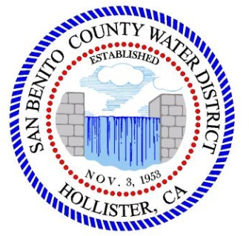
Workshop
San Benito County Water District
Groundwater Sustainability Agency
Sustainable Groundwater Management: North San Benito Groundwater Basin
March 10, 2021

Slide 2
Agenda
Overview of SGMA and GSP process and North San Benito Basin
What is sustainable groundwater management?
Implementation: monitoring and reporting
Implementation: projects and management actions
How will GSP implementation be funded?
Next Steps:

Slide 3
Sustainable Groundwater Management Act (SGMA)
Landmark legislation in 2014 in response to groundwater overdraft in other California groundwater basins
Includes comprehensive requirements for:
  Forming a groundwater sustainability agency (GSA)
  Preparing a groundwater sustainability plan (GSP)
  Meeting deadlines
Promotes local control
Provides for State assistance and if needed, State intervention

Slide 4
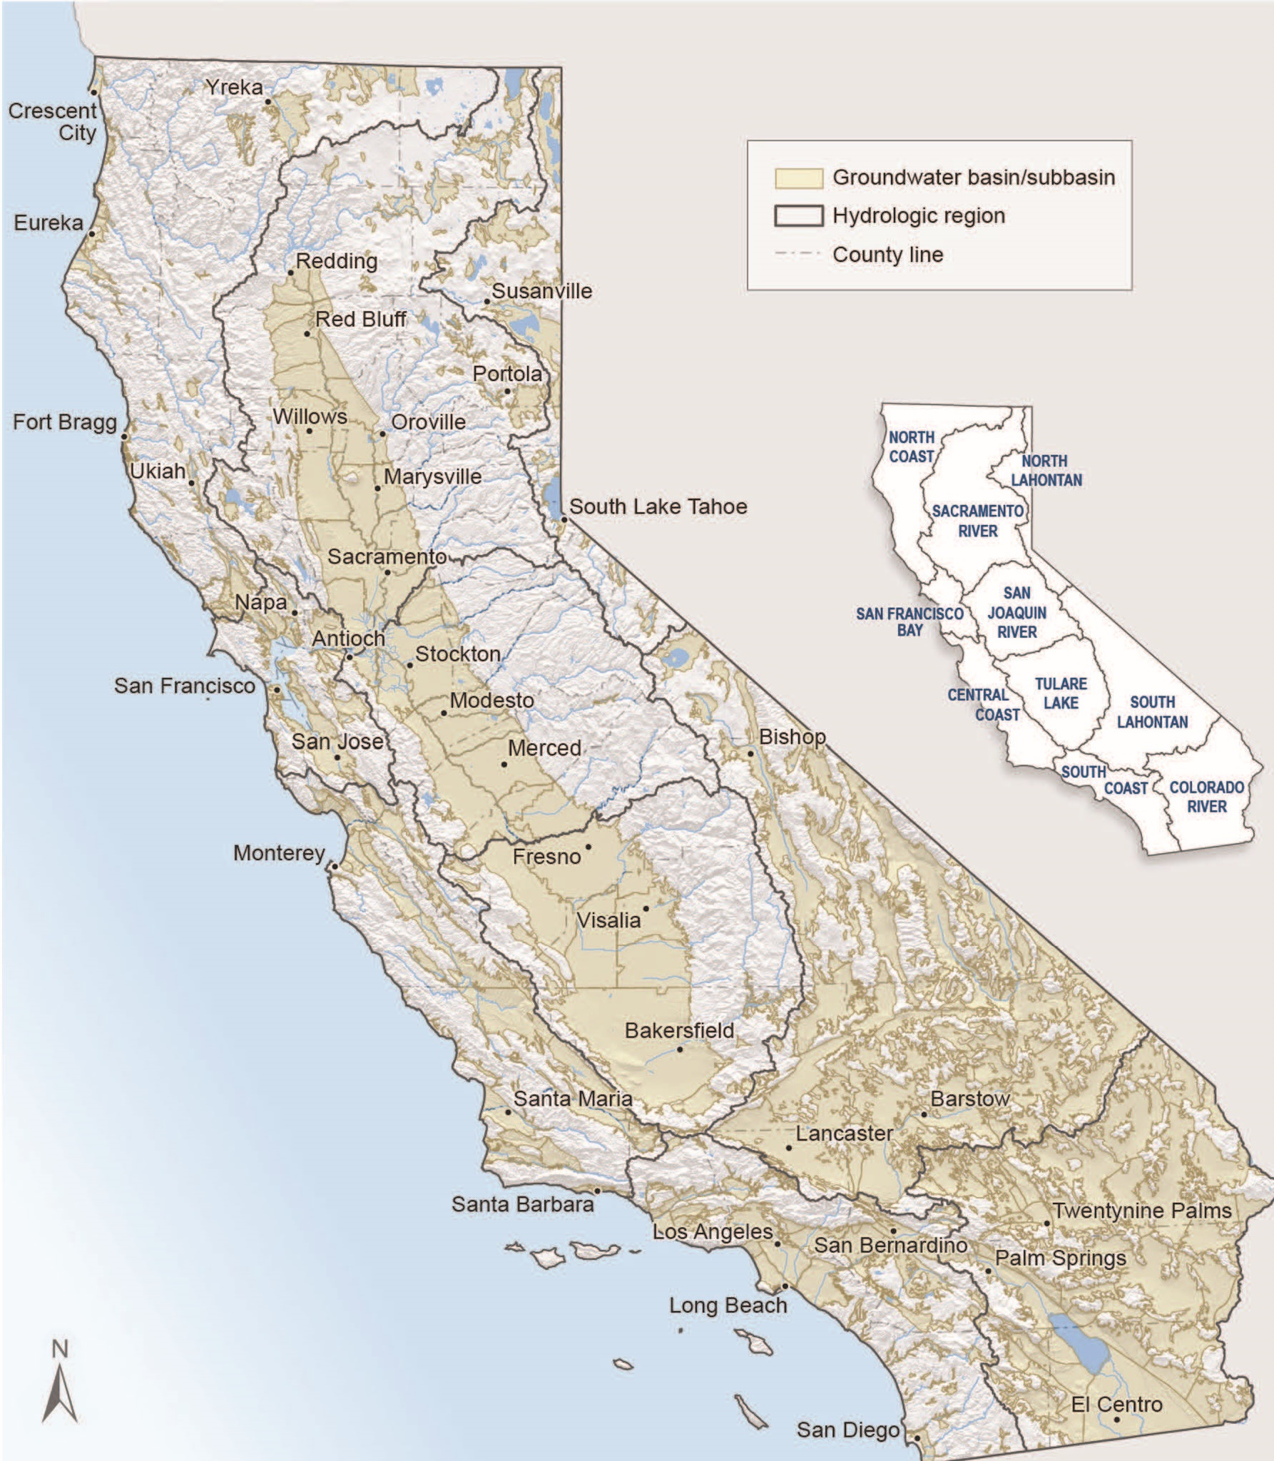
SGMA applies to San Benito
DWR prioritized all 515 basins based on:
Population and rate of growth
Number of public supply wells
Total number of wells
Irrigated acreage
Reliance on groundwater
Groundwater impacts
(e.g., overdraft, subsidence)

Slide 5
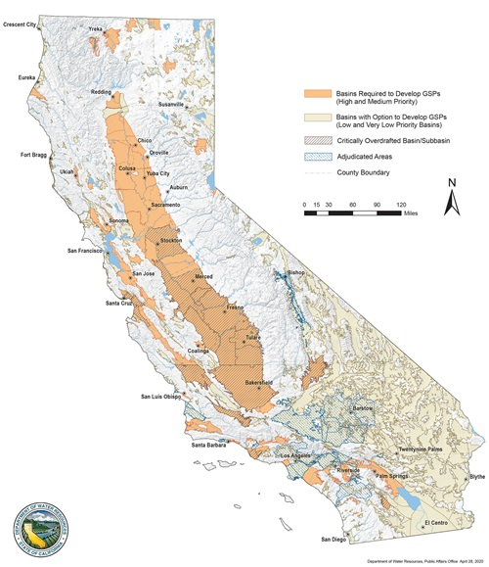
SGMA applies to San Benito
DWR assigned priorities:
High
Medium
Low
Very low
North San Benito is medium priority and subject to SGMA
  Not critically overdrafted
SGMA requirements apply

Slide 6
SGMA and the GSP Process
Implementation
Today
2040/2042
Achieve and demonstrate sustainability
June 2017: GSAs formed:
January 2022: GSP completion
June 2018: GSP started
San Benito County Water District GSA
Santa Clara County Water District GSA (Valley Water)

Slide 7
GSP Preparation
2021
Plan Development
Adoption hearing
Nov or Dec 2021
Management Actions / Monitoring
Draft GSP workshop
2020
Implementation workshop
Sustainability Criteria
Projects/actions workshop
March 10, 2021
Management Areas / Water Budgets
Water budget/sustainability
September 23, 2020
2019
Hydrogeologic Conceptual Model / Groundwater
HCM-GW Conditions
June 18, 2019
Data Compilation / Data
Management System
Kickoff workshop November 7, 2018
2018
Plan Area / Institutional Setting

Slide 8
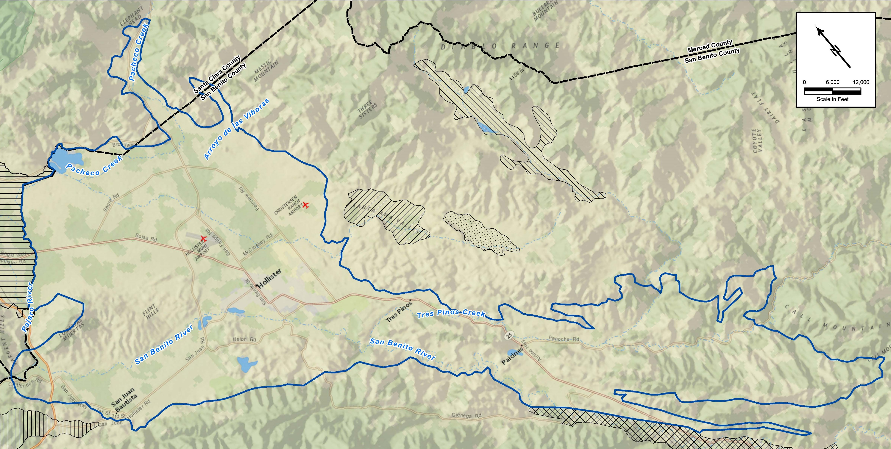
North San Benito Groundwater Basin
Consolidated Bolsa, Hollister, and San Juan subbasins and Tres Pinos basin
200 square miles in San Benito and Santa Clara counties

Slide 9
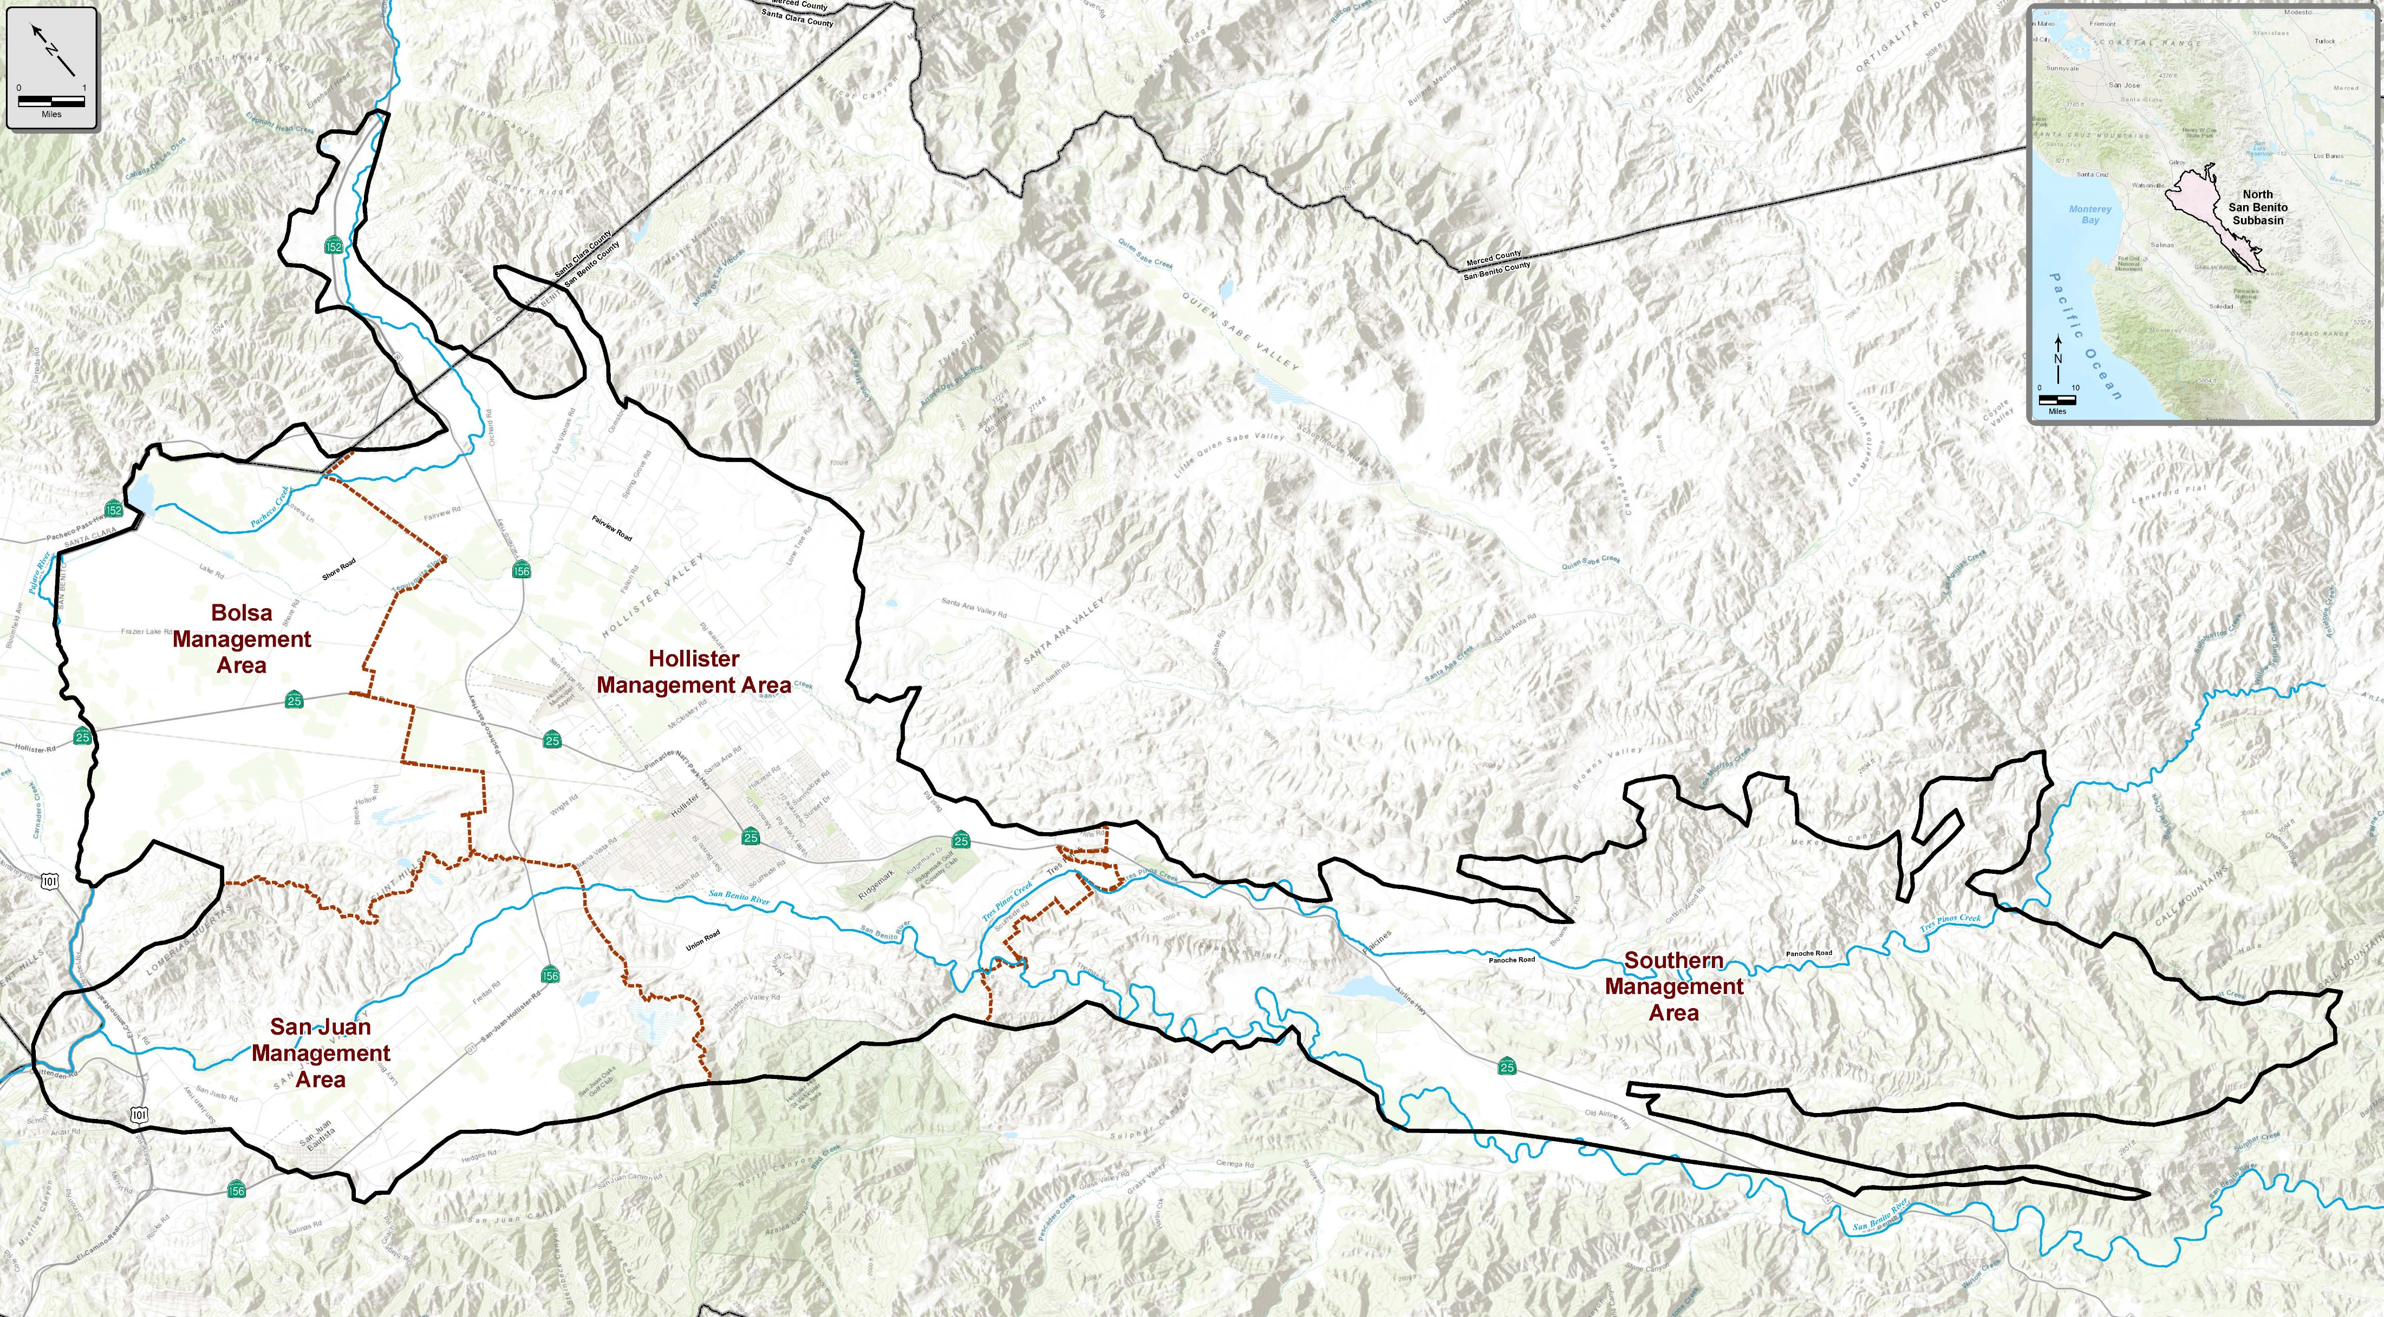
One Basin with Four Management Areas (MAs)
Based mostly on water supply sources:
Imported Central Valley Project water in Zone 6 and in Santa Clara County
Local surface water from Hernandez and Paicines reservoirs in Zone 3

Slide 10

Questions?

Slide 11
What is sustainable groundwater management?

Slide 12






What is sustainable management?
The management and use of groundwater in a manner that can be maintained without causing undesirable results:
Chronic lowering of groundwater levels
Reduction of groundwater storage
Seawater intrusion: Not applicable here!
Degraded water quality
Land subsidence
Depletions of connected surface water with impacts on beneficial uses

Slide 13
How do we measure sustainability?
Sustainability Criteria:
Undesirable results
  What are undesirable results that we want to avoid?
Minimum thresholds (MT)
  e.g., How low is too low for water levels?
Measurable objectives
  e.g., What is the desired range of water levels?

Slide 14
Groundwater Levels: Background
  Levels decline during droughts and then recover; no overdraft
  Objective: avoid loss of well yield and maintain levels in historical range
  Track groundwater levels at 22 Key Wells across the basin

Slide 15
Groundwater Levels: Minimum Threshold
  Define MT as historical low level adjusted to protect nearby wells.
  Undesirable results are indicated when:
  Groundwater levels cross the MT two consecutive times in two consecutive years, in 60 percent or more of the Key Wells in each MA.

Slide 16
Groundwater Storage
Groundwater basin has provided water supply during prolonged and severe droughts (1922-1934, 1987-1990)
The amount of storage in the operating range of water levels is enough to meet demands during future droughts
The basin is sustainably managed relative to storage: no overdraft since CVP imports
Objective: Provide reliable storage for water supply during drought
MT is fulfilled by the minimum threshold for groundwater levels as proxy.

Slide 17
Land Subsidence
No undesirable results of subsidence have been reported, but some subsidence has been measured locally (2 inches over 15 years)
Potential exists for undesirable results
  Reduction in drainage capacity; drainage problems
  Impacts on grade of facilities, e.g., pipelines, roads, runways
  Subsidence around a wellhead, e.g., casing collapse
  Non-recoverable loss of storage capacity in the aquifers

Slide 18
Land Subsidence Minimum Threshold
A rate of decline equal to or greater than 0.2 feet in any five-year period.
The extent of cumulative subsidence across the basin will be monitored and evaluated using satellite data.
Subsidence is closely linked to groundwater levels.
Significant inelastic subsidence is unlikely to occur if groundwater levels remain above minimum thresholds.

Slide 19
Water Quality Background
General mineral quality is naturally poor
TDS and nitrate are constituents of concern
TDS and nitrate loading has occurred for decades due to human activities
Objective: protect and improve groundwater quality
Manage groundwater without causing undesirable results
Address significant and unreasonable effects common throughout the basin
Avoid duplicating existing programs that address pollutants and site cleanup
Avoid management actions that spread localized contamination

Slide 20
Water Quality Minimum Threshold
Defined for nitrate and total dissolved solids (TDS) for each MA based on RWQCB Basin Plan Water Quality Objectives:
  Nitrate drinking water standard = 45 mg/L
  TDS recommended value = 1,200 mg/L
The MTs for each are defined as the percentage of wells with concentrations exceeding those objectives based on current conditions (2015-2017).
The objective for both is to maintain or reduce the percentage of wells with median concentrations exceeding the MTs.

Slide 21
Interconnected Surface Water and Groundwater Dependent Ecosystems (GDEs)
Background: GSP includes detailed investigations:
Evaluation of off-channel wetlands and field inspection of riparian areas
Identification of streams with shallow groundwater (Pajaro River, Pacheco Creek, San Benito River, Tres Pinos Creek)
Identification of conditions when impacts could occur (drought 1987-1992)
Numerical modeling of potential pumping impacts on steelhead
Objective: Protect beneficial uses of connected surface waters

Slide 22
Interconnected Surface Water and GDEs
Minimum Threshold: Amount of depletion associated with the lowest water levels during the 1987-1992 drought.
Undesirable results would occur if:
more than 25 percent of monitored wells within 1 mile of a shallow water table reach had static spring water levels lower than the lowest static spring water level during 1987-1992.

Slide 23
North San Benito Sustainability
No undesirable results of chronic groundwater level declines reported.
Groundwater in storage provides supply for drought and there has been no overdraft since CVP imports.
Subsidence has been measured but no undesirable results reported.
Despite poor water quality, beneficial uses have continued and are considered sustainable.
Groundwater-surface water and GDEs are sustainable, but more information needed on steelhead migration along the San Benito River.

Slide 24
Questions?

Slide 25
Implementation: Monitoring and Reporting

Slide 26
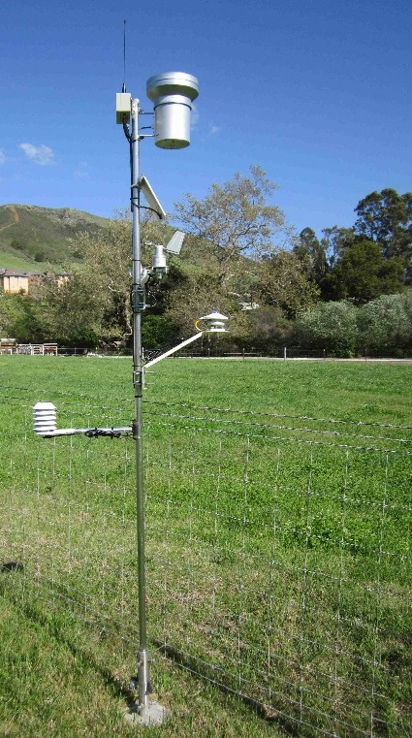
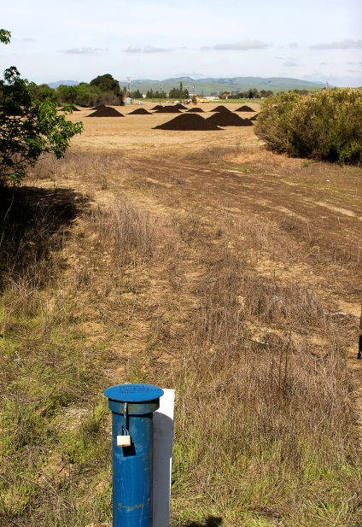
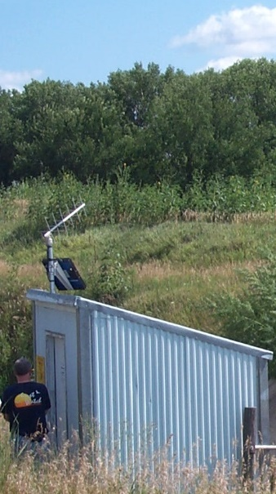
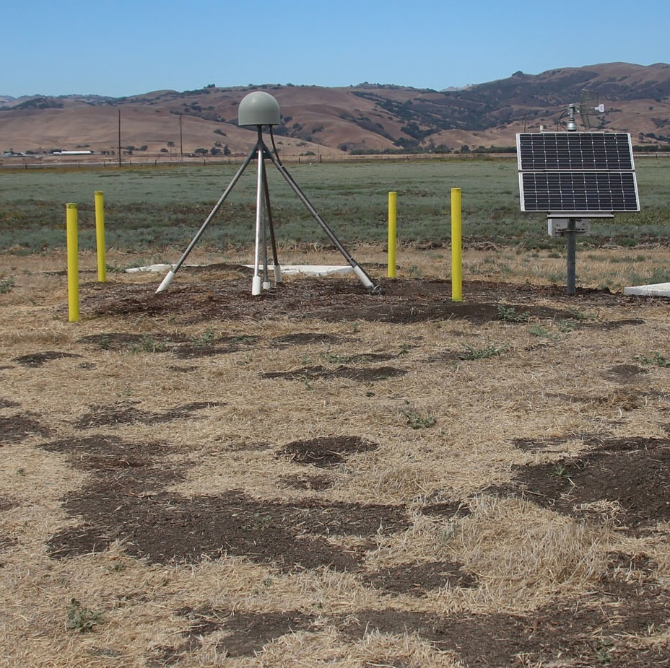
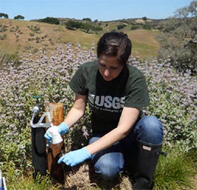
Monitoring Program
Allows us to:
Track changes
Identify problems
Demonstrate sustainability
Climate
Surface water flow
Groundwater levels
Water quality
Groundwater pumping
CVP imports
Hernandez/Paicines
Percolation
Wastewater/recycling
Subsidence data

Slide 27
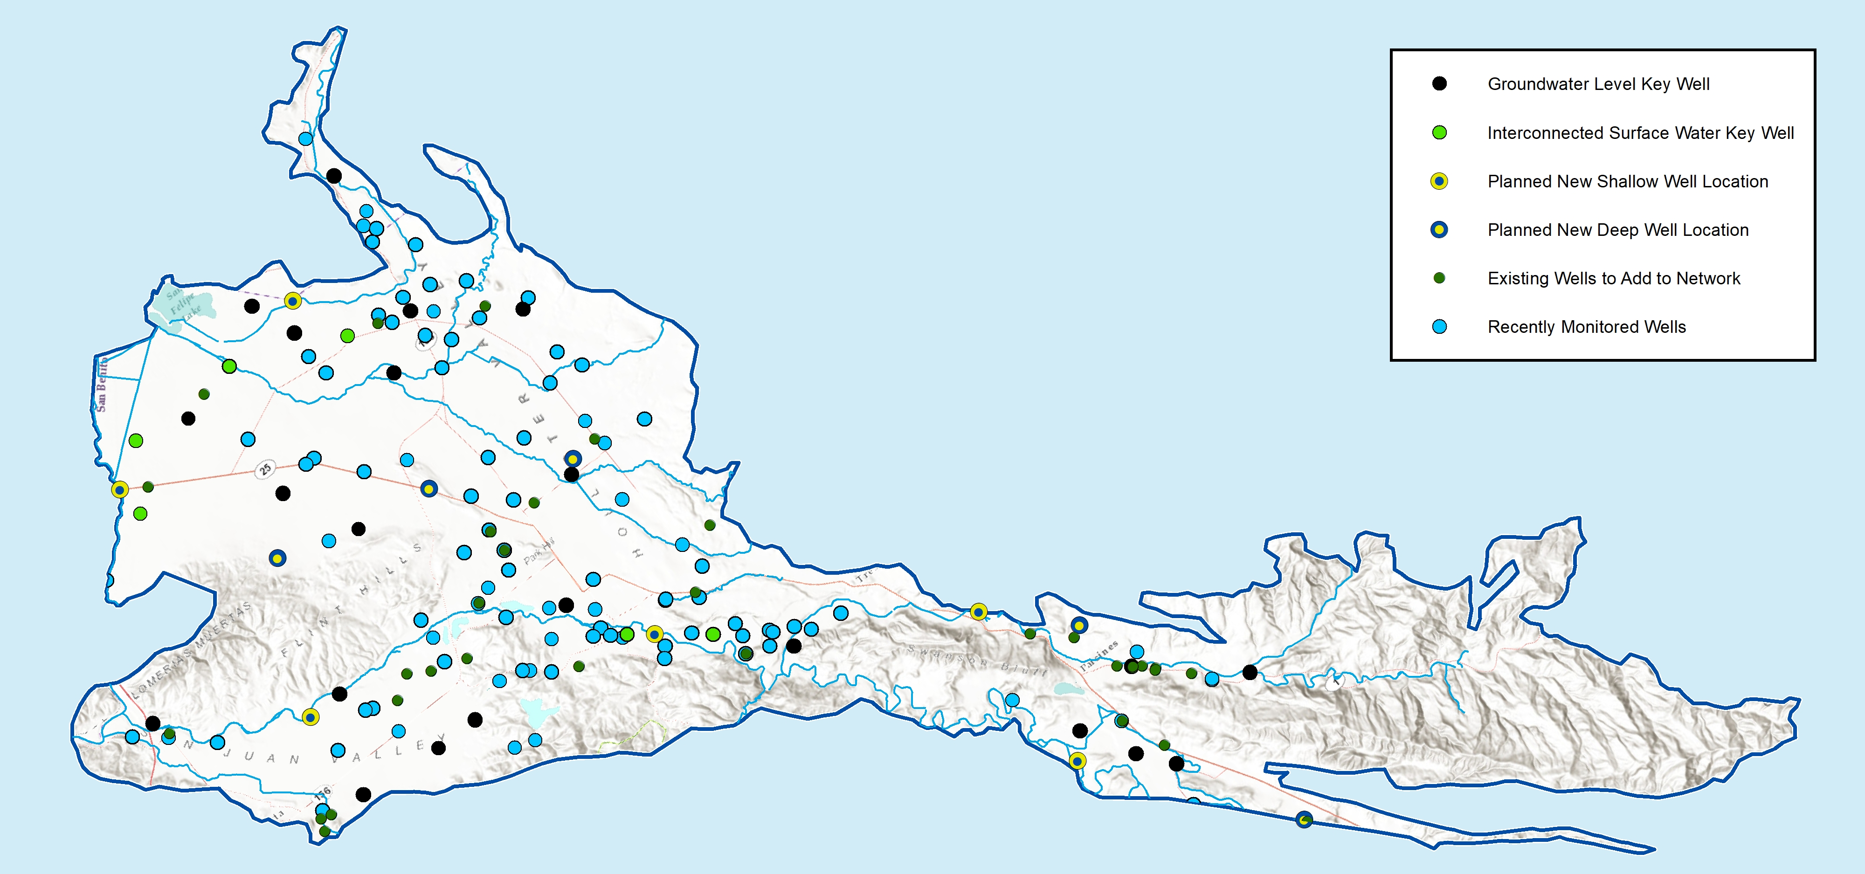
Groundwater Monitoring
Well Network
22 Key Wells track groundwater levels
Additional monitoring for quality and shallow groundwater near streams
Adding new dedicated wells and expanding coverage across entire basin

Slide 28
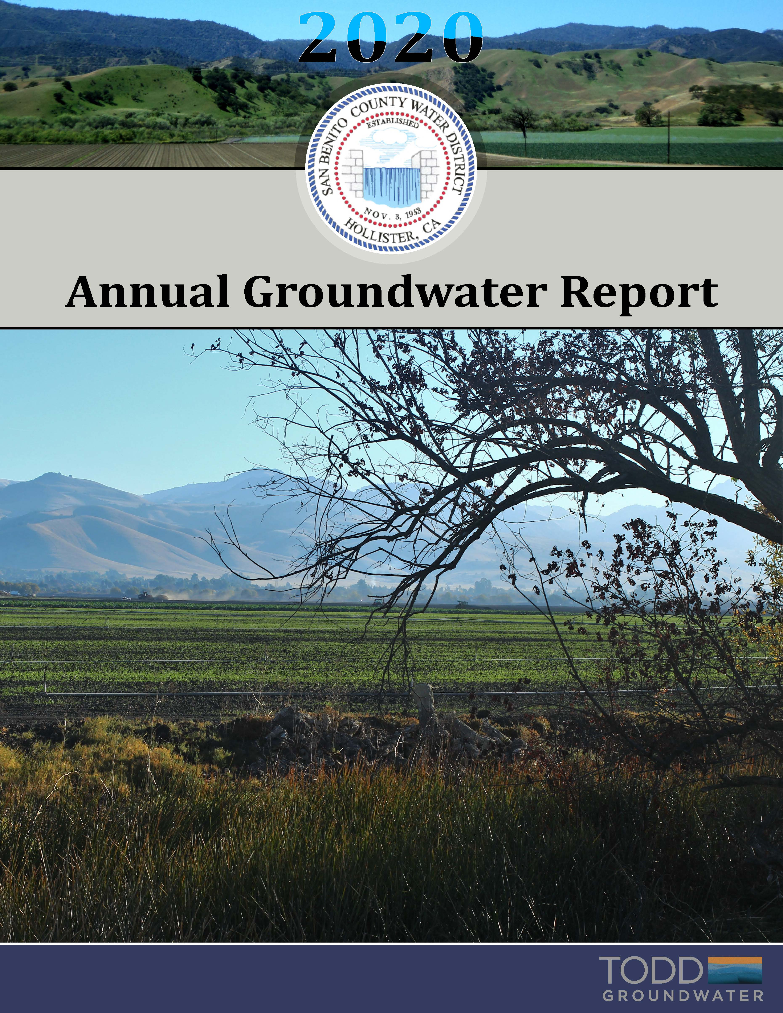
Annual reporting will be expanded
SBCWD Annual Groundwater Reports have been prepared but need to cover entire basin
SGMA has more requirements
  Groundwater elevation data
  Groundwater extraction
  Surface water supply
  Total water use
  Change in groundwater in storage (use numerical model)
  progress implementing the GSP
SGMA requires five-year GSP updates

Slide 29

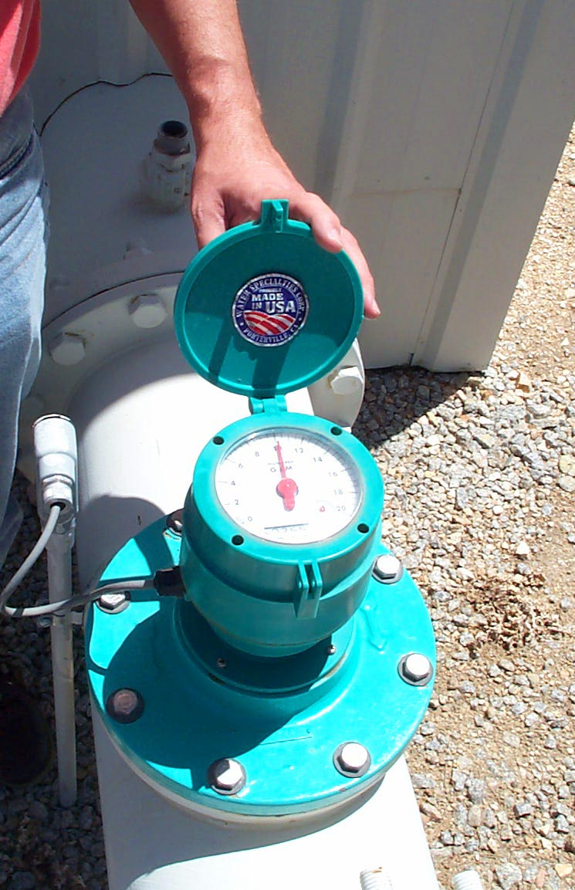
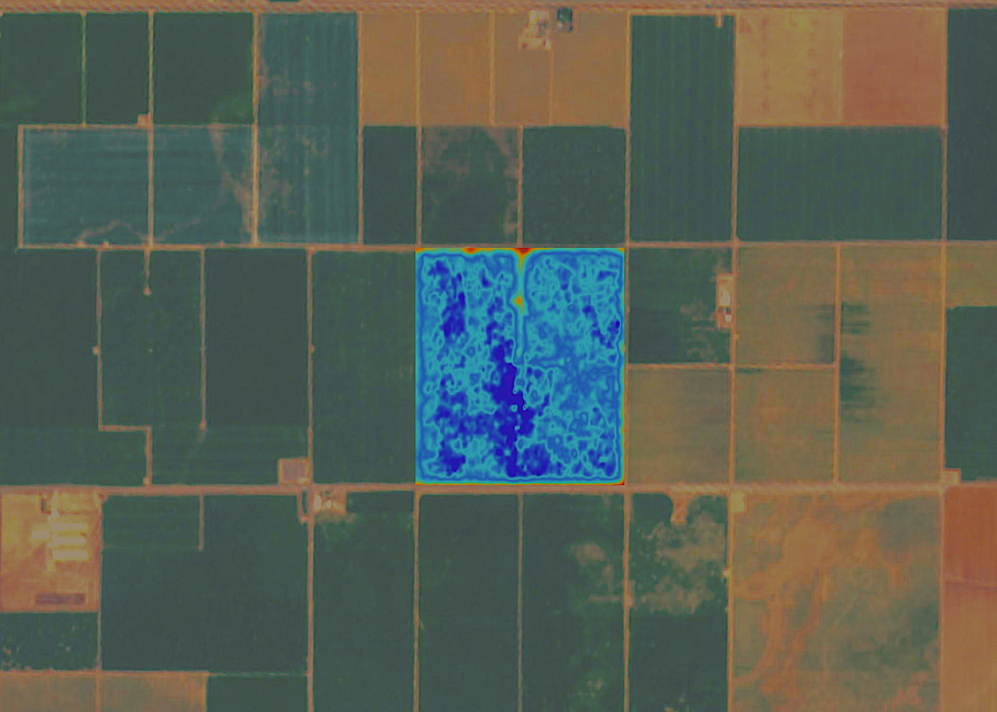
  Measurement of basin-wide pumping is required
    Multiple methods are available
      Municipal providers use metering
      Need an accurate methodology to evaluate agricultural and rural pumping
      Currently evaluating remote sensing techniques
16

Slide 30
Implementation:
Projects and Management Actions

Slide 31
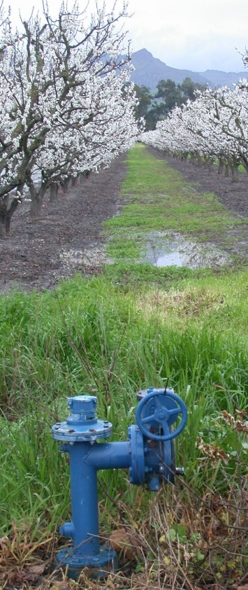
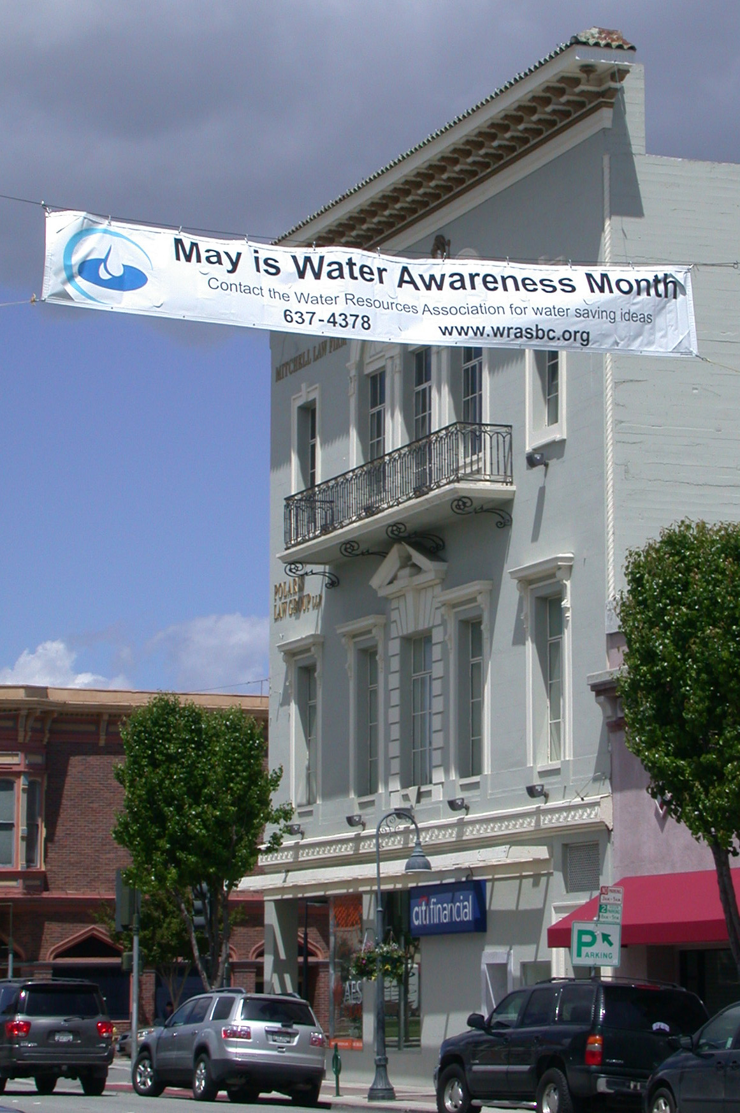
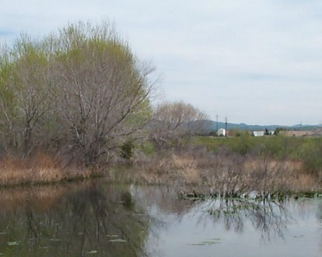
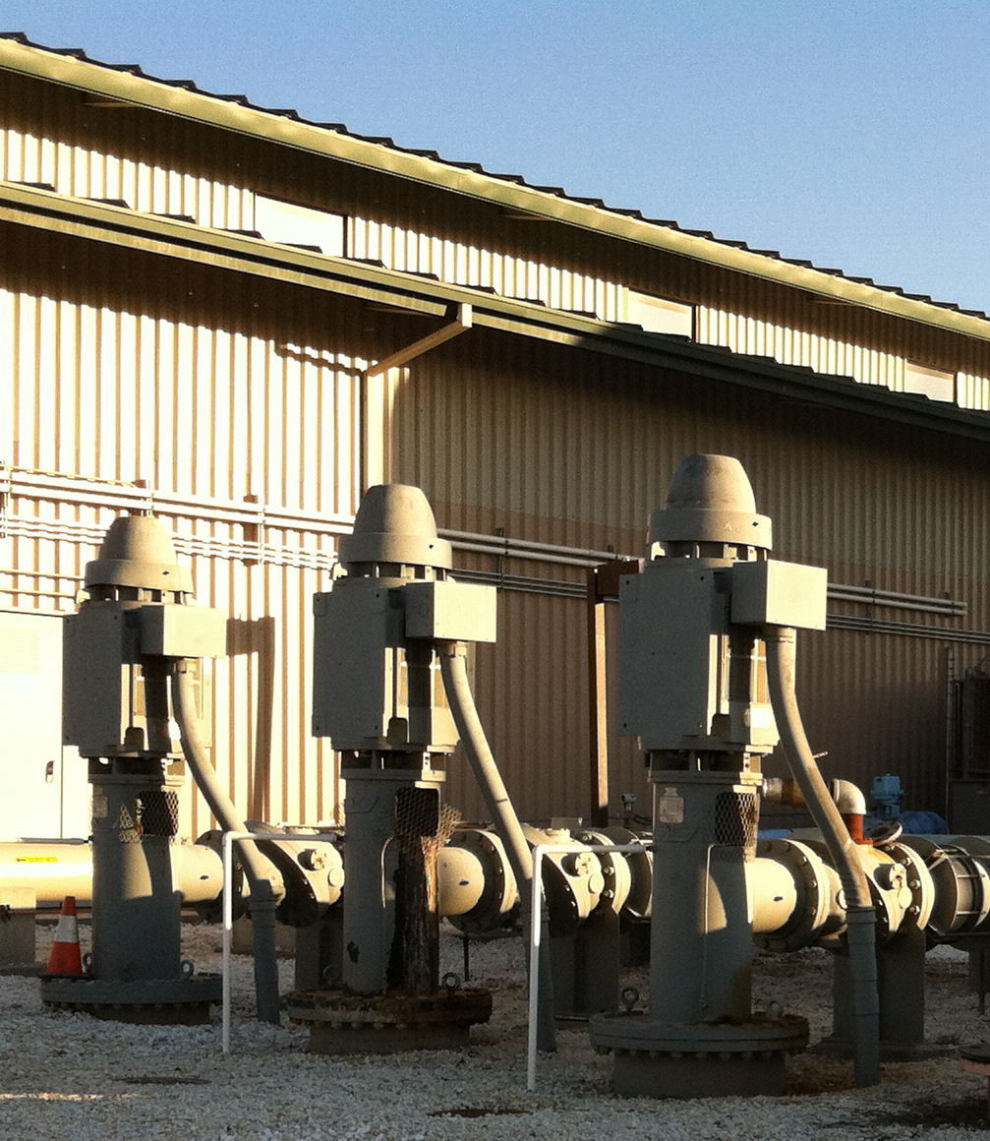
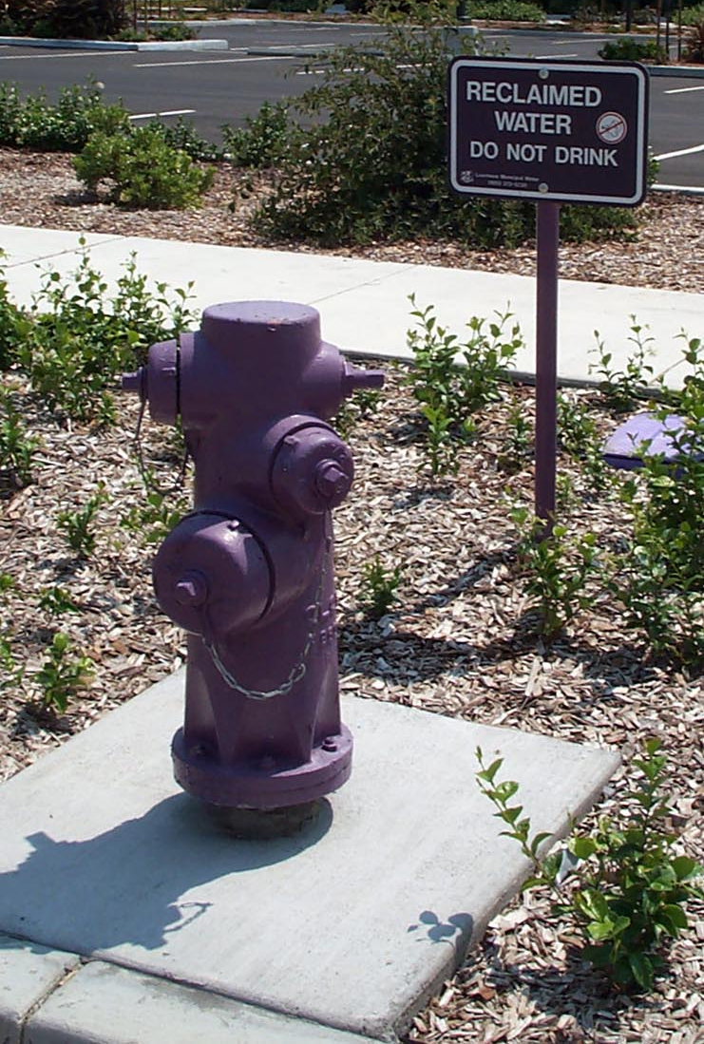
GSP presents potential projects
Develop Surface Water Storage
Expand Managed Aquifer Recharge
Enhance Conjunctive Use
Increase Stormwater Recharge
Support Hollister Urban Area Water Project
Enhance Water Conservation

Slide 32
GSP presents potential management actions
Provide long-term basin-wide funding mechanism
Improve monitoring and data management
Provide annual monitoring and reporting
Develop response plans
Enhance water quality improvement programs
Reduce potential impacts to GDEs (steelhead / riparian)

Slide 33
Questions?

Slide 34
How will GSP implementation be funded?

Slide 35
How will GSP implementation be funded?
Land-based funding to be established to support annual activities
Groundwater consumption-based funding to be established to support monitoring of groundwater extraction
  First, need to establish method to measure groundwater extraction

Slide 36
Authority to Charge Fees
Water Code Sec 10730(a) A GSA may impose fees to fund costs of a GSP to prepare and amend a GSP including but not limited to monitoring and annual reporting.
Billing Options
  Urban users, direct billing to urban agencies based on acreage in service area
    City of Hollister
    Sunnyslope County Water District
    Tres Pinos County Water District
    San Juan Bautista
  All Other Irrigable Land Billed Through County Tax Rolls
    Ag
    Rural Parcels
    Golf Courses
    Large Industrial Users/Small Water Systems

Slide 37
Categorization for Land Based Funding
Categorization of Assessor’s Parcels in North San Benito Basin
Un-irrigable range land-topography, hydrology, recent/current land use
Irrigated / irrigable lands
  Urban service areas-Hollister, Sunnyslope, San Juan Bautista, Tres Pinos
  Golf courses-Ridgemark, San Juan Oaks
  Small water systems
  Rural parcels
  Agriculture

Slide 38
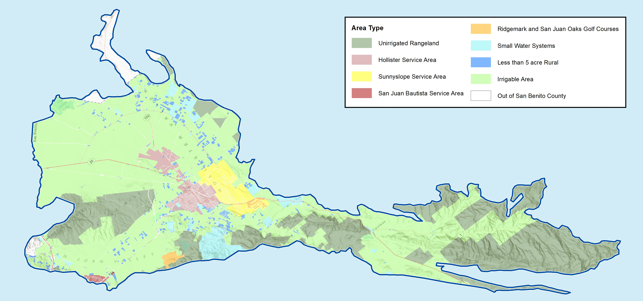
Preliminary Mapping for Land Based Funding

Slide 39
Land Based vs Consumption
First 5 years: Acreage-Based Fee
Land Category | Costs for GSP Development, Monitoring and Reporting for Annual Update
Irrigated/Irrigable Acres | √
Urban Area | √
Golf Courses | √
Small Water Systems | √
Industrial | √
Rural Parcels | √
Unirrigable Rangeland | N/A

Slide 40
Land Based vs Consumption
Proposed Fee After 5 Years
Land Category | Costs for GSP Annual and Plan Updates | Costs for Monitoring for Annual GSP Updates | Costs for Measurement of Extractions
 | (Acreage Based) | (Acreage Based) | (Consumption Based)
Irrigated/Irrigable Acres | √ | √ | √
Urban Area | √ | √ | √
Golf Courses | √ | √ | √
Small Water Systems | √ | √ | √
Industrial | √ | √ | √
Rural Parcels | √ | √ | √
De Minimis | √ | √ | N/A
Unirrigable Rangeland | N/A | N/A | N/A

Slide 41
Estimated Total Cost
Estimated Total GSP Costs
Initial GSP Development | $3,235,000
(Less Grant Reimbursement) | -$2,000,000
GSP Cost to Recapture | $1,235,000
Initial Costs Amortized over 5 years | $247,000
Annual Monitoring and Reporting | $390,000
Estimated Annual Cost to Recover in Fees | $637,000

Slide 42
Preliminary Allocation of Cost
Land Category | Acreage | % of Total Acres | GSP Annual Recapture, $ | Annual Monitoring + Reporting, $ | Total Cost, $ | Cost Per Acre, $
Hollister Service Area | 3,005 | 3.28% | 8,105 | 12,797 | 20,902 | 6.96
Sunnyslope Service Area | 3,164 | 3.45% | 8,533 | 13,473 | 22,006 | 6.96
San Juan Bautisa Service Area | 250 | 0.27% | 673 | 1,063 | 1,737 | 6.96
Golf Courses | 594 | 0.65% | 1,602 | 2,530 | 4,132 | 6.96
Small Water Systems/Industrial | 4,292 | 4.69% | 11,576 | 18,278 | 29,854 | 6.96
Irrigated/Irrigable Area | 74,349 | 81.19% | 200,542 | 316,645 | 517,186 | 6.96
Rural Parcels | 2,566 | 2.80% | 6,922 | 10,930 | 17,853 | 6.96
Santa Clara County Parcels | 3,354 | 3.66% | 9,047 | 14,284 | 23,331 | 6.96
 | 91,574 | 100.00% | 247,000 | 390,000 | 637,000
Unirrigable Rangeland | 36,120

Slide 43
Other Agency Solutions
Name | Legal Authority | Comments
Indian Wells | Water Code Sec 10730 | $3.00 per 0.1 ac-ft
Kings River East GSA | Prop. 26 (exempt as reg. cost) | $1.45 per ac-ft $3,250/yr member agency with no impact on groundwater
Salinas Valley GSP | Prop. 26 (exempt as reg. cost) | $4.79 per irrigated acre $2.26 per urban connection
McMullin Area GSP | Prop. 218 | 19 per acre (excludes parcel 2 acres or less)
North Fork Kings GSP | Prop. 218 | $10.00 per acre Applied equally to all acreage in GSP
South Fork Kings GSP | Prop. 218 | $9.80 per acre Applied equally to all acreage in GSP

Slide 44
Avoid State Intervention
If the GSA does not impose fees, and as a result, cannot complete and implement the GSP, the state could intervene and impose fees
Fee Category | Fee Amount | Applicable Parties
Base Filing Fee | $300 per well | All extractors required to report (not de minimis)
Probationary Rate | $40 per AF | Extractors in probationary basins (not de minimis)
De minimis Fee | $100 per well | De minimis extractors in probationary basins
Automatic Late Fee | 25% per month | Extractors that do not file reports by due date

Slide 45
Questions?

Slide 46
Upcoming Meetings
TAC Meeting No. 16 and Board of Director’s Meeting | Projects, Actions, Implementation | April 28, 2021
TAC Meeting No. 17 and Board of Director’s Meeting | Draft GSP | TBA, 2021
Workshop No. 5 | Draft GSP | TBA, 2021

Slide 47
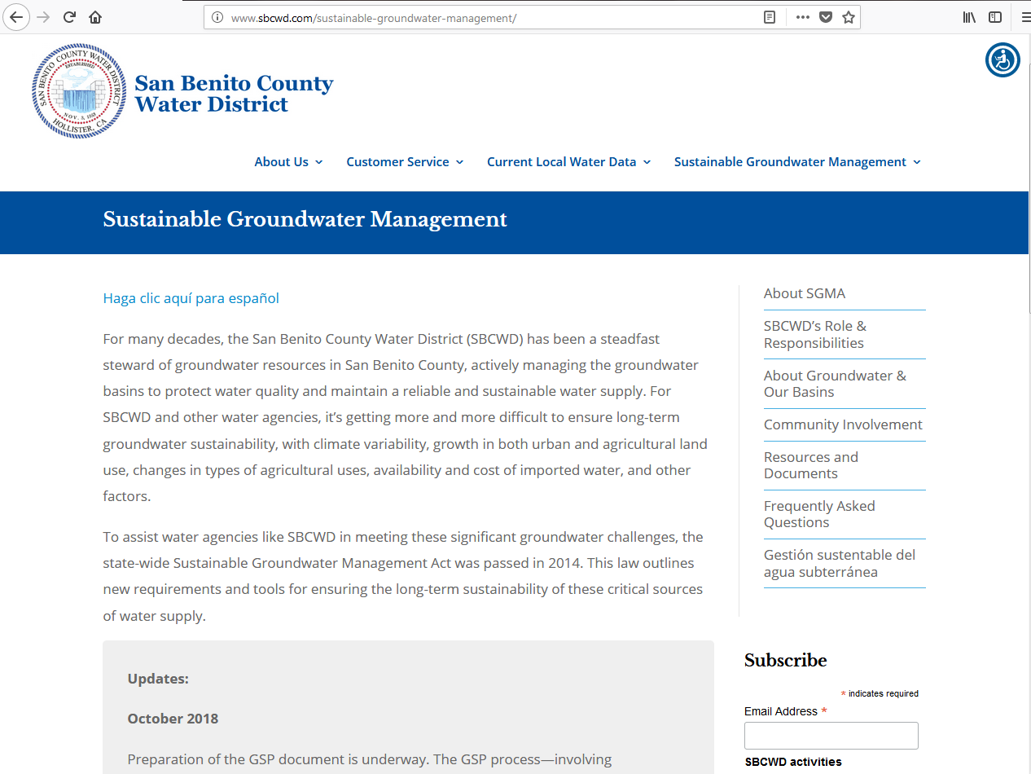
Information is available at www.sbcwd.com

