Slide 1
GROUNDWATER MANAGEMENT FEE
July 14, 2021
North San Benito Groundwater Sustainability Agency

Slide 2
Sustainable Groundwater Management Act (SGMA)
Landmark legislation in 2014 in response to groundwater overdraft in other California groundwater basins
Includes comprehensive requirements for:
  Forming a groundwater sustainability agency (GSA)
  Preparing a groundwater sustainability plan (GSP)
  Meeting deadlines
Promotes local control
Provides for State assistance and if needed, State intervention

Slide 3
SGMA and the GSP Process
Implementation
Today
2040/2042
Achieve and demonstrate sustainability
June 2017: GSAs formed:
January 2022: GSP completion
June 2018: GSP started
San Benito County Water District GSA
Santa Clara County Water District GSA (Valley Water)

Slide 4
GSP Preparation
2021
Plan Development
Management Actions / Monitoring
2020
Sustainability Criteria
Management Areas / Water Budgets
2019
Hydrogeologic Conceptual Model / Groundwater
Data Compilation / Data
Management System
2018
Plan Area / Institutional Setting

Slide 5
Community Workshops
Nov 14, 2018: Introduction to SGMA and GSP Process
June 18, 2019: Hydrogeologic Conceptual Model
Sept 23, 2020: Management Areas, Water Budgets, Sustainability Criteria
Dec 10, 2020: GSP Presentation to Public and Elected Officials of COH, SBC, Sunnyslope, San Juan Bautista
Mar 10, 2021: Implementation, Monitoring, Reporting, Projects, Management Actions, Funding
July 14, 2021: Public Meeting on Groundwater Management Fee
Aug 4, 2021: Presentation of Draft GSP
Nov 17, 2021: Adoption Hearing

Slide 6
Technical Advisory Committee Members
John Guertin, Harry Mavrogenes, Benny Young, Mike Chambless: County of San Benito
Mary Paxton, Bryan Swanson, Abraham Prado: City of Hollister
Don Ridenhour, Drew Lander: Sunnyslope County Water District
Garrett Haertel: San Benito County Water District:
Roger Pierno: Santa Clara Valley Water District
Stan Pura: Mission Ranches
BobSwanson: Bob Swanson Ranch LLC
Greg Swett: San Benito County Farm Bureau
Jeff Micko: Micko Consultants
Paul Rovella: Johnson, Rovella, Retterer, Rosenthal & Gilles, LLP

Slide 7
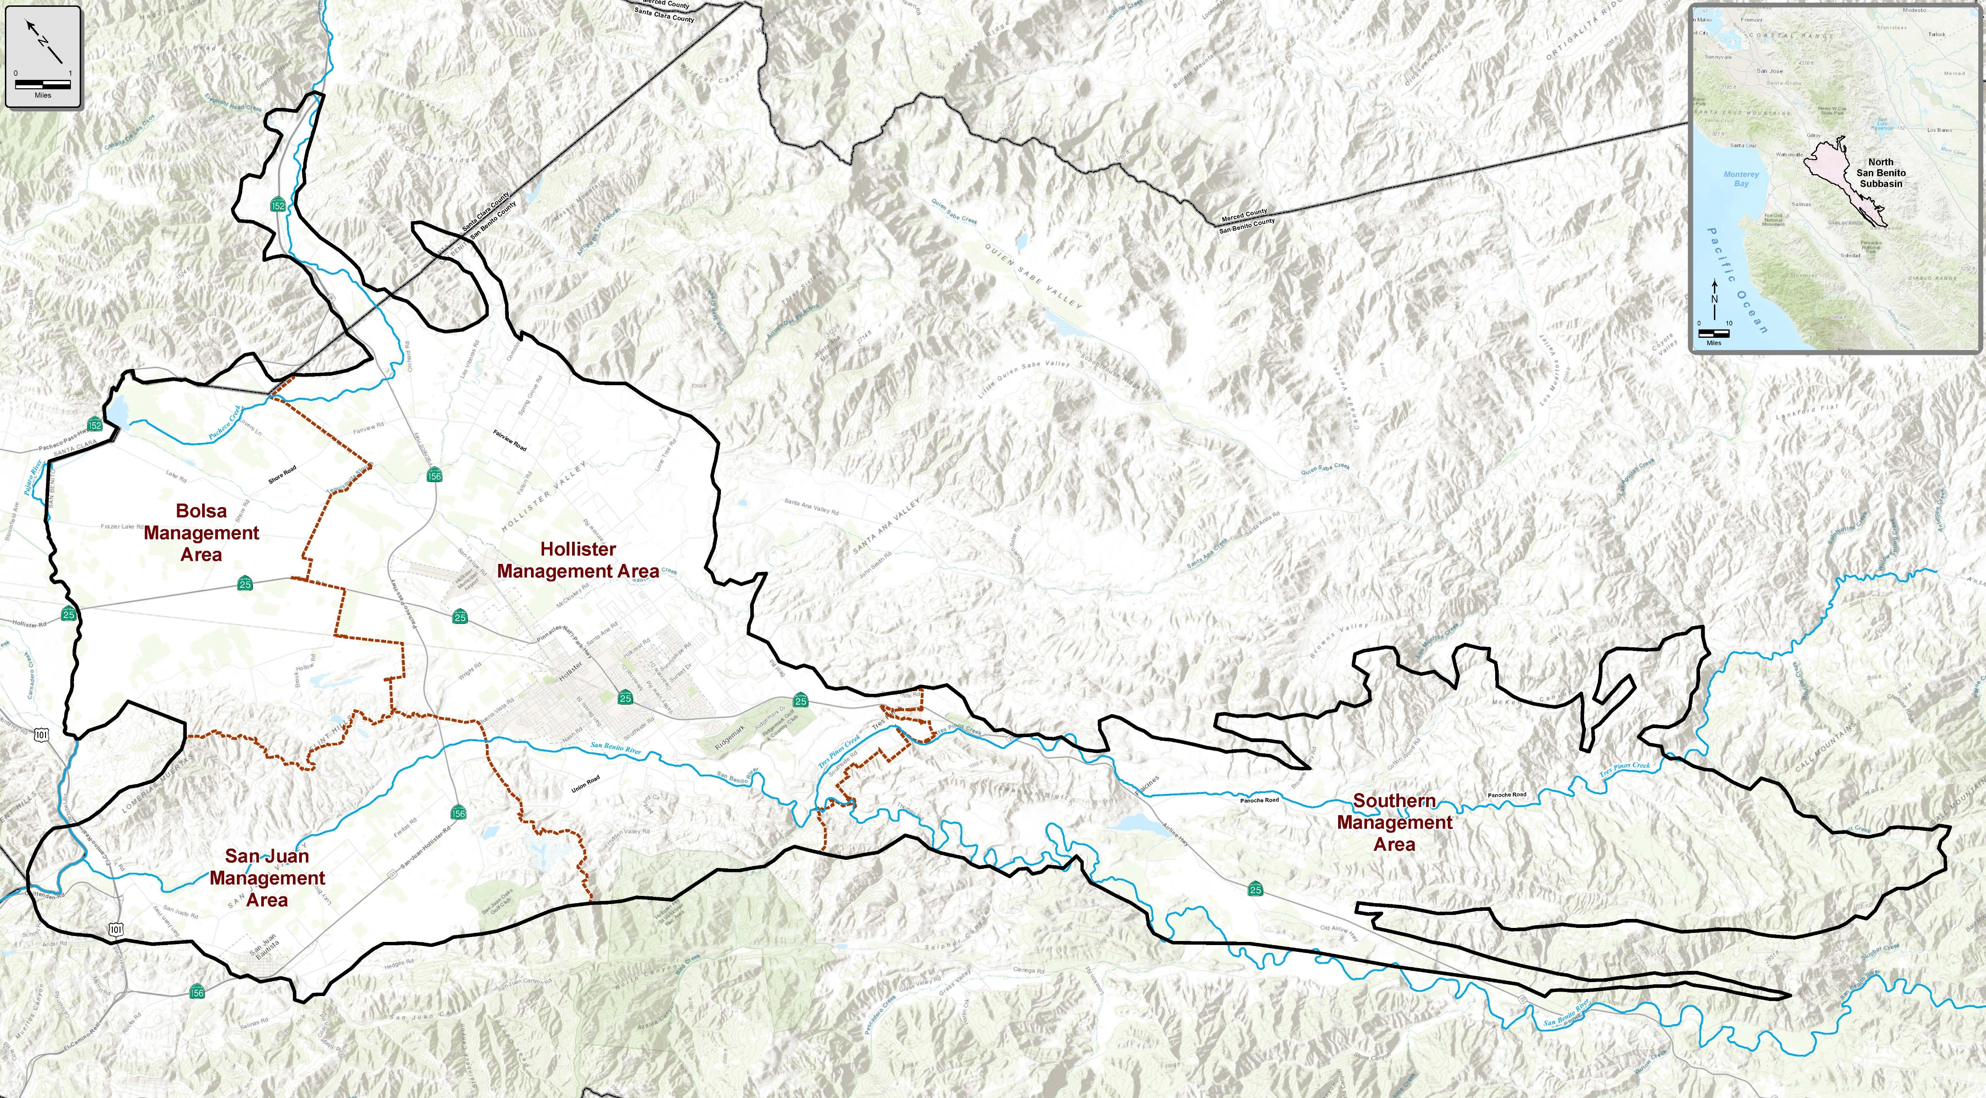
One Basin with Four Management Areas (MAs)
Based mostly on water supply sources:
Imported Central Valley Project water in Zone 6 and in Santa Clara County
Local surface water from Hernandez and Paicines reservoirs in Zone 3

Slide 8
Overview of the GSP
Introduction
Plan Area
Hydrogeologic Conceptual Model
Groundwater Conditions
Water Balance
Sustainable Management Criteria
Monitoring Network
Projects and Management Actions
Implementation Plan
References

Slide 9
Monitoring Well Installations
Installation of 6 deep wells to improve the data gaps in the deep part of the aquifer
Installation of 6 shallow wells for monitoring impacts on groundwater dependent ecosystems

Slide 10
Implementation: Monitoring and Reporting

Slide 11
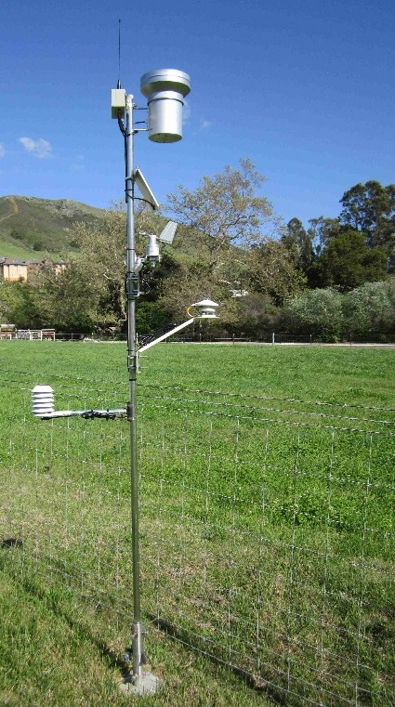
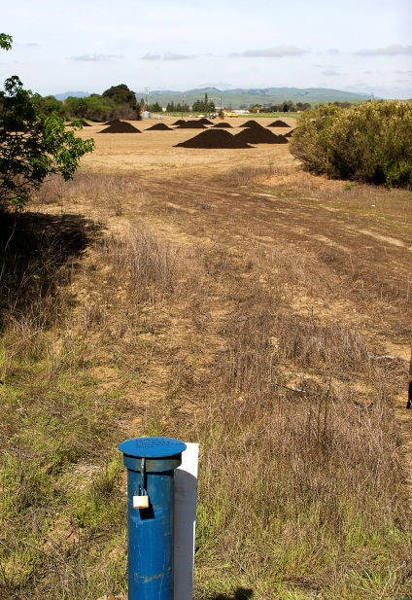
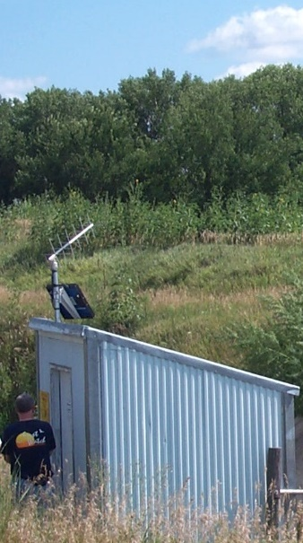
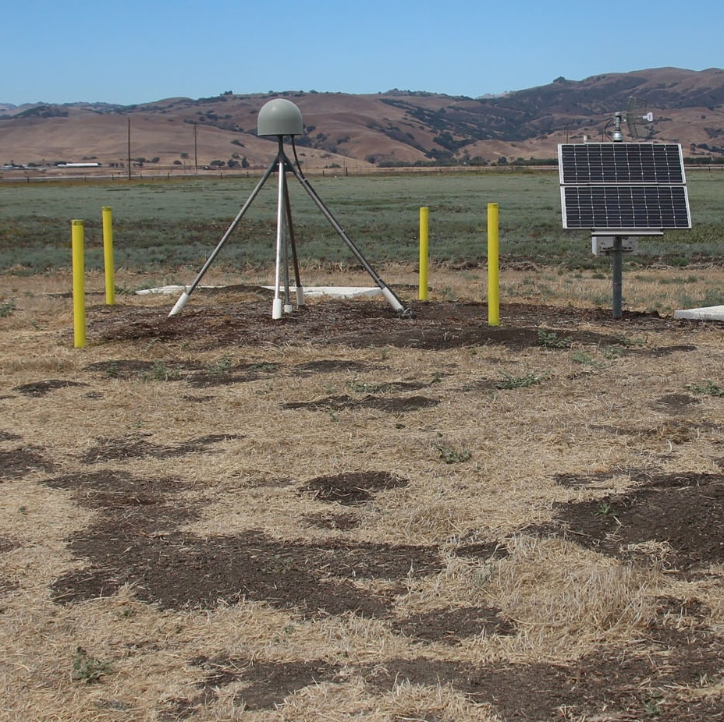
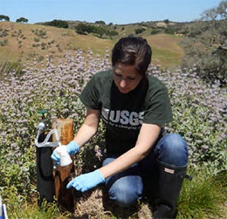
Monitoring Program
Allows us to:
Track changes
Identify problems
Demonstrate sustainability
Climate
Surface water flow
Groundwater levels
Water quality
Groundwater pumping
CVP imports
Hernandez/Paicines
Percolation
Wastewater/recycling
Subsidence data

Slide 12
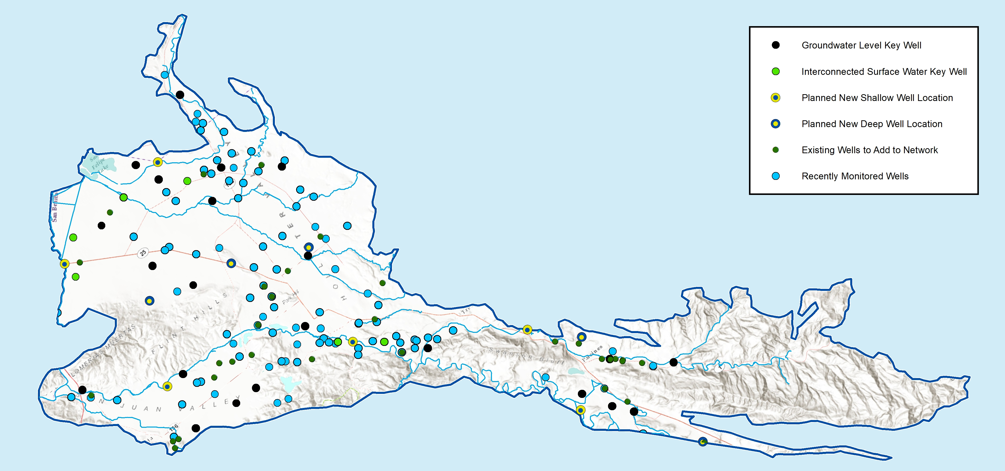
Groundwater Monitoring
Well Network
22 Key Wells track groundwater levels
Additional monitoring for quality and shallow groundwater near streams
Adding new dedicated wells and expanding coverage across entire basin

Slide 13
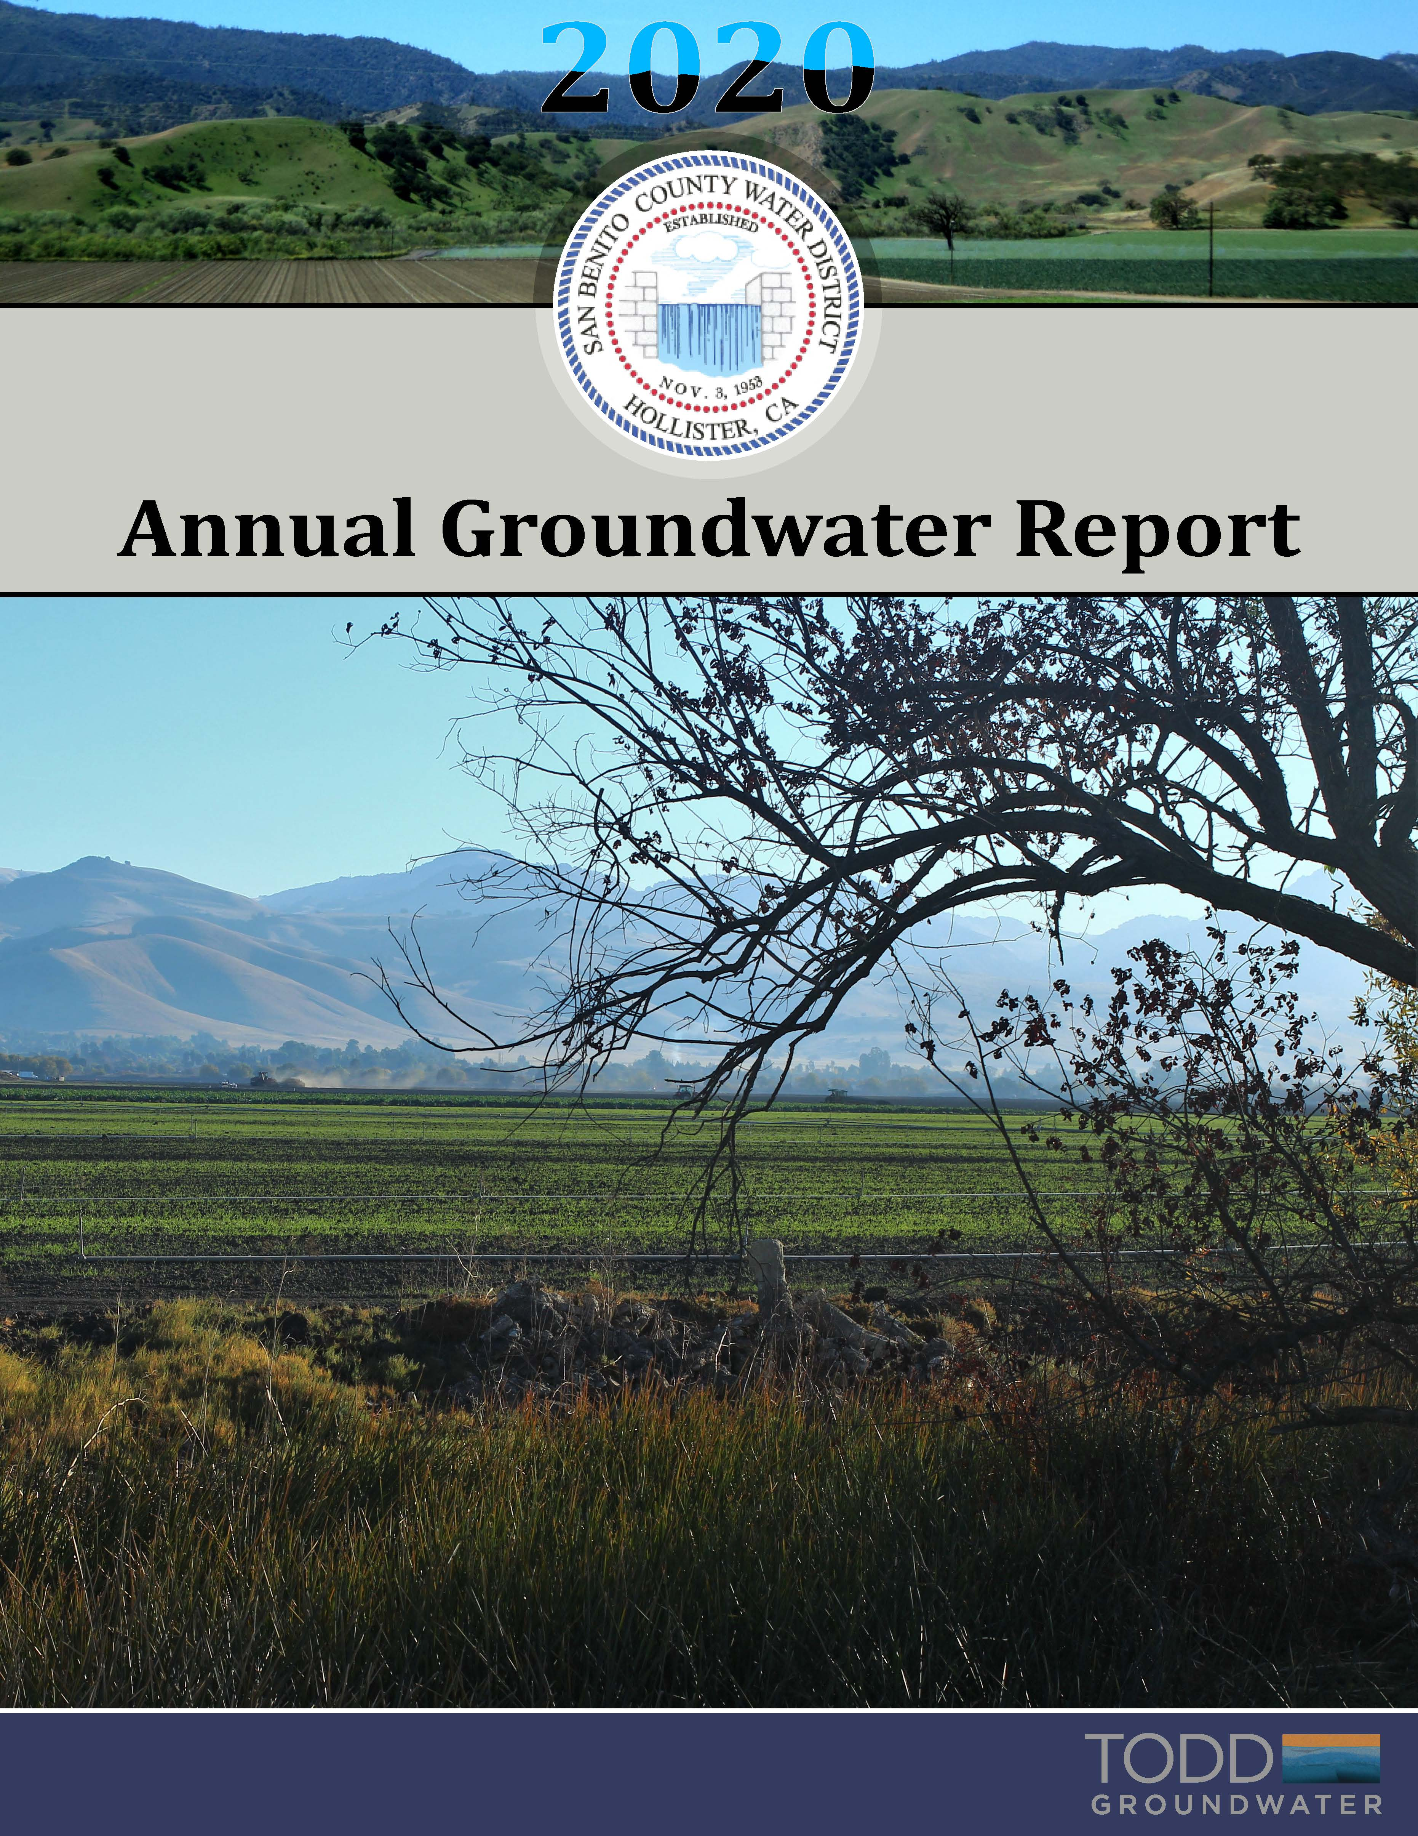
Annual reporting will be expanded
SBCWD Annual Groundwater Reports have been prepared but need to cover entire basin
SGMA has more requirements
  Groundwater elevation data
  Groundwater extraction
  Surface water supply
  Total water use
  Change in groundwater in storage (use numerical model)
  progress implementing the GSP
SGMA requires five-year GSP updates

Slide 14

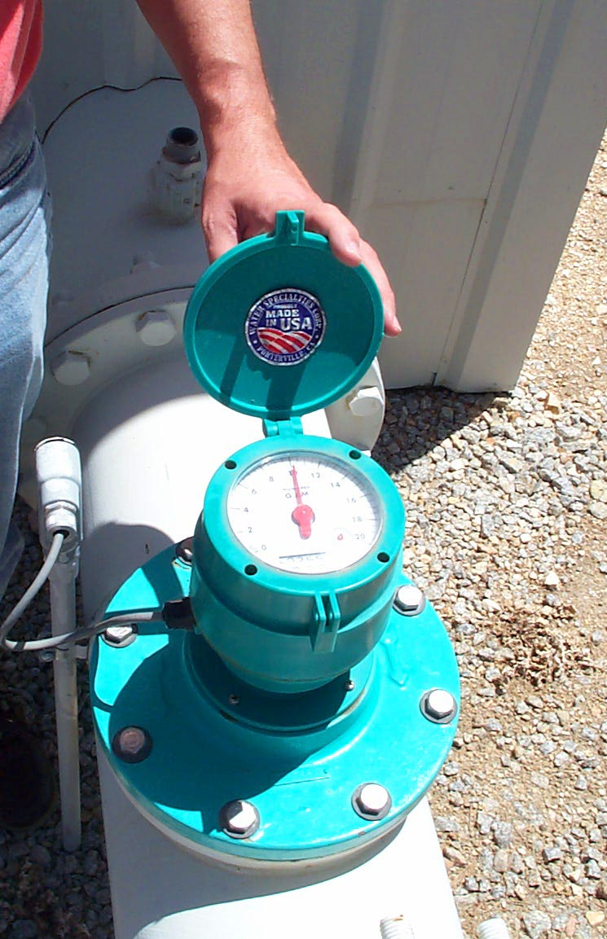
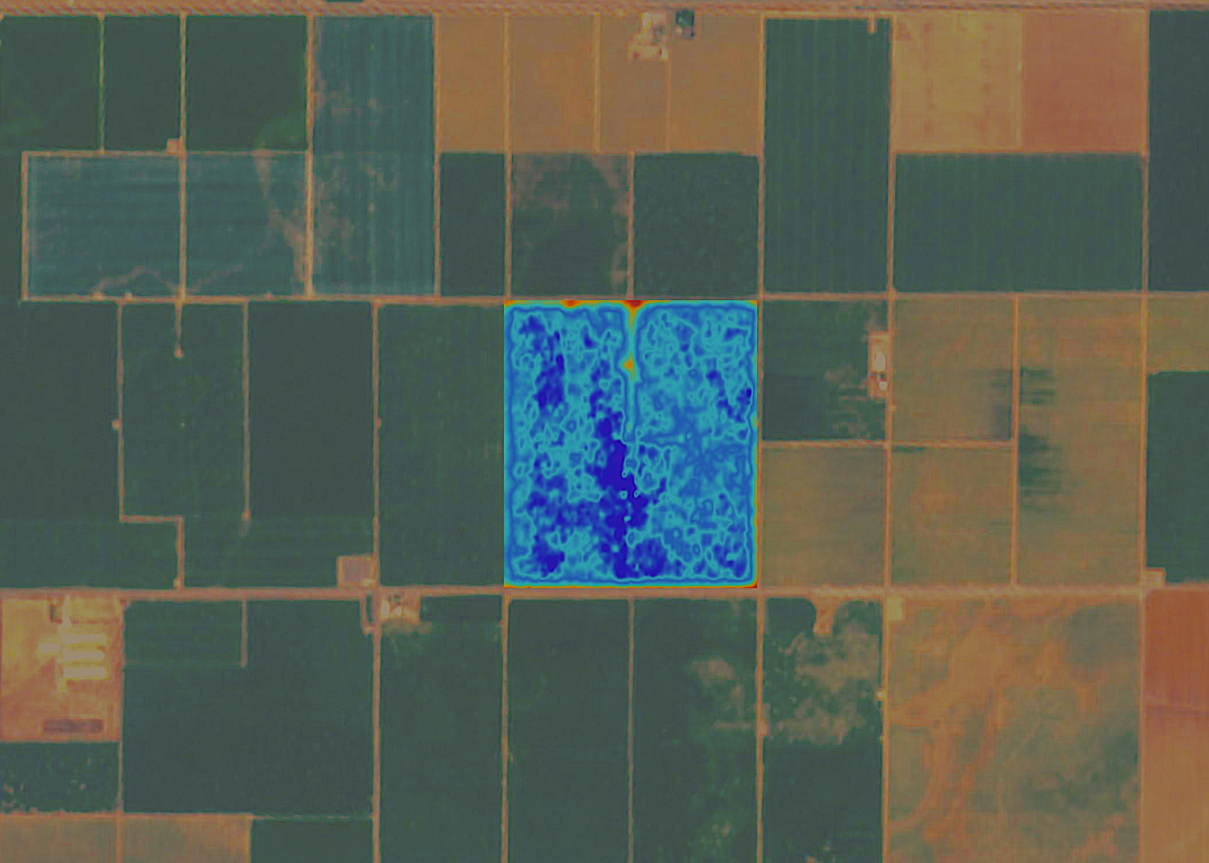
  Measurement of basin-wide pumping is required
    Multiple methods are available
      Municipal providers use metering
      Need an accurate methodology to evaluate agricultural and rural pumping
      Currently evaluating remote sensing techniques
16

Slide 15
How will GSP implementation be funded?
Acreage-based funding to be established to:
  Recover local cost of GSP development
  Support annual activities:
    Monitoring
    Annual Reporting
    Basin-Wide Measurement
    Administration

Slide 16
Authority to Charge Fees
Water Code Sec 10730(a) A GSA may impose fees to fund costs of a GSP to prepare and amend a GSP including but not limited to monitoring and annual reporting.
Billing
  Urban users, direct billing to urban agencies based on acreage in service area
    City of Hollister
    Sunnyslope County Water District
    San Juan Bautista
  Santa Clara County Water District-direct bill to agency
  All Other Land Within the Basin Billed Through County Tax Rolls
    Ag
    Rural Parcels
    Golf Courses
    Large Industrial Users/Small Water Systems

Slide 17
Categorization for Land Based Funding
Categorization of Assessor’s Parcels in North San Benito Basin
Areas Benefitting from GSP
Upland Areas with Insignificant GSP Benefit
Major Municipal and Industrial Areas

Slide 18
Areas Benefitting from GSP
Based on topography, hydrology, current/recent land use
Parcels that overlie at least part of the valley floor areas, and/or show sign of irrigated agricultural or other water use on aerial imagery.
Includes:
  Small water systems
  Golf courses
  Rural properties

Slide 19
Upland Areas with Insignificant GSP Benefit
Based on topography, hydrology, current/recent land use
Parcels that do not overlie any part of the valley floor areas
Do not benefit from overlying or being in close proximity to a principal aquifer
Show no signs of current or historical irrigated agricultural or other water use on aerial imagery.

Slide 20
Major Municipal and Industrial Service Areas
  City of Hollister Service Area
  Sunnyslope County Water District Service Area
  City of San Juan Bautista Service Area

Slide 21
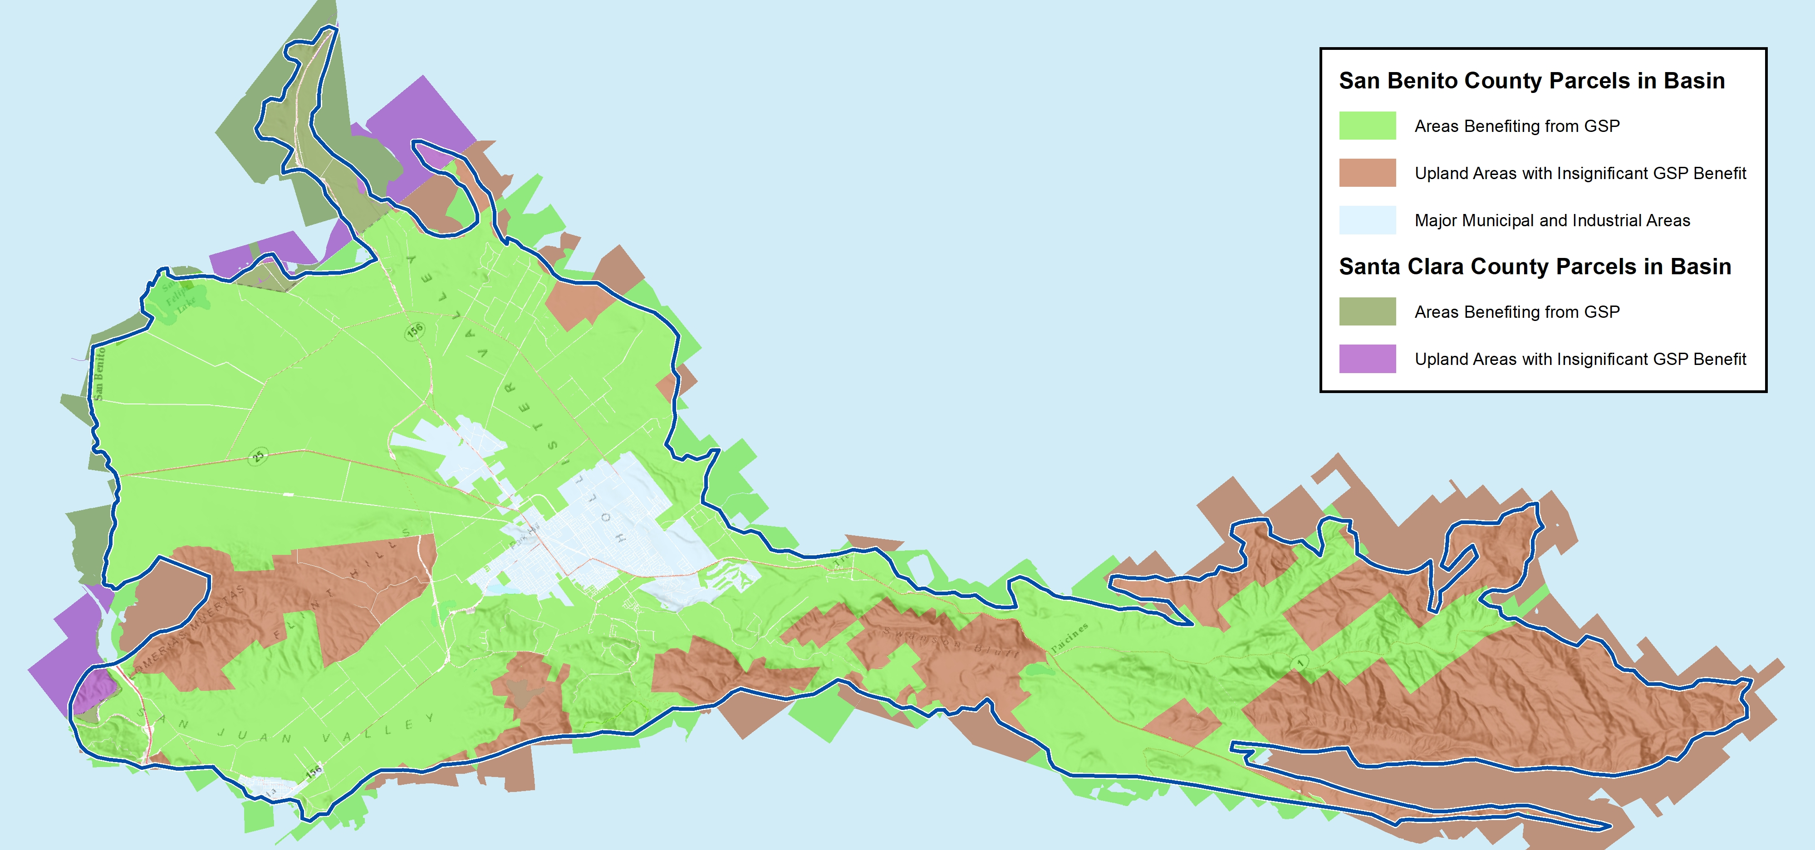
North San Benito Basin Parcel Attribution for
SGMA Implementation Funding

Slide 22
GSP Development and Monitoring Well Costs

Slide 24
Other Agency Solutions
Name | Fees
Indian Wells | $3.00 per 0.1 ac-ft
Kings River East GSA | $1.45 per ac-ft $3,250/yr member agency with no impact on groundwater
Salinas Valley GSP | $4.79 per irrigated acre $2.26 per urban connection
McMullin Area GSP | $19 per acre (excludes parcel 2 acres or less)
North Fork Kings GSP | $10.00 per acre Applied equally to all acreage in GSP
South Fork Kings GSP | $9.80 per acre Applied equally to all acreage in GSP

Slide 25
Other Agency Solutions
Name | Fees
Montecito GSA | $194 per acre
Tri-County (Tulare, Kings, Kern) GSA | $10.00 per ac-ft
Cuyama GSA | $46 per ac-ft
East Turlock | $0.95 per acre for all irrigated and non-irrigated land $4.55 per acre supplemental for irrigated lands only
Madera County GSA | $22.45 per acre for all irrigated acres regardless of land type or water use
Fox Canyon (Ventura) GSA | $20.00 per ac-ft

Slide 26
Avoid State Intervention
If the GSA does not impose fees, and as a result, cannot complete and implement the GSP, the state could intervene and impose fees
Fee Category | Fee Amount | Applicable Parties
Base Filing Fee | $300 per well | All extractors required to report (not de minimis)
Probationary Rate | $10-40 per AF | Extractors in probationary basins (not de minimis)
De minimis Fee | $100 per well | De minimis extractors in probationary basins
Automatic Late Fee | 25% per month | Extractors that do not file reports by due date

Slide 27

Questions?

